Slide 1
The role of suppression in spatial attention: evidence from negative BOLD in human subcortical and cortical structures André Gouws
Notes:
There is clear evidence that attention increases neural responses to attended stimuli.
Much of the work investigating attentional effects have been specifically optimised to detect enhancement of responses, but routinely fail to take into account another phenomenon:
In addition to enhancement at attended locations, we know that unattended locations can be suppressed.
The relative contributions of enhancement and suppression to visual attention is unclear.
?? How do these mechanisms depend on task and stimulus, and at which stages of the visual system they are expressed?
Today I would like to tell you about just one of many of the experiments we have performed, using fMRI as a tool to investigate these questions.

Slide 2
Questions I hope to answer
Is there an fMRI signature of suppression?
Where is suppression observed in the human visual system?
Under what stimulus and task conditions is suppression observed?
Can we identify potential sources of suppression?
* Including full disclosure of a few caveats and gotchas along the way
Notes:
We will start by looking at what negative BOLD is.
We will then ask (READ SLIDE) …

Slide 3
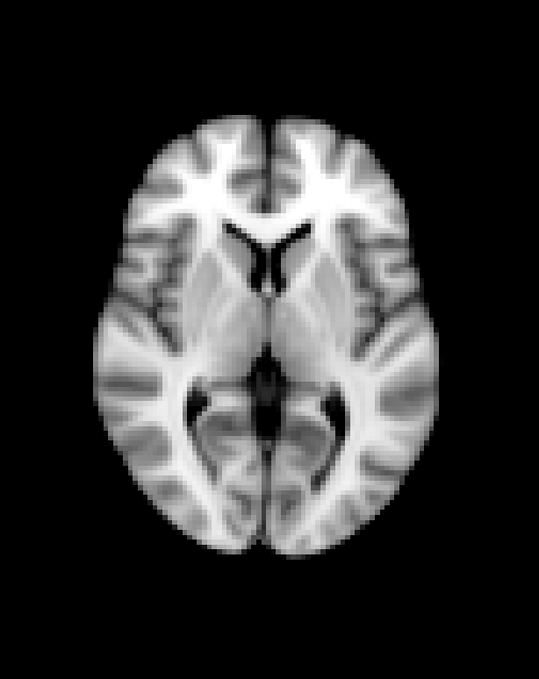
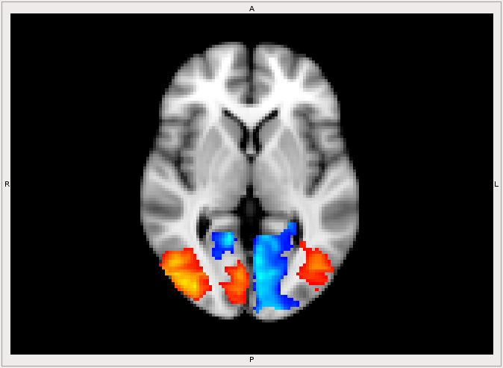
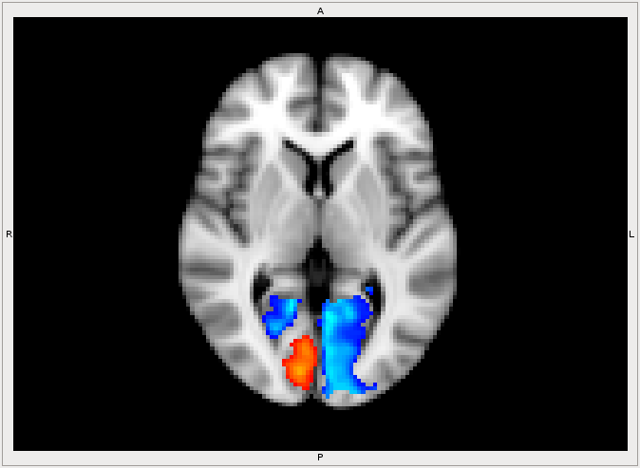
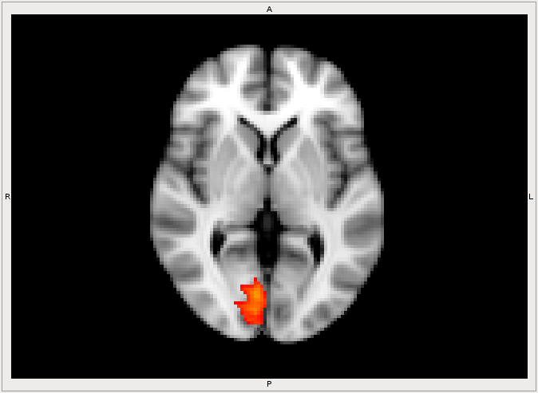
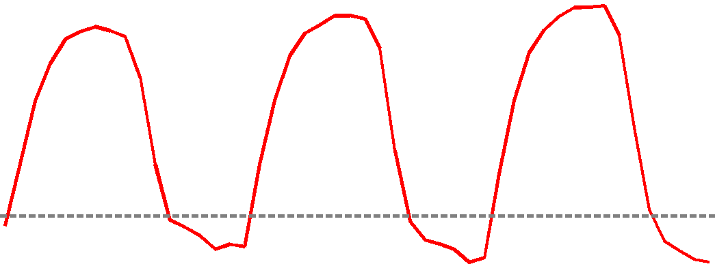
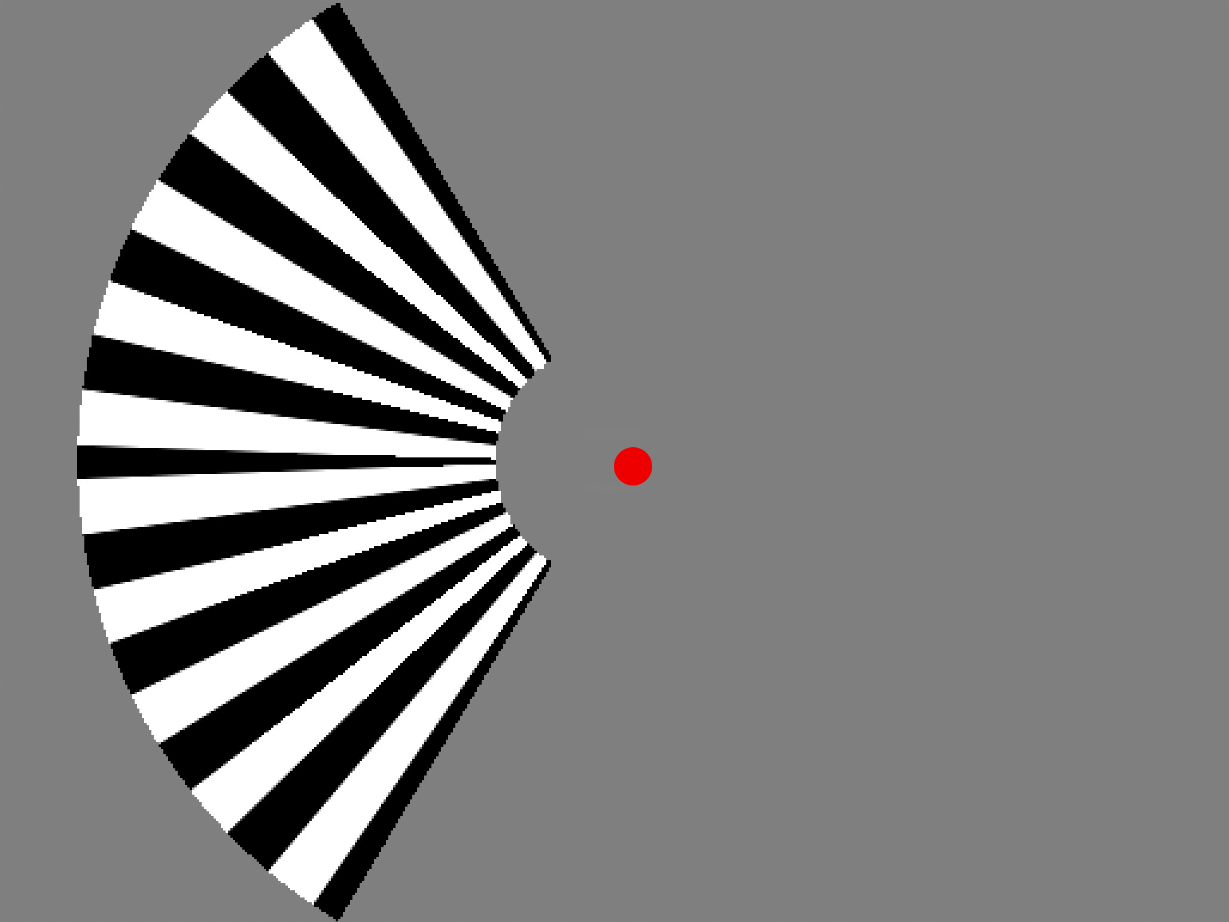
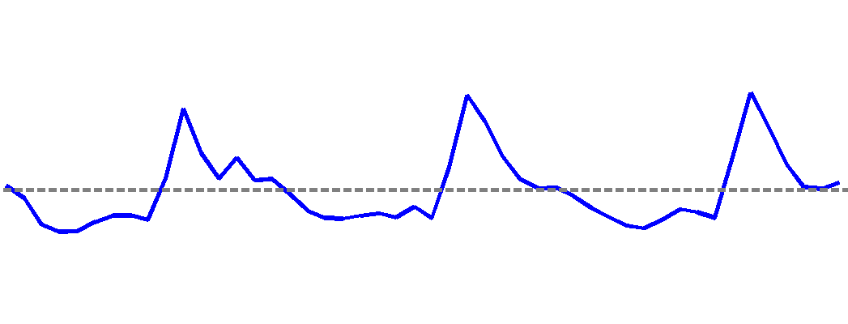
Suppression: A negative BOLD signal
Notes:
Lets consider a typical simple visual stimulus presented in an mri scanner:
Stim LVF (CLICK)
We know the right primary visual cortex represents the stimulus location
While the stimulus is on we see a response in contralateral right early visual cortex that increases..
In regions of cortex that represent the right visual field are not stimulated (CLICK), we often see a signal that drops below baseline while the stimulus is on, returning to baseline when it is of, and even overshooting the baseline.
Take home message:
Depending on the properties of the stimulus, we may also see positive responses in higher visual areas, both contralateral and ipsilateral to the stimulus.
negative BOLD signals are phase locked to the onset of the stimulus
It is important to note that both positive and

Slide 4
Previous studies of negative BOLD responses

Slide 5
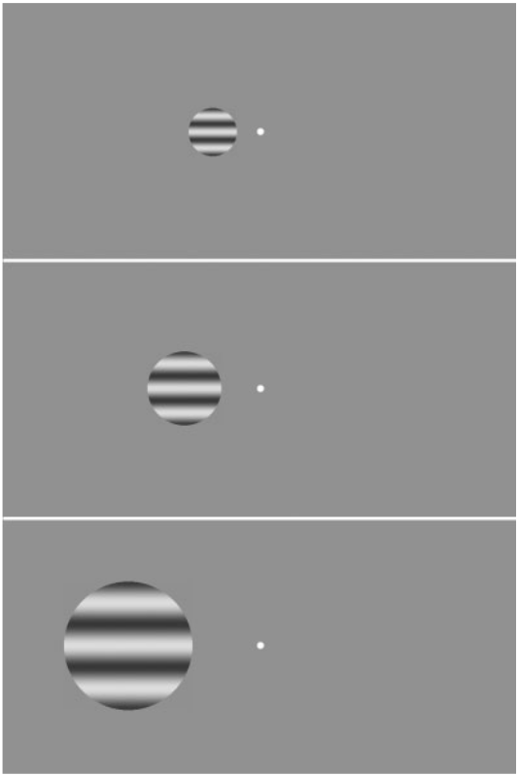
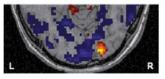
WHERE? The spatial extent of negative BOLD
Smith et al. Negative BOLD in the Visual Cortex: Evidence Against Blood Stealing. Hum. Brain Mapp 2004
Notes:
Some early studies set out to characterise the spatial extent of negative BOLD signal.
Andy Smith and colleagues presented lateralized stimuli of varying sizes (CLICK) …
… showing that as the stimulus increased in size, the region of positive BOLD increased in size.
The surrounding are of negative BOLD in the adjacent cortex shrunk.
However, negative BOLD was always detectable in the ipsilateral hemisphere and did not change with stimulus size.
Up until this point, many people had argued that negative BOLD was simply an epiphenomenon of positive BOLD: areas that were increasing their blood flow were simple stealing blood from neighbouring areas.
(LINKER SENTENCE)
Elsewhere, others had started exploring features other than the spatial extent of the negative BOLD response:
Smith was the first to argue that the negative BOLD in the ipsilateral hemisphere was evidence against blood stealing because of the independent blood supplies to the left and right visual hemispheres.

Slide 6
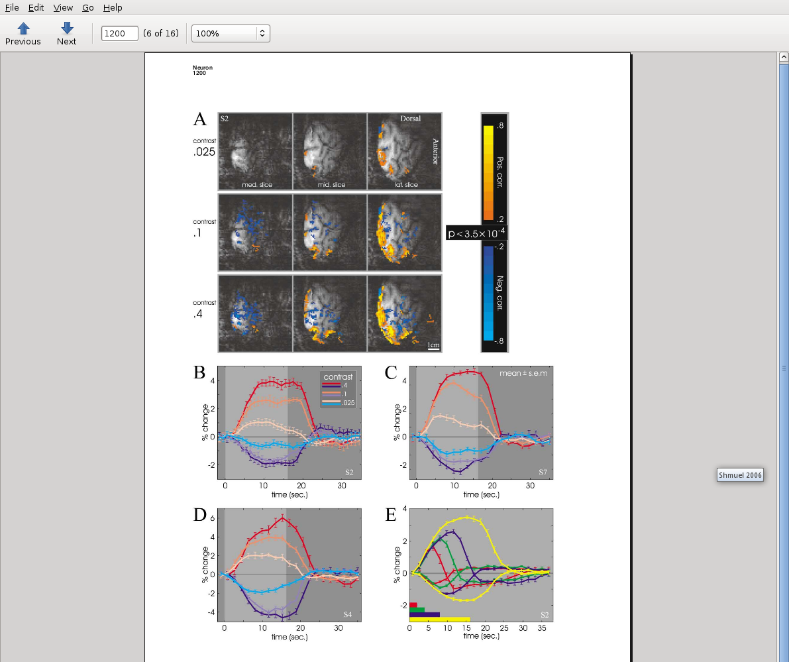
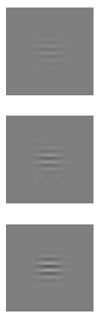
HOW DOES NEGATIVE BOLD VARY? Contrast dependence
Negative BOLD appears to be an inverse of the positive BOLD response
Both positive and negative BOLD responses show stimulus contrast dependence.
% BOLD
Sustained negative BOLD, blood flow and oxygen consumption response and its coupling to the positive response in the human brain. Shmuel et al., Neuron. 2002
Notes:
Shmuel and colleagues were interested in characterizing the STIMULUS DEPENDENCE of negative BOLD, specifically dependence on stimulus contrast.
They used a central stimulus of different contrast levels with a central task to show (READ SLIDE) …
This plot shows how the amplitude of the BOLD signal changes over time during a single on/off cycle of the stimulus.
Areas shaded light grey represent periods when the stimulus was on, those in dark gray when it was off.
There are error bars on this signal because its is actually the average of many identical stimulus cycles acquired under the same conditions

Slide 7

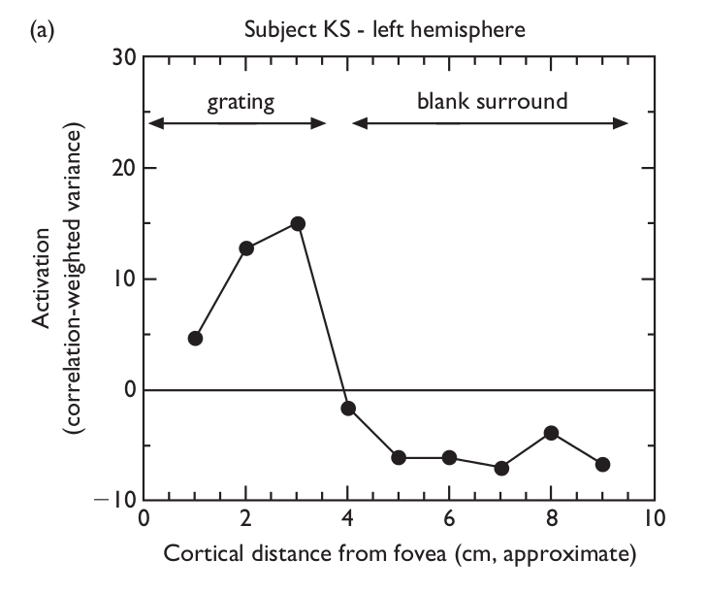
HOW DOES NEGATIVE BOLD VARY? Task dependence
Attentional suppression of activity in the human visual cortex. Smith et al., NeuroReport, 2000
Notes:
DESCRIBE: NOT TIME BUT SPACE
FACILITATION AT THE STIMULUS, SUPPRESSION NOT
Other work by Andy Smith and colleagues investigated the TASK rather than STIMULUS dependence of negative BOLD
The presented a central stimulus – PASSIVE or CENTRAL TASK
They report their results in this fashion:
Along the Y axis we have the amount of activation realtive to baseline
Along the x axis we have distance along the cortex from the centre of the stimulus
So the gray shading indicates parts of the cortex that represent the stimulus, and white the adjacent areas of coretx that don’t.
Smith showed that when a central task was performed, Not only is there FACILITATION at the stimulus representation, but there is UPPRESSION in the unattended, unstimulated areas.
This effect was greater for the central task condition than passive viewing.

Slide 8
Negative BOLD – the story so far
In the visual domain: a decrease from baseline detectable in early visual cortex
Where?
Adjacent to and distant from positive responses
Lateralised stimuli
What affects negative bold?
Stimulus contrast
Task
Central stimuli
Notes:
So what we know about negative BOLD so far: (READ SLIDE)
So what are some of the gaps in our knowledge? (CLICK)

Slide 9
Negative BOLD: what don’t we know?
Expanding on the WHERE question?
can we detect it in even earlier, sub-cortical visual structures like the LGN?
The LGN is particularly well placed to modulate visual responses
Notes:
(READ SLIDE)

Slide 10
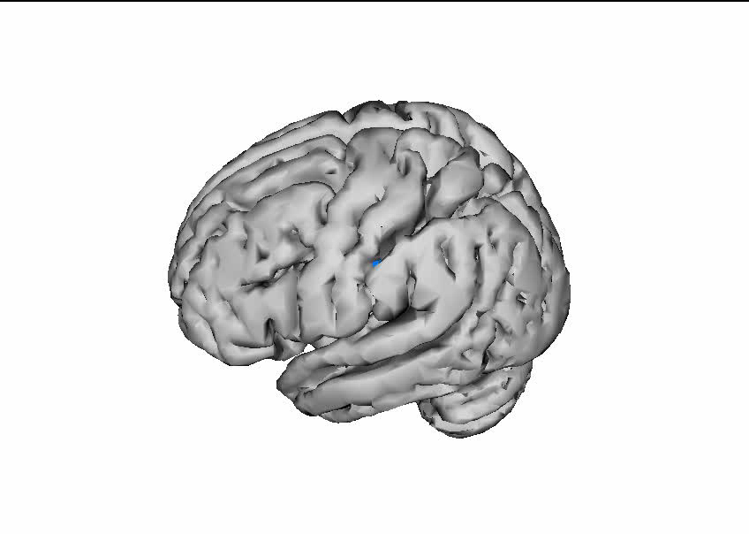
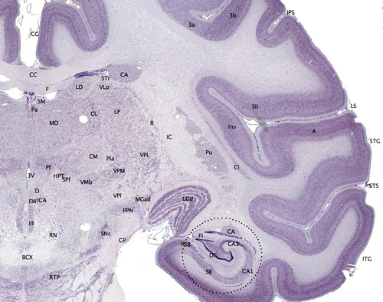
The human LGN
Relay from the retina to visual cortex , but 90% of input comes from feedback
Each LGN retinotopically maps its contralateral visual field
Typical size in the region of 150mm³ ^{Andrews and Purves, 1997}
N.B. only ~13 voxels at typical fMRI voxel size 2x2x3mm³
Implicated in attentional modulation of visual responses
Notes:
(READ SLIDE)

Slide 11
Outline
What is negative BOLD?
What is the stimulus (contrast) and task dependence of negative BOLD signals?
Can these signals be recorded in the human LGN?
What could the source of negative BOLD signals be?
Notes:
As I said before, some studies have looked at the effect of task or stimulus features independently, but never both together.
Clearly there could be an interaction, so we set out answer this question.

Slide 12
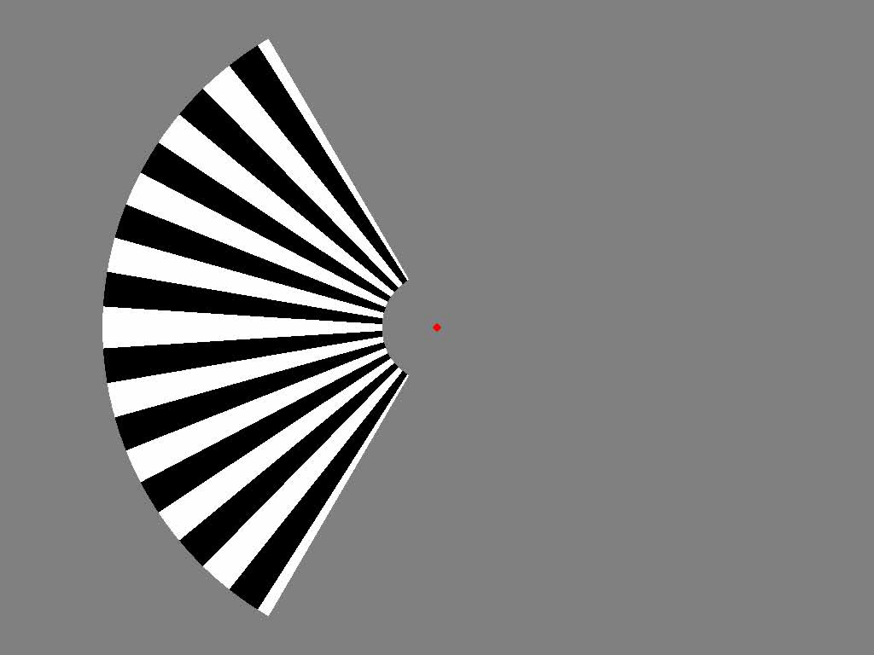
Stimuli #1
Notes:
This is what our stimulus looks like. Subjects fixate the central dot.
The stimulus is 120 degrees of square-wave achromatic radial grating on a gray background equiluminant to the grating, restricted to a single visual field.
The grating drifts while on, and changes direction randomly every 1 – 3 seconds.
The grating is one for 16s and then off for 16 seconds.

Slide 13

Defining tasks: central or stimulus-related
Central fixation array made up of 9 squares, one disappearing every 333ms
Changes continuously for the duration of the scan
9 pixels (0.35 degrees)
Notes:
The central fixation is not actually a dot, but rather is a ... (READ SLIDE)
Our central task is designed to detract the subjects attention away from the salient drifting grating, and requires the participant count the number of times the square at 12 o’clock disappears.

Slide 14
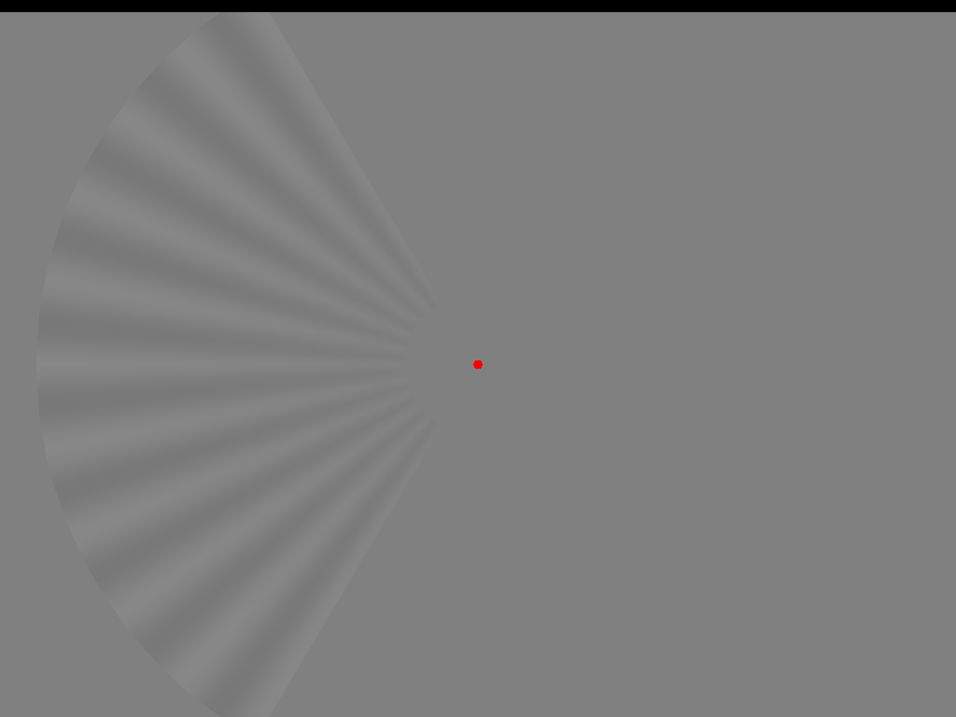
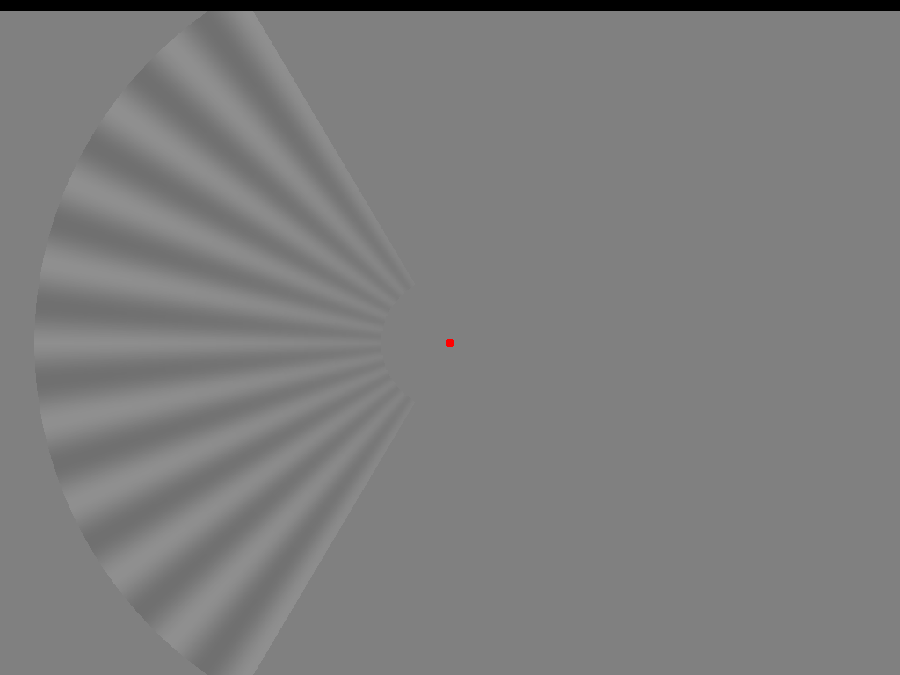
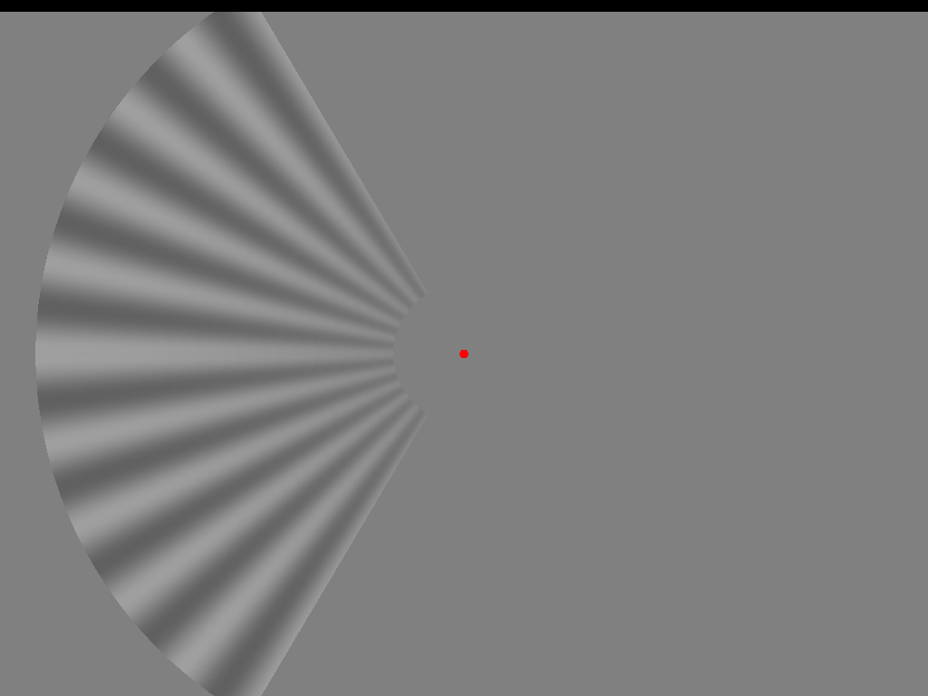
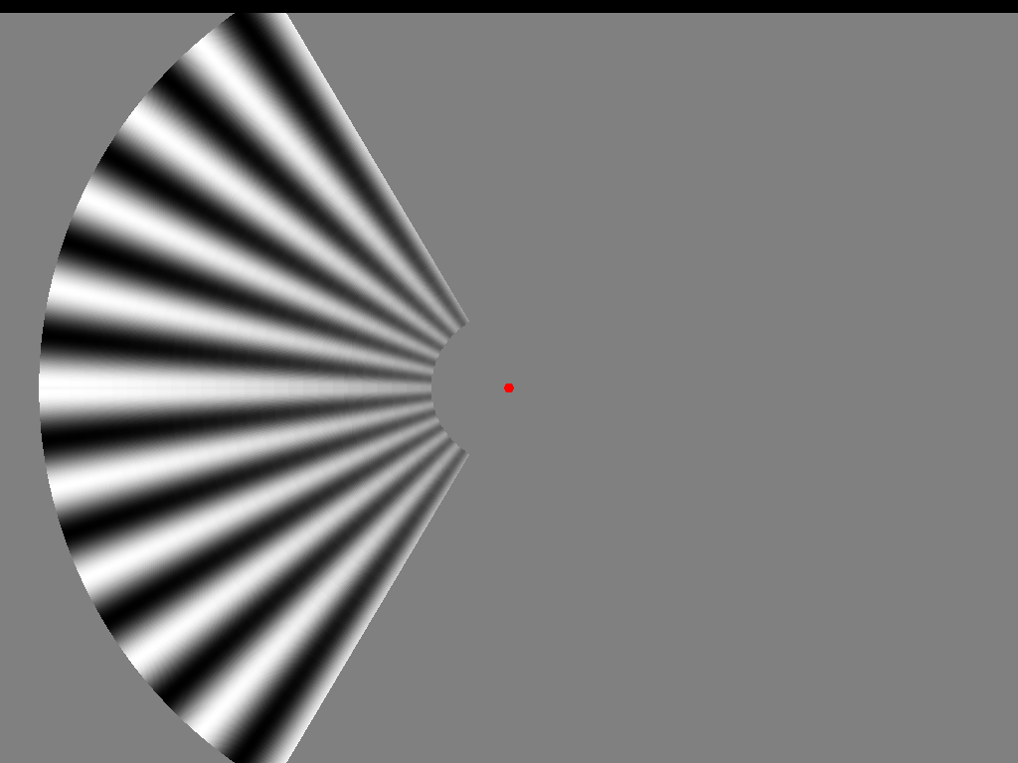
What are we going to measure? Contrast x Task: a 4x2 design
6%
12%
25%
100%
Task
Stimulus luminance contrast

Slide 15
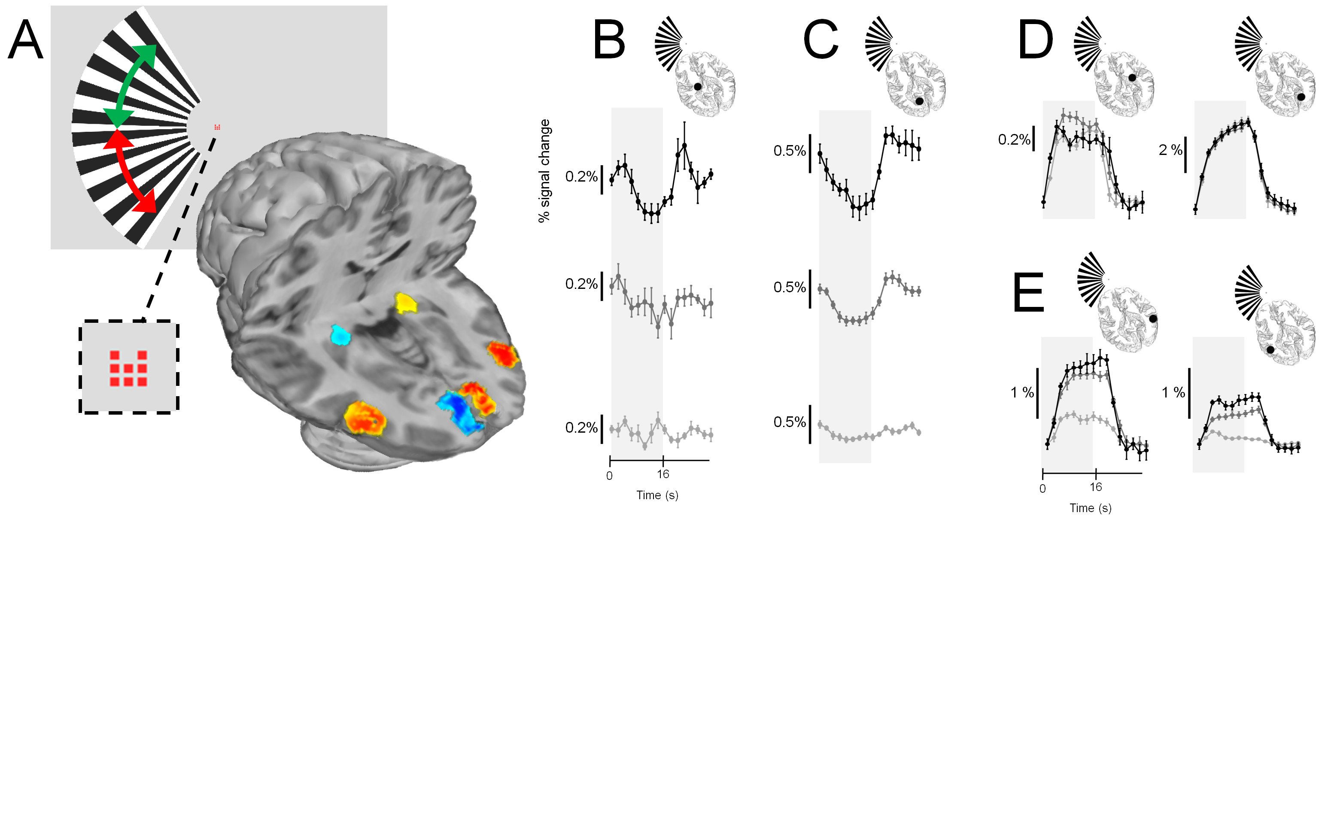
Where we going to measure?

Slide 16
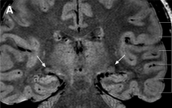
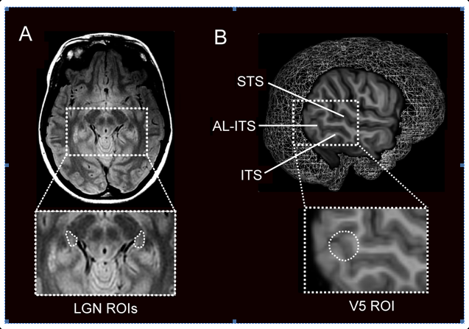
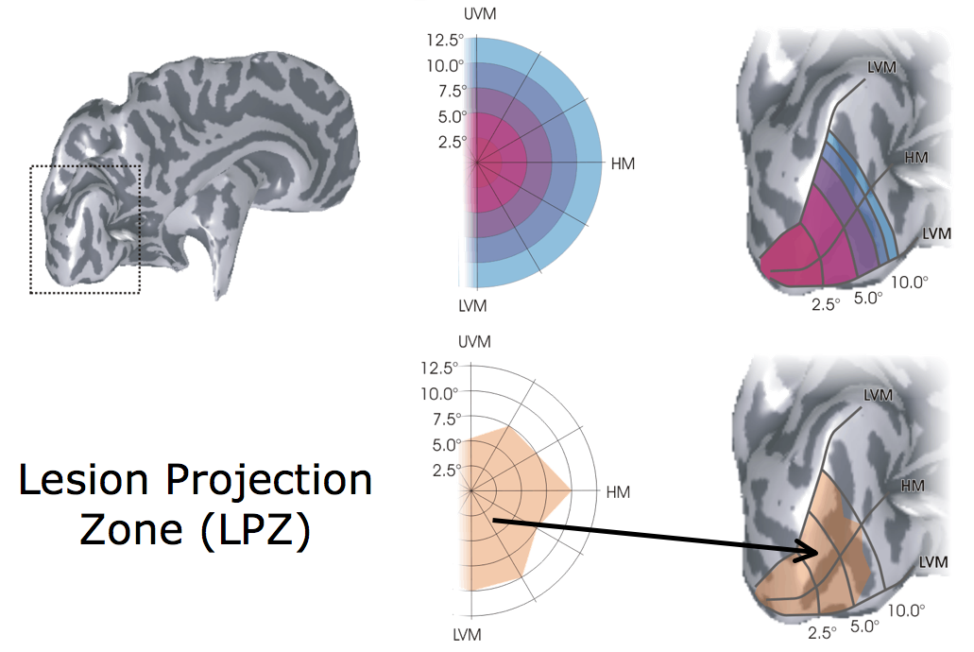
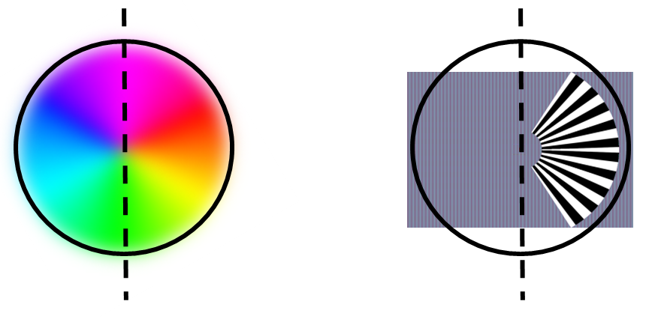
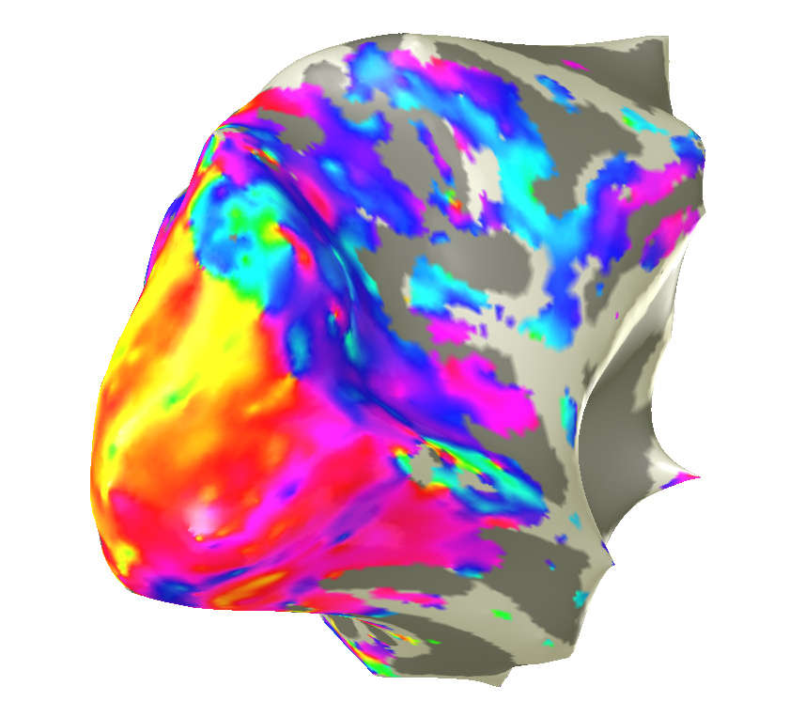
Defining regions of interest
LGN: anatomical landmarks in proton-density MRI ^{Fujita et al., 2002}
V5: anatomical landmarks in T1-weighted MRI ^{Dumoulin et al., 2000}
V1: retinotopic mapping DeYoe, Engel, Sereno, Wandell et al. 1995-

Slide 17
Methods: the effect of task and contrast on BOLD responses
8 participants, normal vision
Eight experiments ( 4 x 2 design):
Four scans in a single session at the same contrast / task combination
Additional sessions for retinotopic mapping
Paradigm
Block design with 8 cycles of 16s on / off
Repetition time (TR) of 2s, 25 slices at 1.5 x 1.5 x 2.4 mm³
ROI analysis
Independently localised anatomical ROIs used to extract time series data for assessment by standard general linear modelling techniques

Slide 18
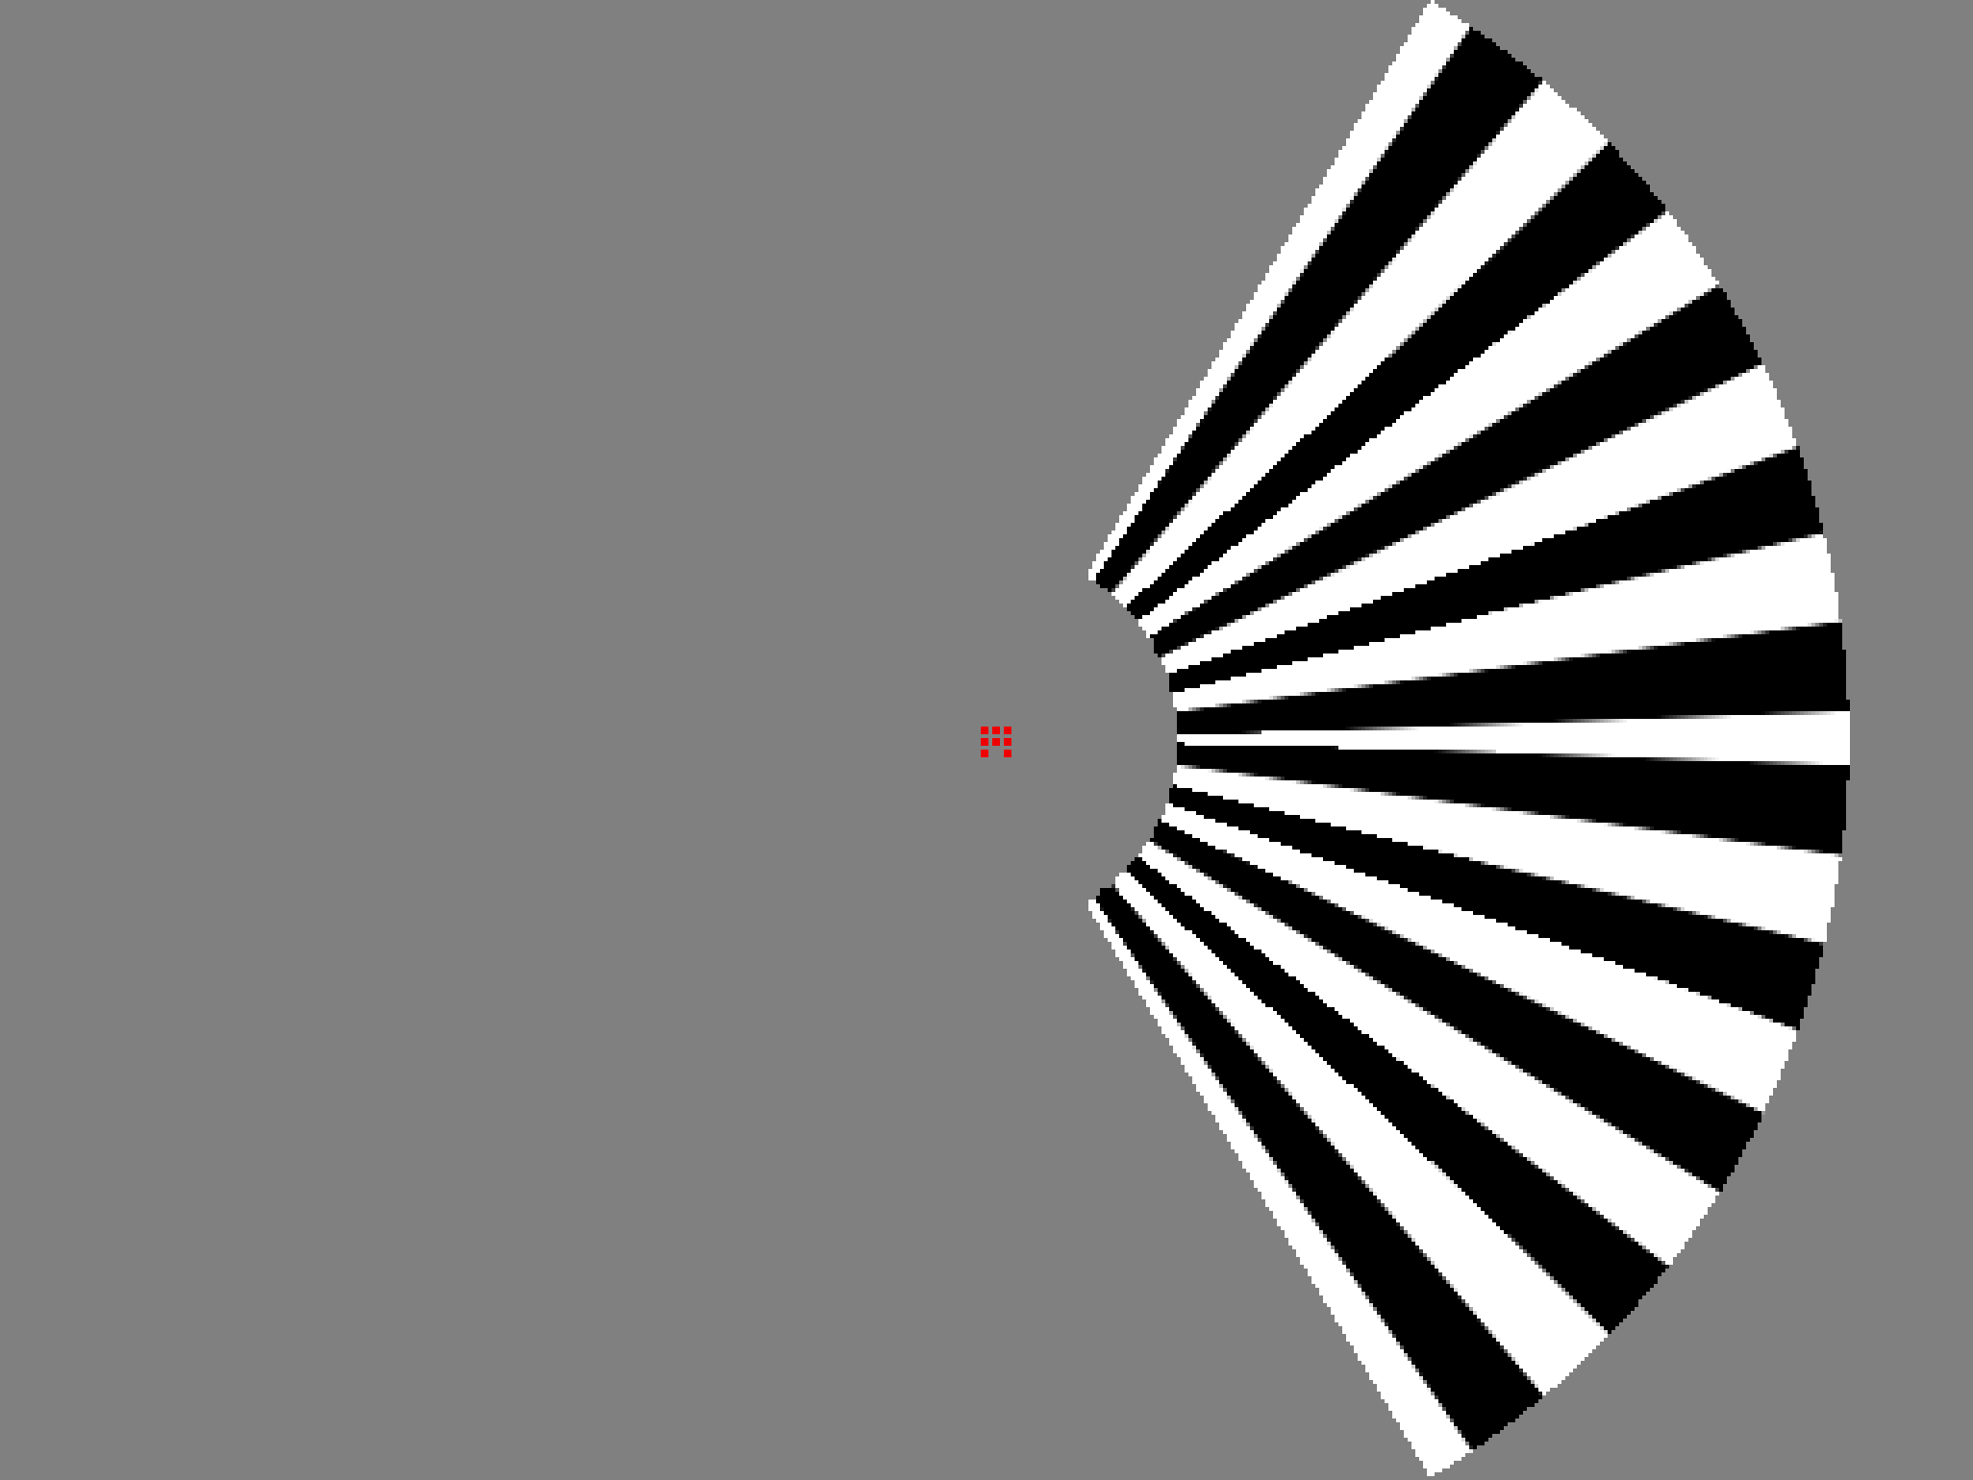

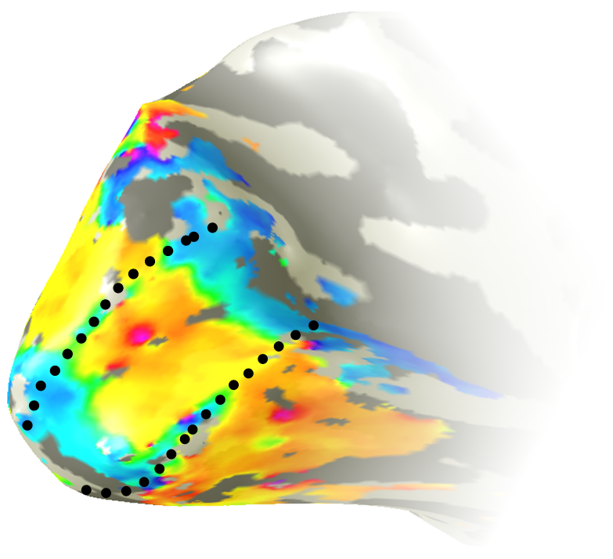
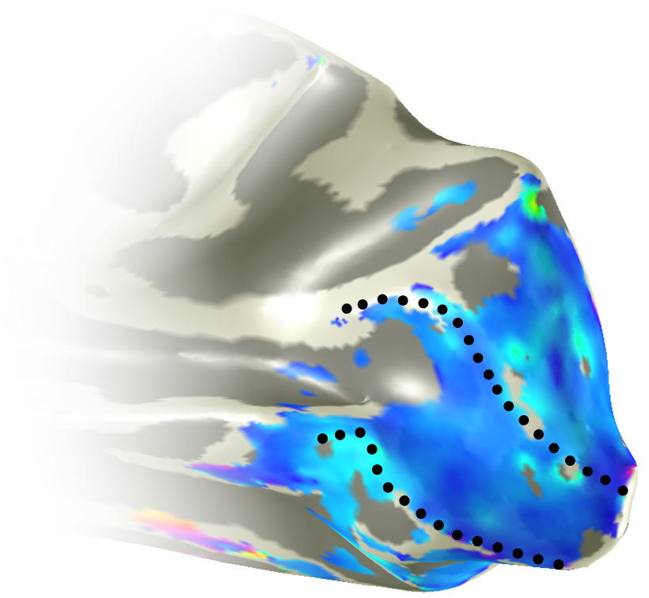
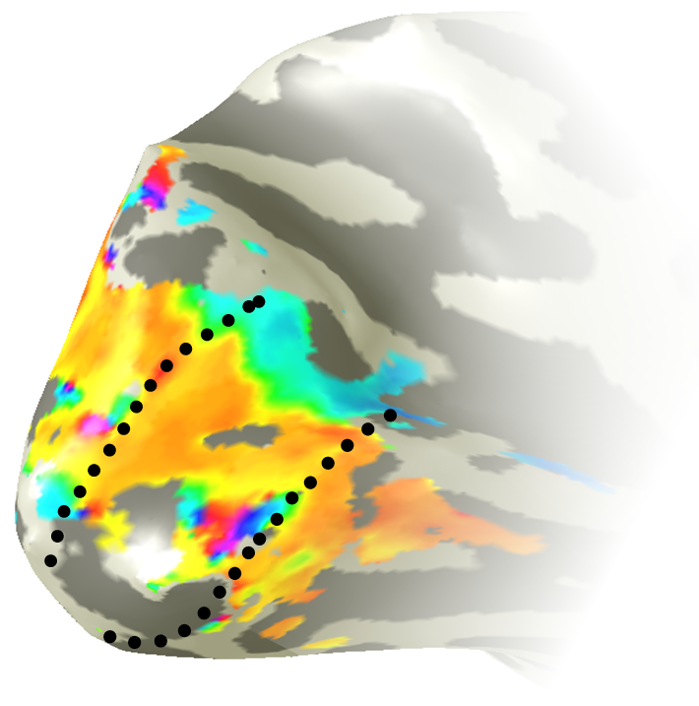
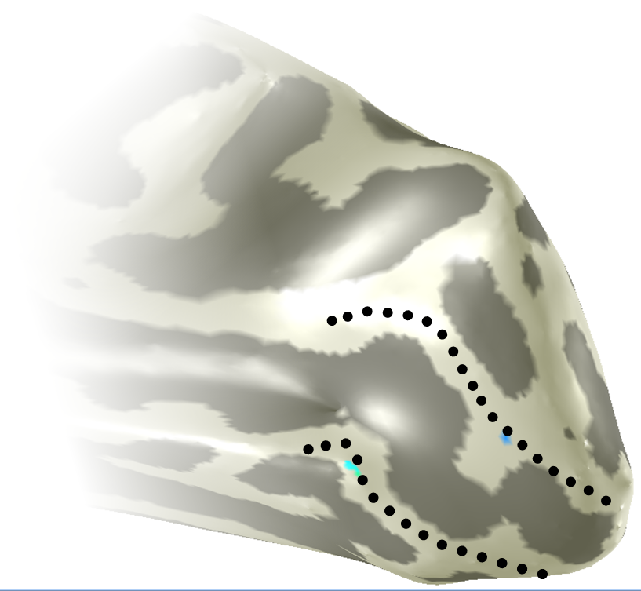
Does it work? BOLD signals in V1
Activation in early visual cortex
Contralateral V1
Ipsilateral V1
Stimulus-
related
Central
Notes:
We can look at the distribution of BOLD responses from a single subject.
These are inflated representations of the subjects cortex and we have zoomed in on the occipital lobe of the left and right hemispheres. Positive BOLD responses are shown in warm colours and negative responses in blue.
The black dotted lines show the border of V1. This subject viewed the stimulus in their right visual field.
…
Under central task conditions, when the grating is being ignored and the central task is being performed throughout the scan, the negative BOLD signal disappears.
So we believe that we are able to generate negative BOLD signals, and manipulate them with task, in cortex at least.
But something else at the individual level caught our eye and concerned us a little

Slide 19
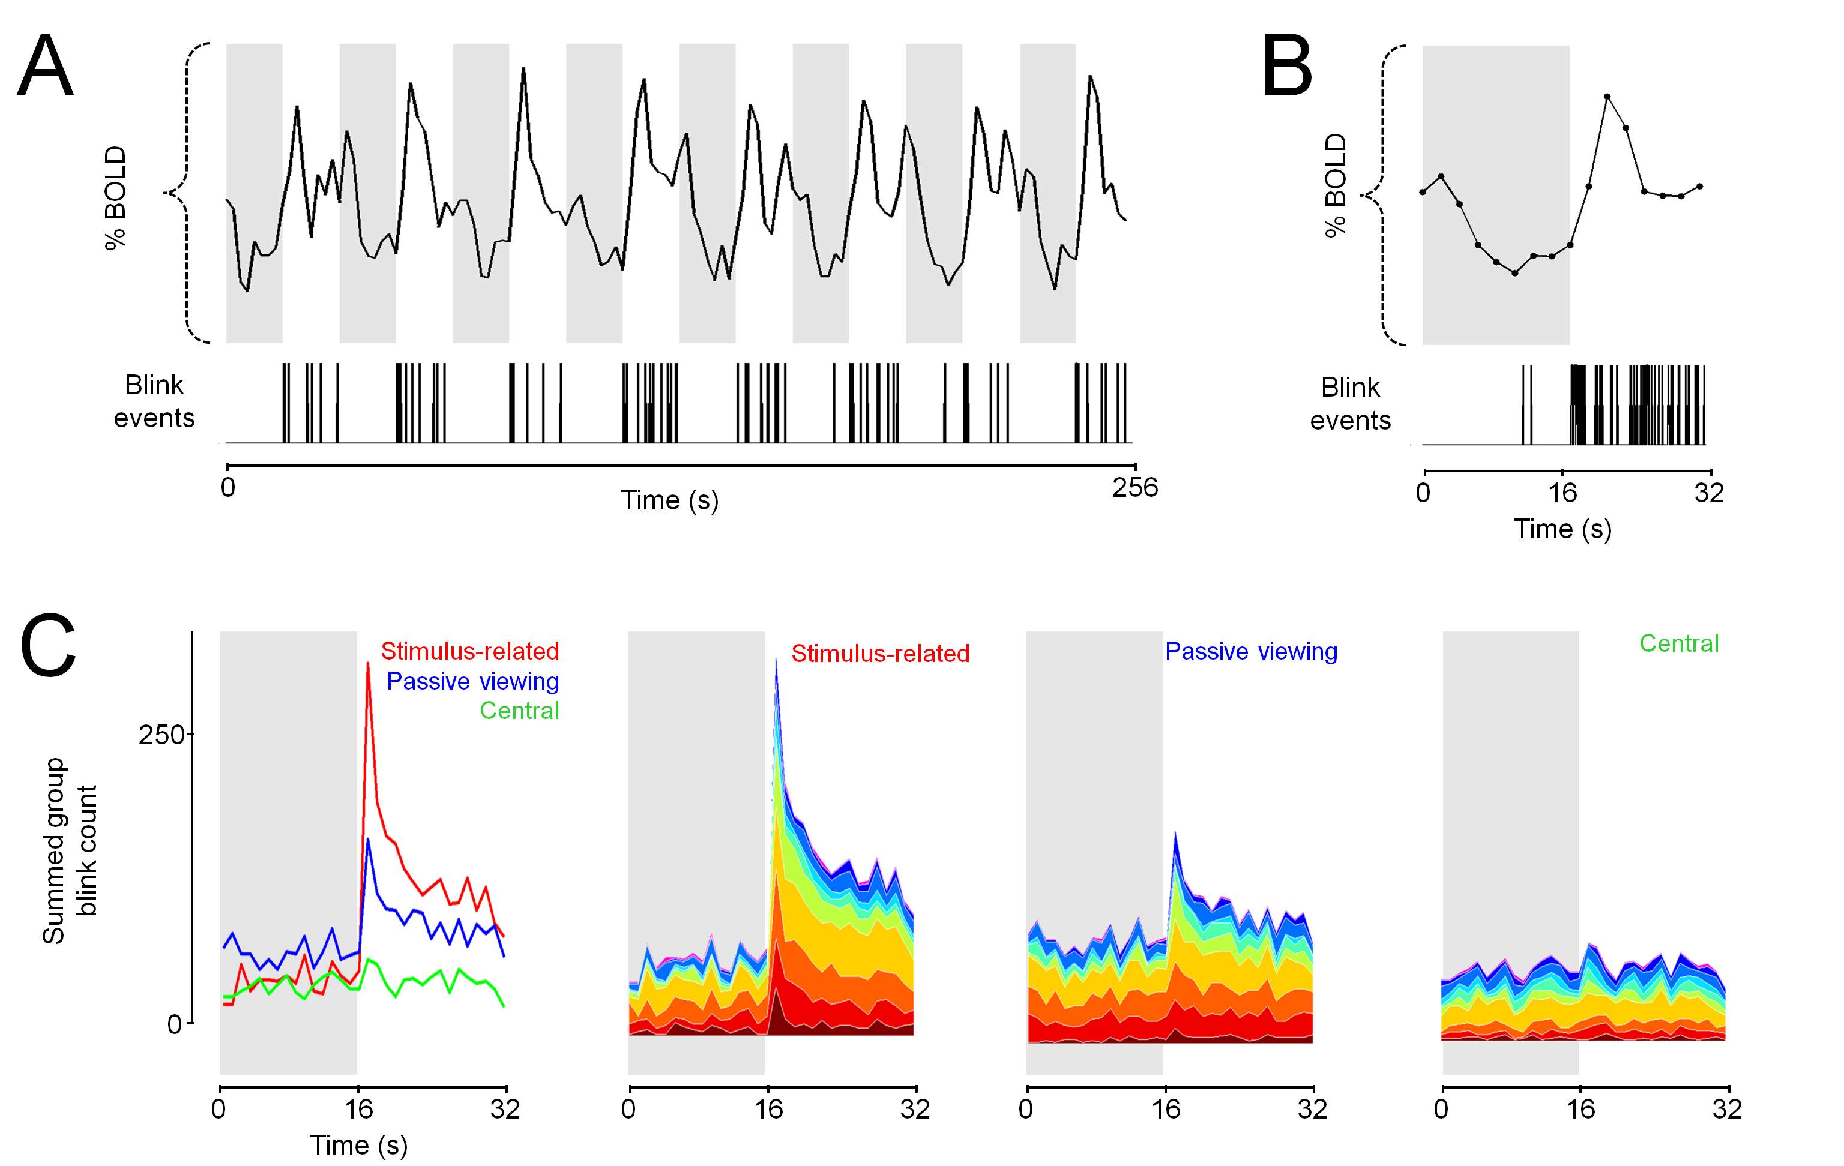
A time series artefact?
Ipsilateral V1
Time

Slide 20
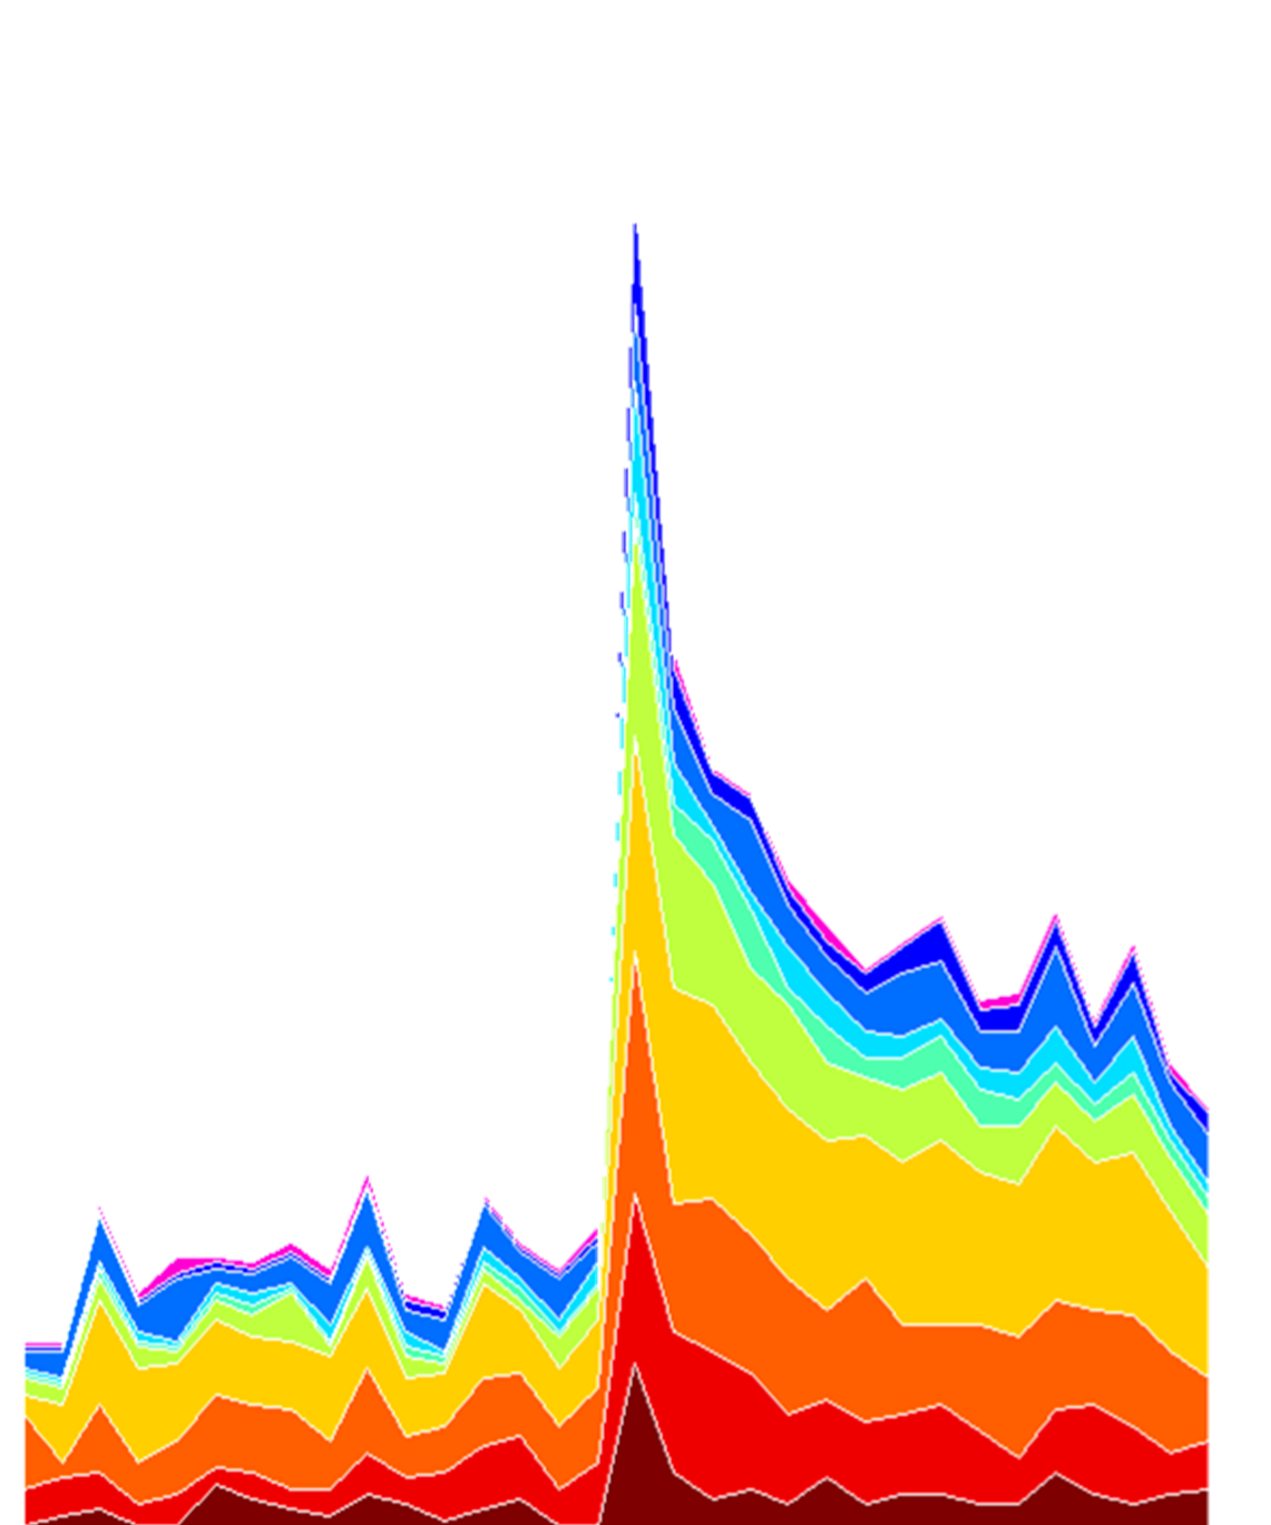
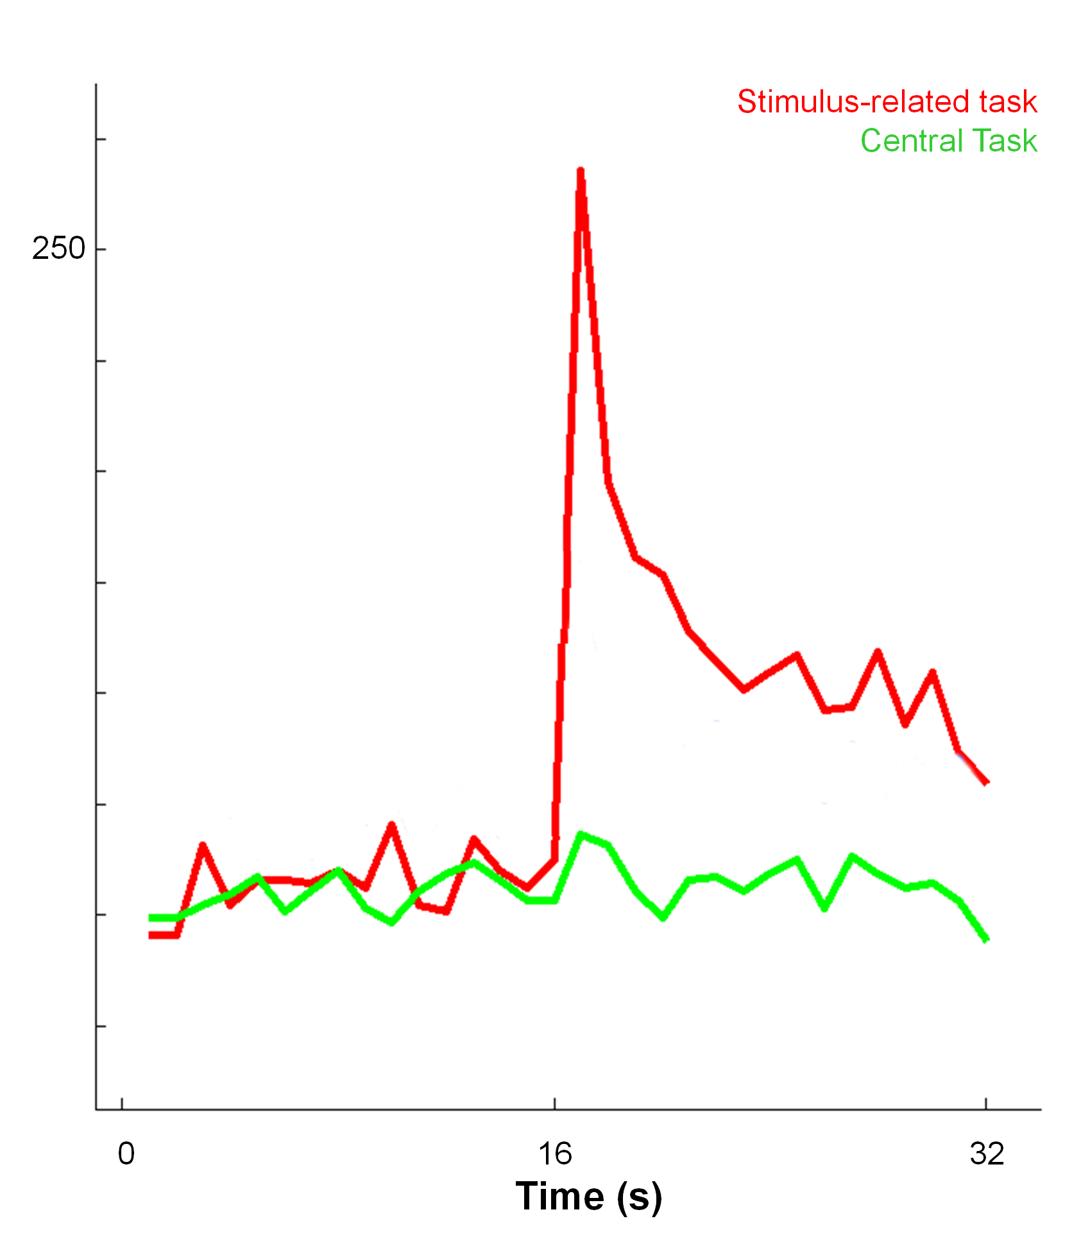
Negative BOLD – what’s the blinking problem?
Summed group blink count
Notes:
Here we show the timseries extracted from ipsilateral V1 in an exemplar participant. When we collapse this to a single cycle, the overshoot after the stimulus stops is clearly evident. We hypothesised that particularly under the stimulus related task conditions, participants may blink more when the stimulus is off, so we recorded their eyes during scanning. (CLICK)
Here I am plotting the blink events for this participant on the same timescale as the fMRI data. The blinks appear to fall in the period when the stimulus is off, as we can confirm by averaging across cycles. (CLICK)
What effect does this have at the group level? (CLICK) If we sum all the blink events across all subjects and collapse them across a single cycle, we see that there is almost no difference in blink frequency during the central task – in green - where the subjects is performing a task throughout the scan. However, under passive viewing in blue and especially stimulus-related task conditions in red, the subjects blink more systematically.
(CLICK) we can break down the group cumulative blink count into individuals by colour. This shows large variation in blink distribution and frequency across subject.
What’s the problem? Blinking produces a change in luminance on the retina which will be detected by the visual coretx and produce a response in visual areas. This could present as a positive BOLD response that starts as the peripheral stimulus turns off, just as we see here. This could be a real confound for our negative BOLD data.

Slide 21
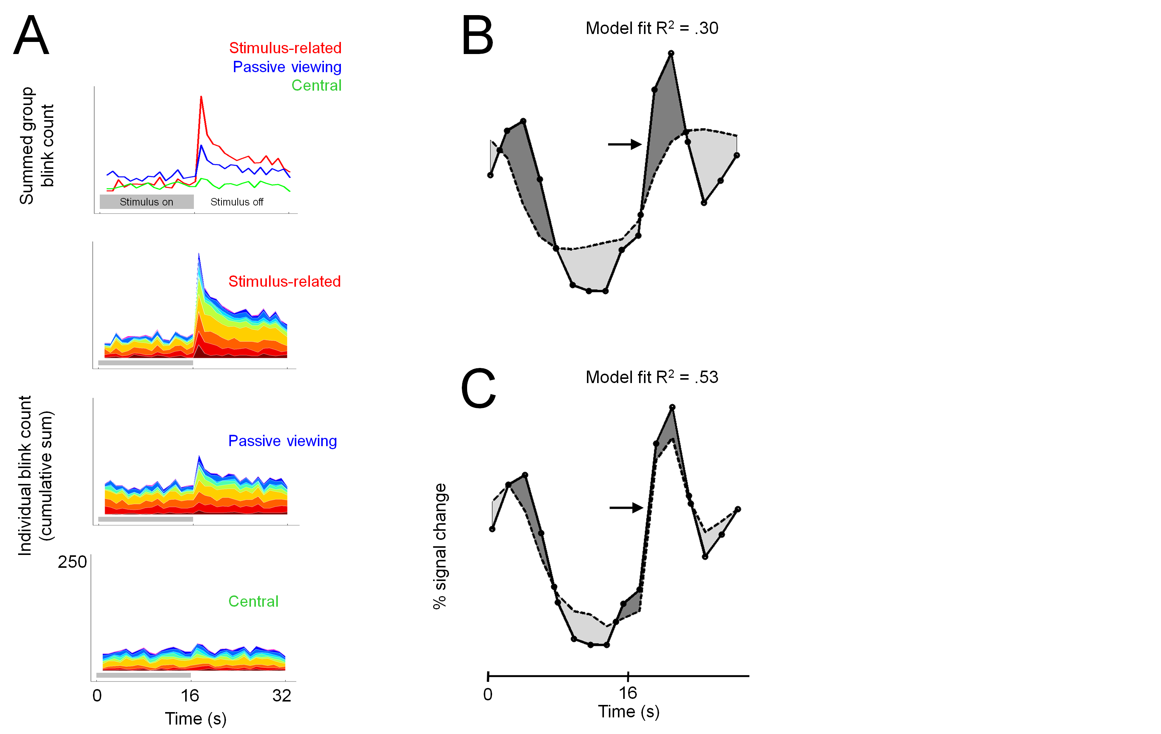
Modelling blink events in GLM analyses
Individual subject blink events convolved with HRF
Added to GLM design matrix as a regressor
Assess the effect by using hierarchical linear models:
Adding the blink significantly improves model fits
Notes:
(READ SLIDE)
Here is an example of how the data (solid line) are fit by the model (dotted line) without blinks are a regressor with the unexplained variance higlighted.
(CLICK) we can see that when the blink regressor is added to the model, the fit improves significantly.
Again, it is important to stress that adding this regressor in subjects who do not blink systematically makes very little difference to the model fits, so we are not artificially inflating our significance by including this regressor for ALL subjects individually.

Slide 22
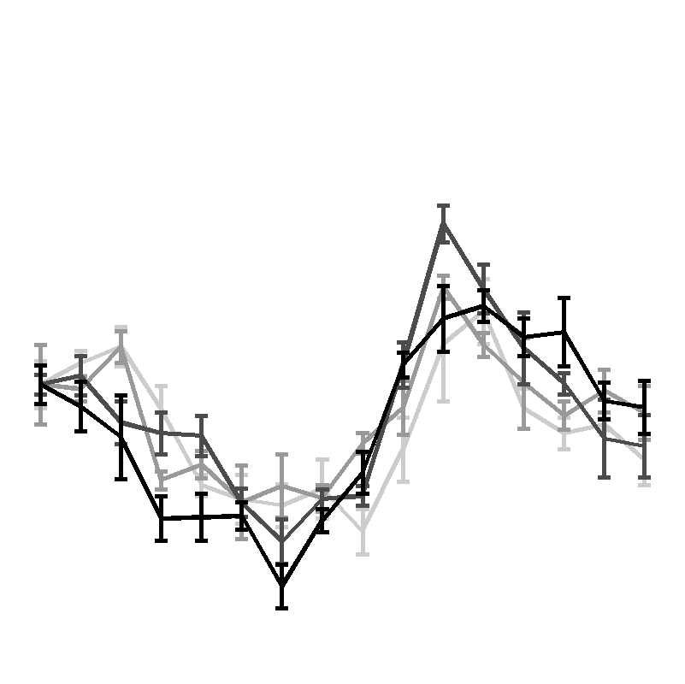
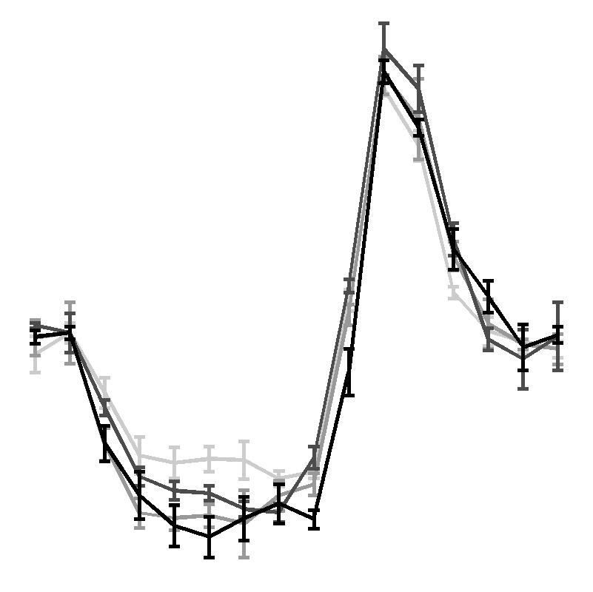
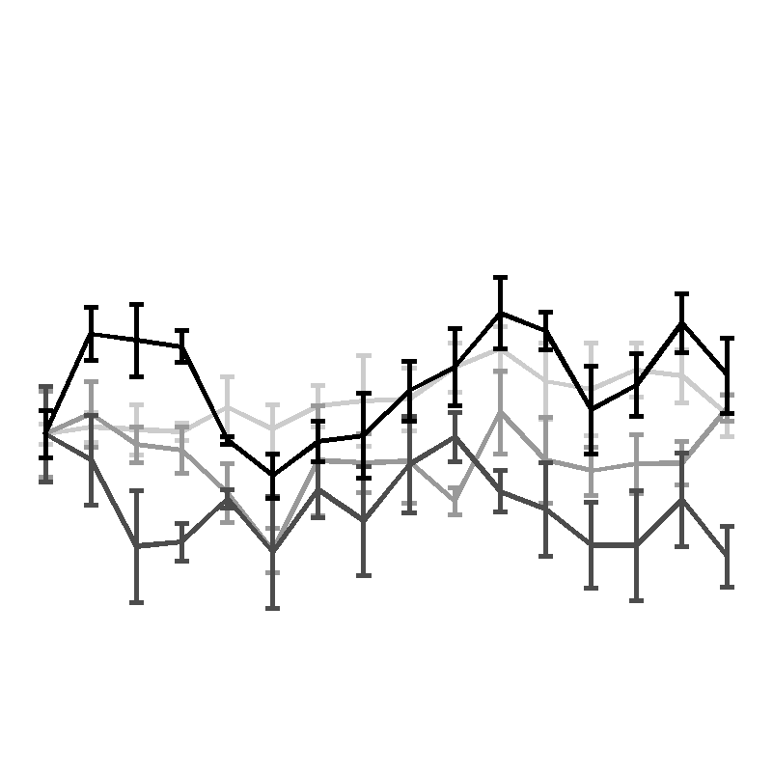
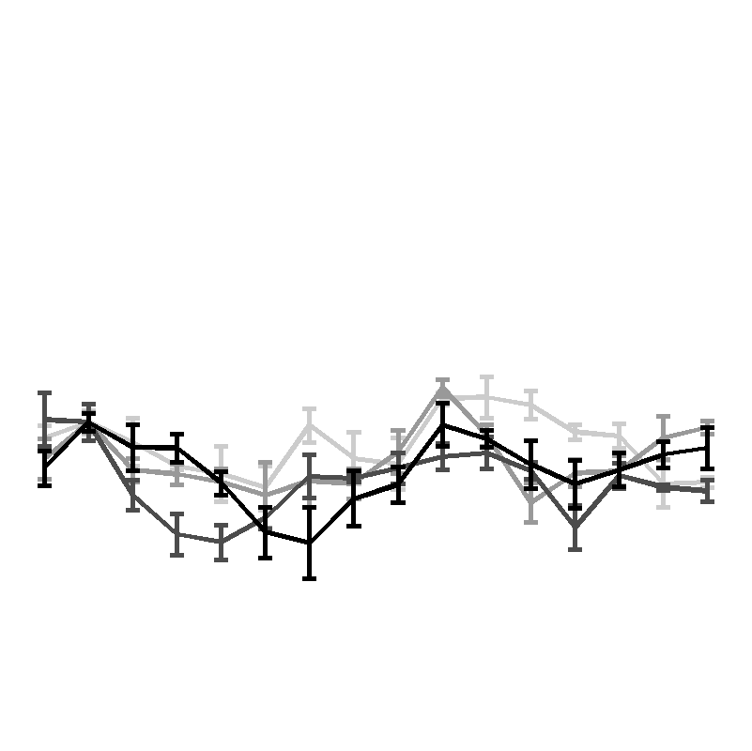
Contrast dependence of negative BOLD responses : fMRI time series
Ipsilateral V1
Ipsilateral LGN
Central
task
Stimulus-related
task
Central
task
Stimulus-related
task
Stimulus
contrast
100%
% signal change (BOLD)
25 %
12 %
6 %
0.2%
0.2%
32s stimulus cycle
Single stimulus cycle average for given ROI/condition; all voxels; all 4 scans; all 8 participants
Notes:
READ READ Here are the group mean single cycle time series for the negative BOLD areas, ipsilateral V1and LGN.
Under stimulus-related task conditions, the stimulus contrast appears to have very little effect on the responses.
The insets in each plot show the response during the central task, which appear to be essentially zero.
Thus negative BOLD in V1 and the LGN appear highly task dependent but contrast invariant.

Slide 23
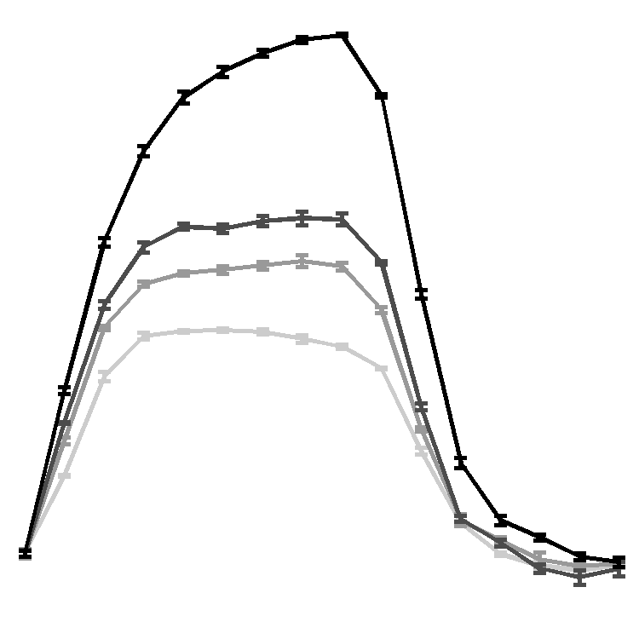
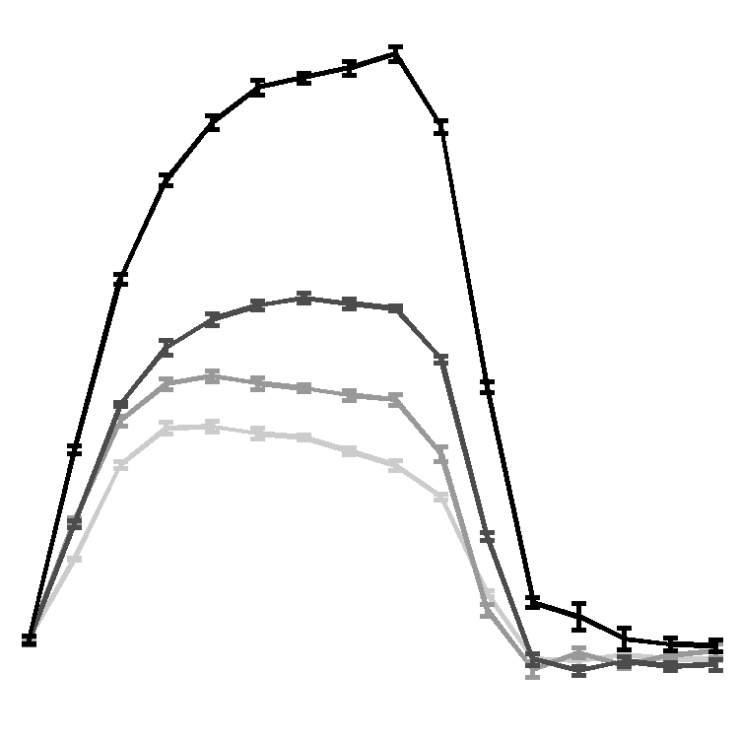
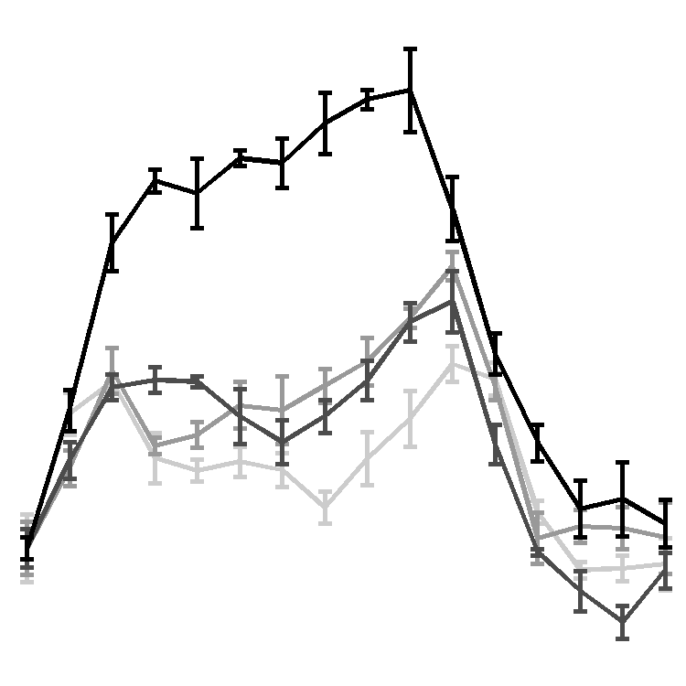
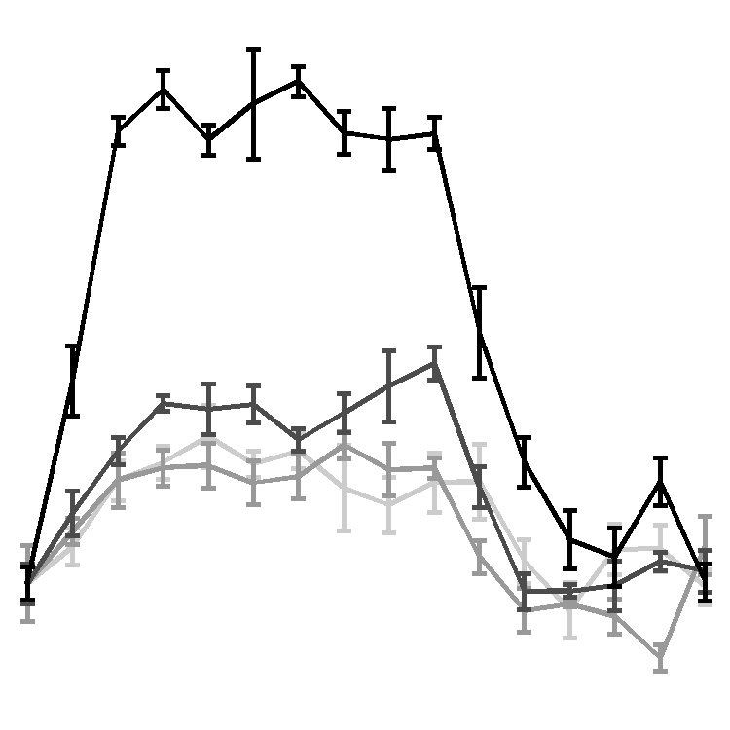
Contrast dependence of positive BOLD responses : fMRI time series
Contralateral V1
Contralateral LGN
Stimulus-related
task
Central
task
Stimulus-related
task
Central
task
Single stimulus cycle average for given ROI/condition; all voxels; all 4 scans; all 8 participants
Notes:
READ READ Now to the contralateral V1 and LGN.
Plotting the contrast responses for the stimulus related and central tasks alongside each other, we see differences within task as a function of the stimulus contrast, but little evidence of and effect of task
We can overlay the two sets of data to emphasise this.
Thus for contralateral V1 and LGN we see the opposite effects of task and contrast that we saw in ipsilateral negative BOLD regions:
Positive BOLD is highly contarst dependent but appears task invariant.
So lets formally assess the differences.

Slide 24
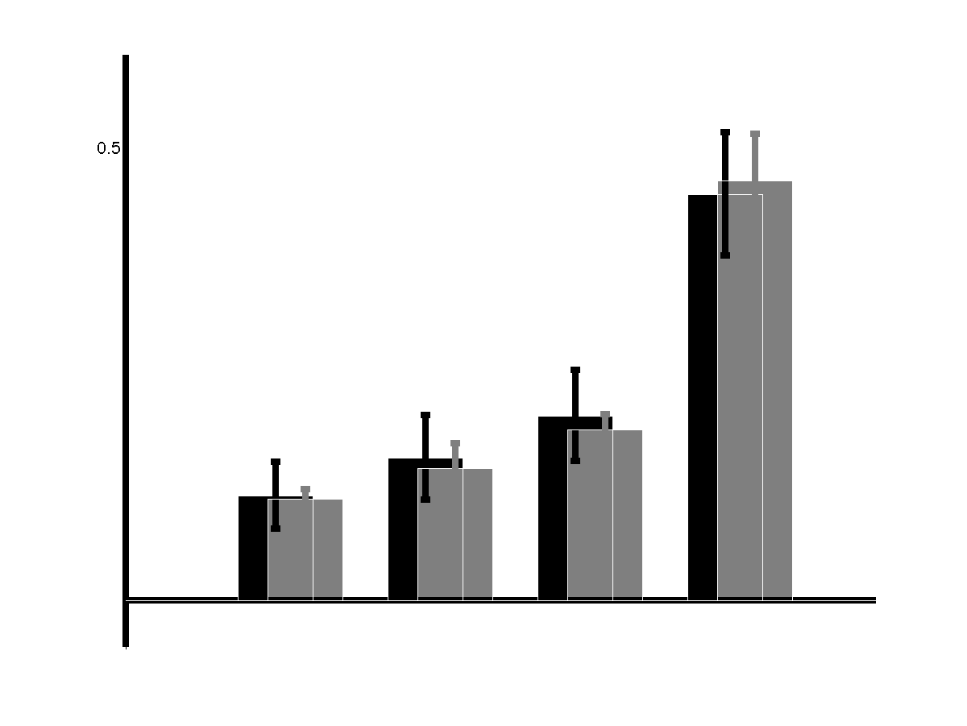
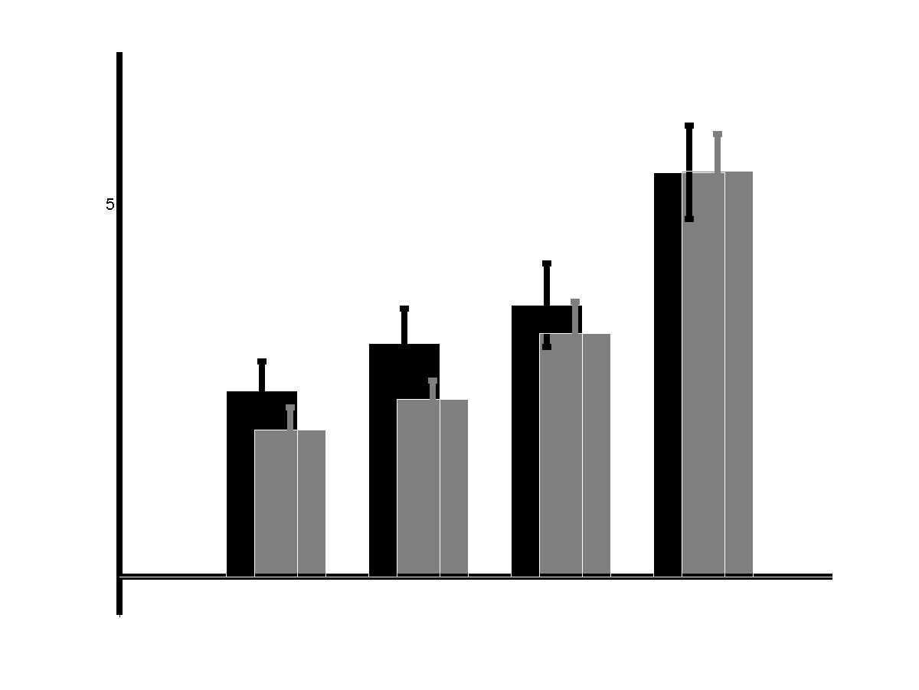
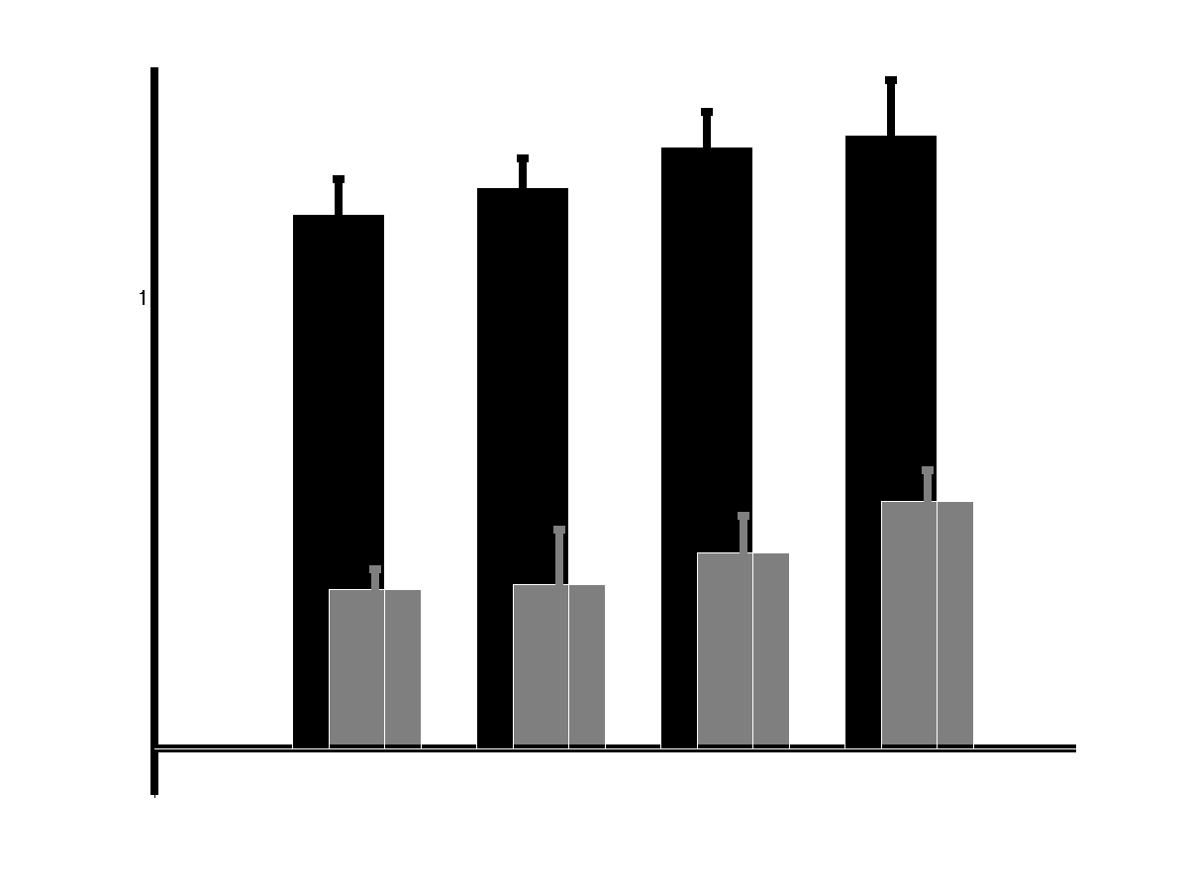
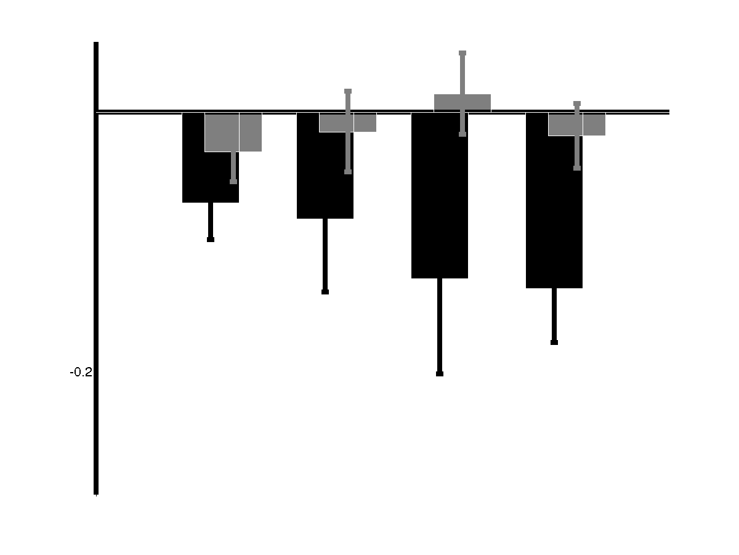
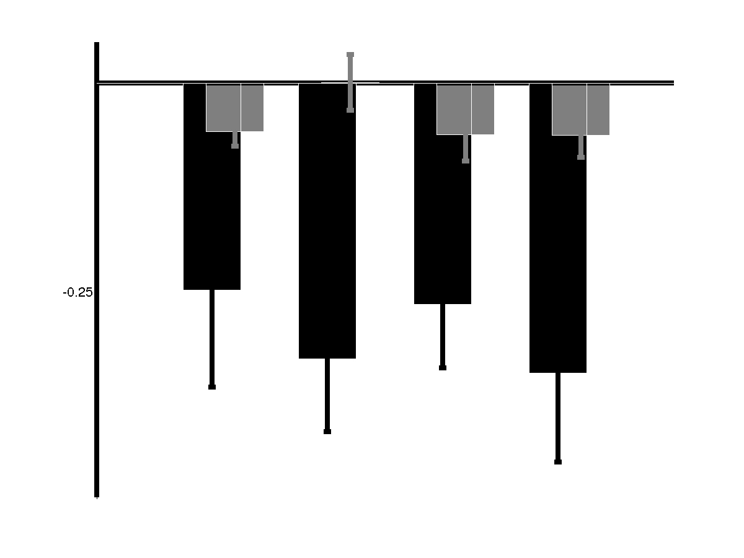
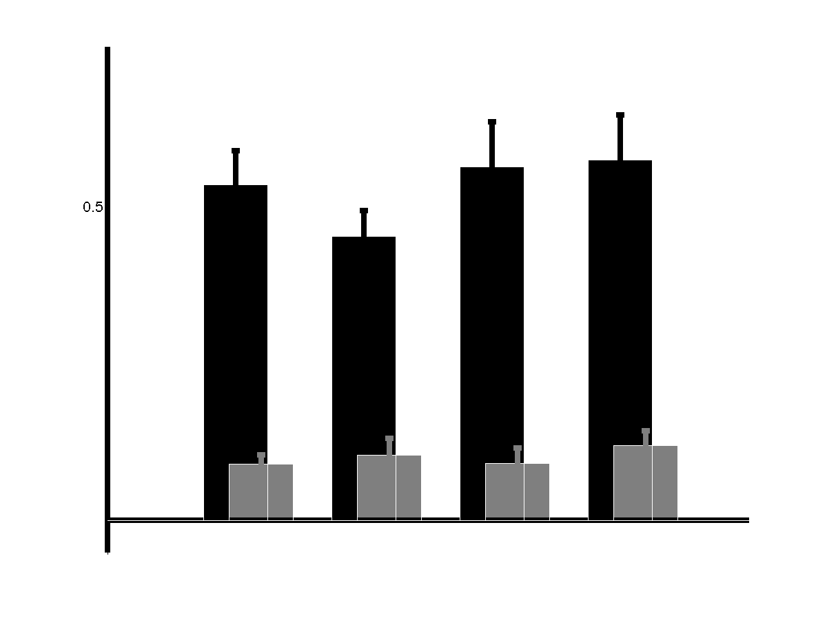
Repeated measures ANOVA results: Contrast & task dependence
LGN
V1
V5
***
***
*
0.5
Contralateral
0.5
1.0
% BOLD
ns
***
* 1 tailed
6
12
25
100
%Stimulus Contrast
Ipsilateral
-0.5
*
-0.25
***
***
-0.2
Stimulus-related task
Central task
* p<0.05 *** p<10⁻⁴
Notes:
READ READ READ We ran GLMs to estimate response amplitudes for each ROI, task and contrast combination for each subject. These values were entered into a two way repeated measured ANOVA testing for main effects of stimulus contrast and task. Here are the results: (DESCRIBE FIGURE)
(CLICK) For the contralateral LGN we found a highly significant effect of stimulus contrast, but not main effect of task.
(CLICK) In the ipsilateral LGN, we saw the opposite: a significant main effect of task but not of stimulus contrast.
(CLICK) This pattern was largely mimicked by V1 regions of interest: Contrast dependence in contralateral areas and Task dependence in ipsilateral areas.
(CLICK) in V5 bilaterally there was a highly significant main effect of task. There was also a subtle but significant main effect of contrast in contralateral V5.
Crucially, we gave shown little evidence of attentional modulation of the positive responses in early visual cortex. However, on closer inspection there was a hint on task dependence in contralateral V1 – significant when the T-test is one tailed, in the predicted direction of course.
This forced us to take a different approach to characterising our positive BOLD contrast response data.

Slide 25
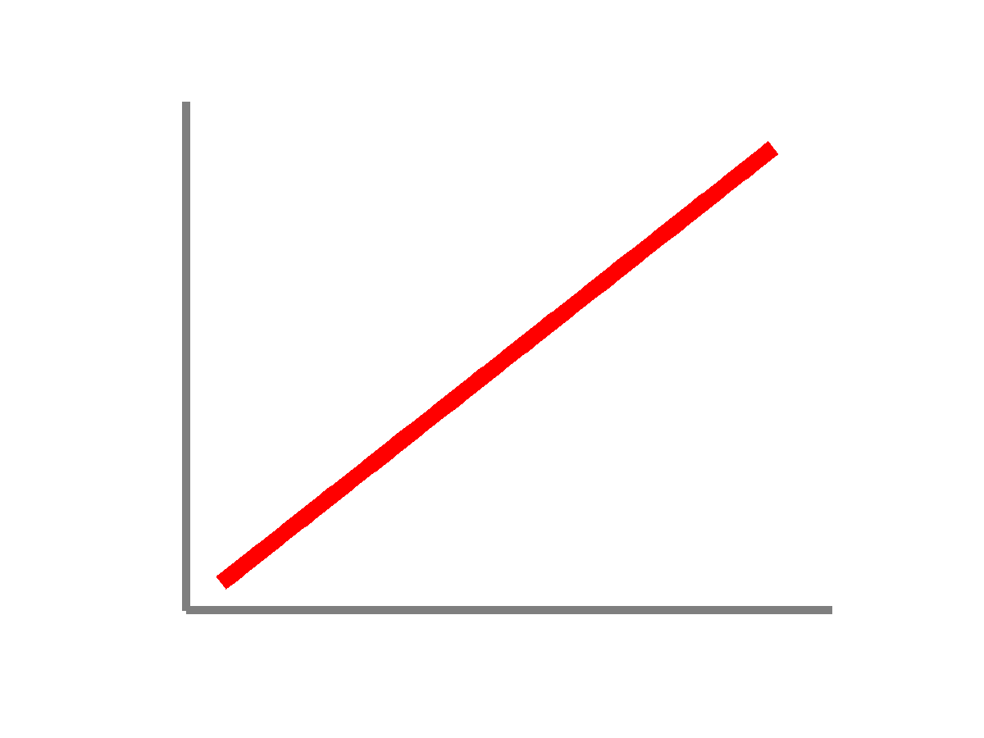
ANOVAs vs. Power functions
ANOVAs are not as sensitive as model fitting techniques: power functions are known to be relatively good descriptors of the contrast responses in early visual areas*
R = k.C^{γ}
max
γ = 1
k = 1
Response (R)
min
0%
100%
Contrast (C)
Notes:
(READ SLIDE)
The response R at a given contrast is given by the contrast value C presented to an exponent gamma ( γ ) multiplied by a scalar k.
(Click)
R100 is the maximum response as measured at 100% stimulus contrast, so one area mighjt change its response at all contrast levels (click) resulting in response gain
C50 is the semisaturation coefficient - - what is the contrast level required to generate 50% of the maximum response?
When only small amounts of contrast are required to generate a near maximal response we say that the function is compressive.

Slide 26
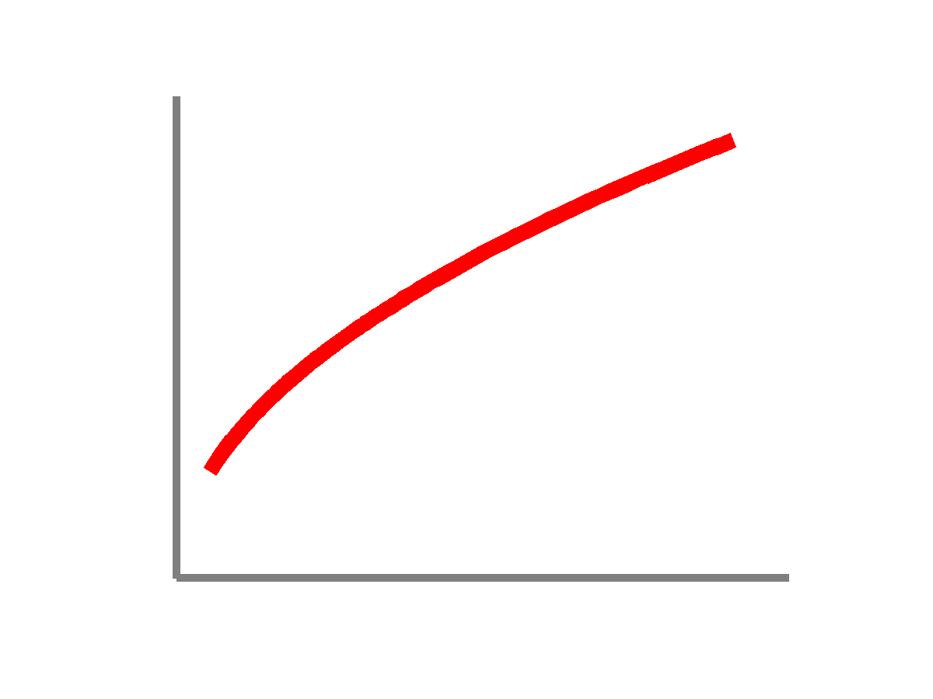

Power functions explained: assessing gamma
R = k.C^{γ}
max
γ = 1
γ = 0.5
γ = 0.25
Response (R)
C50=50%
C50=25%
C50=6%
min
100%
Contrast (C)
C50 : The contrast required to produce half maximum response
Contrast gain: maximum response remains unchanged but a larger response is obtained at intermediate stimulus contrasts

Slide 27



Power functions explained: maximum response
R = k.C^{γ}
max
R100
R100
Response (R)
R100
min
0%
100%
100%
Contrast (C)
R100: the response at maximum (100%) stimulus contrast
Response gain: additive / multiplicative mechanisms acting by increasing the response at all stimulus contrasts *

Slide 28

Assessing R100 and C50 with non-parametric statistics: effect of attention on BOLD responses
LGN
V1
V5
Contralateral
C50 n/s
C50 **
C50 *
R100 n/s
R100 n/s
R100 ***
Ipsilateral
C50 n/s
R100 ***
Notes:
Here are the results from the power function fits to the data.
(CLICK) non paramertic estimated distributions revealed no significant difference in either C50 or the maximum response in the contralateral LGN i.e. no effect of attention on positive BOLD.
(CLICK) In contralateral V1, function fitting refined the borderline significance of the contrast gain hinted by the ANOVA and we find a subtle but highly significant contrast gain in the response.
(CLICK) A hint of contrast gain can be seen in contralateral V5, but the response change her is obviously dominated by a highly significant response gain mechanism.
(CLICK) for completeness, here are the fits for ipsilateral LGN and V1. Comparisons here are essentially meaningless as the central task responses are not significantly difference from zero.
Ipsilateral V5 shows evidence of a highly significant response gain mechanism.

Slide 29
Summary
Negative BOLD acts very low level levels in the human visual system: LGN
Negative BOLD appears largely invariant to stimulus features but is highly dependent on task
In fact, negative BOLD seems to carry the majority of the effect size of task-related modulation in early visual structures when we actively disambiguate negative from positive BOLD responses

Slide 30
But what about Shmuel?
Our finding: negative BOLD is largely contrast invariant
Shmuel et al. (2002) reported that negative BOLD in V1 is highly contrast dependent.
Crucially: used a central stimulus and measured negative BOLD flanking the positive BOLD under central task conditions.
Sustained negative BOLD, blood flow and oxygen consumption response and its coupling to the positive response in the human brain. Shmuel et al., Neuron. 2002

Slide 31


NBR is task invariant under peripheral task conditions:
* p<0.05 *** p<10⁻⁴
-0.25
***
-0.25
*
*
*
NBR is (even adjacent negative BOLD) is task invariant under stimulus related (peripheral) task conditions

Slide 32

No attentional modulation in contralateral LGN?
Our finding: positive BOLD in the LGN contralateral to a stimulus is task independent
O'Connor DH, Fukui MM, Pinsk MA, Kastner S (2002) Attention modulates responses in the human lateral geniculate nucleus. Nat. Neurosci. 5: 1203-1209.
High contrast
High contrast with attention
% BOLD
Low contrast
Low contrast with attention
Time (s)
Optimised to detect enhancement
Adapted from O’Connor et al, 2002

Slide 33

Positive BOLD with a lateralised stimulus
Right brain
Left brain

Slide 34

Negative BOLD with a lateralised stimulus
Right brain
Left brain

Slide 35

Positive BOLD with alternating stimulation
Right brain
Left brain

Slide 36

Negative BOLD with alternating stimulation
Right brain
Left brain

Slide 37

REAL BOLD with a lateralised stimulus
Right brain
Left brain

Slide 38
Outline
What is negative BOLD?
Can negative BOLD be measured in early (very) visual areas: the LGN?
What is the stimulus and task dependence of negative BOLD signals?
What could the source of negative BOLD signals be?

Slide 39

How can suppression arise? … especially ipsilateral suppression …
Suppression can be detected in VERY early structures ipsilateral to a stimulus
How does this information cross the midline?
LGN – No
V1 callosal fibers – No
Exstrastriate areas with big receptive fields – maybe
Colliculus - maybe

Slide 40


The Pulvinar
Long thought to be a modulator of visual salience _{Petersen and Robinson 1990}
Lot of interest recently:
2011 Signals conveyed in the pulvinar pathway from superior colliculus to cortical area MT. Wurtz RH_{. J Neurosci. 2011}
Gating and control of primary visual cortex by pulvinar. Casagrande VA. _{Nat Neurosci. 2012:}
Subcortical Projections of Area V2 in the Macaque. Ungerleider LG, Galkin TW, Desimone R, Gattass R. _{J Cogn Neurosci. 2014}
Attention gates visual coding in the human pulvinar. Fischer J, Whitney D. _{Nat Commun. 2012:}

Slide 41


The Pulvinar

Slide 42



Whole brain* GLM analyses
Whole brain GLM analysis in FSL on
100% contrast data (n=8), stimulus-related and central
Included the stimulus and blink as regressors
Added the probabilistic thalamic atlas as a mask to restrict the volume of interest.
Notes:
We fead our data into a classic FSL whole brain GLM analyses, but restrcited our outcome measures by masking just the thalamus

Slide 43

Notes:
Here are the results from the data acquired in experiment 1.
The group mean z-score maps, cluster corrected and thresholded at a significance level p<0.05, are overlaid on the MNI standard anatomical brain. The region in green represents the thalamus that we restricted our analyses to .
Firstly, we validate the results of our independent ROI analyses by showing that negative BOLD can be seen in the ipsilateral LGN. Intriguingly, this negative BOLD extends beyond the bounds of what we would consider the LGN, but well into a region referred to as the medio-dorsal pulvinar. This area preferentially connects to parietal cortex. This negative BOLD signal disappears under central task conditions.
Positive BOLD responses are seen in the contralateral LGN, and extend into regions of the pulvinar that preferentially connect with the visual cortex – the dorsolateral pulvinar. As seen in the ROI analyses, the positive signals appear unaltered by task.
There is also evidence of activity in the superior colliculus, although imaging the colliculi is notoriously difficult and susceptible to noise.
Most strikingly, we apply exactly the same analyses to the 100% contrast data from experiment two (CLICK) and almost exactly reproduce the finding from experiment one .. A rare occurence indeed.

Slide 44
Notes:
Here are the results from the data acquired in experiment 1.
The group mean z-score maps, cluster corrected and thresholded at a significance level p<0.05, are overlaid on the MNI standard anatomical brain. The region in green represents the thalamus that we restricted our analyses to .
Firstly, we validate the results of our independent ROI analyses by showing that negative BOLD can be seen in the ipsilateral LGN. Intriguingly, this negative BOLD extends beyond the bounds of what we would consider the LGN, but well into a region referred to as the medio-dorsal pulvinar. This area preferentially connects to parietal cortex. This negative BOLD signal disappears under central task conditions.
Positive BOLD responses are seen in the contralateral LGN, and extend into regions of the pulvinar that preferentially connect with the visual cortex – the dorsolateral pulvinar. As seen in the ROI analyses, the positive signals appear unaltered by task.
There is also evidence of activity in the superior colliculus, although imaging the colliculi is notoriously difficult and susceptible to noise.
Most strikingly, we apply exactly the same analyses to the 100% contrast data from experiment two (CLICK) and almost exactly reproduce the finding from experiment one .. A rare occurence indeed.

Slide 45
Notes:
Here are the results from the data acquired in experiment 1.
The group mean z-score maps, cluster corrected and thresholded at a significance level p<0.05, are overlaid on the MNI standard anatomical brain. The region in green represents the thalamus that we restricted our analyses to .
Firstly, we validate the results of our independent ROI analyses by showing that negative BOLD can be seen in the ipsilateral LGN. Intriguingly, this negative BOLD extends beyond the bounds of what we would consider the LGN, but well into a region referred to as the medio-dorsal pulvinar. This area preferentially connects to parietal cortex. This negative BOLD signal disappears under central task conditions.
Positive BOLD responses are seen in the contralateral LGN, and extend into regions of the pulvinar that preferentially connect with the visual cortex – the dorsolateral pulvinar. As seen in the ROI analyses, the positive signals appear unaltered by task.
There is also evidence of activity in the superior colliculus, although imaging the colliculi is notoriously difficult and susceptible to noise.
Most strikingly, we apply exactly the same analyses to the 100% contrast data from experiment two (CLICK) and almost exactly reproduce the finding from experiment one .. A rare occurence indeed.

Slide 46


The Pulvinar: the gateway for hemispheric transfer?
We have shown suppression and activation in anatomically distinct regions of the pulvinar with differential connections to parietal and visual areas.
Do we see any evidence of parietal activity?

Slide 47
Summing up
Negative BOLD can be detected in subcortical structures (and can be robustly reproduced)
These responses seem largely independent of stimulus characteristics but are highly dependent on task, and in our case reflect the spatial allocation of attentional resources
Studies considering enhancement at attended locations should also consider the effects of inhibition at unattended locations, which is a far more efficient mechanism metabolically; understanding the interplay between the two is crucial in debunking attention as a neural and behavioural mechanism
The Pulvinar may play a crucial role in integrating the push-pull mechanisms of attention conferring a competitive bias to attended locations at the expense of processing at unattended locations. Crucially we provide evidence of suppression an activation in anatomically distinct regions of the pulvinar that need to be explored further.

Slide 48
Future work
The ‘hemispheric’ effect
Subcortical contributions
Pulvinar subnucleui
The TRN
Layer dependence of cortical negative BOLD
Multiple ‘attentional’ channel interaction
Better magno- /parvocellular comparisons using pulse width modulated LED arrays
Electrophysiolocal correlates of spatial attention
MEG and EEG

Slide 49
Acknowledgements
Students Over The Years:
L. Glover, W. Schaller, W. Steven, M. Yates, I. Alvarez, D. Watson, Y. Yu, I. Alvarez, M. Aslet, J. Bird, R. Dearden, S. Maslanka, M. Uesaki , J. Rodgers
General legend:
M. Hymers
Mentors (i.e. bosses)
Gary Green & Tony Morland

Slide 50
Thank you for your attention.

Slide 51
Technical challenges and design considerations
High resolution to measure LGN
smaller voxels = smaller signal
1.5 X 1.5 X 2.4 mm³ = ~ 30 voxels
Controlling spatial extent
Each LGN represents the entire contralateral visual field so we could get positive and negative responses in the same LGN, making it difficult to differentiate the signals
Use a lateralised stimulus – ipsilateral LGN only negative BOLD(?)
NBR signals are smaller than PBR signals:
If we do find a relatively small negative signal in this relatively small structure, is there anything we can do to convince ourselves what we have measured is real?
Use different task conditions – the LGN is implicated in attention

Slide 52


Slide 53


Slide 54

Experimental and stimulus design.
Vanduffel W et al. Cereb. Cortex 2000;10:109-126

Slide 56



Slide 57


Suppression in monkey early visual areas
Normalized differential (attended>unattended) ³H-¹⁴C-deoxyglucose uptake in V1 (layer 4Cα) and in the LGN of macaque monkeys during the presentation of a central (foveal) stimulus.
LGN
V1
Adapted from Vanduffel et al., Cereb. Cortex 2000;10:109-126
Notes:
There is evidence from monkey physiology that we may be able to detect suppression at the level of the LGN.
Vanduffel and colleagues looked at the differential uptake of radio-labelled deoxyglucose in monkey visual areas as a function of task.
Monkeys were trained to make a saccade to a left or right target based on the orientation of a central grating stimulus. This task required central attention.
In a second experiment, the orientation of the grating was vertical so did not act as a cue, and the monkey had to make a saccade to the first peripheral target. This task required the monkey to attend to the periphery.
They show that representations of the central stimulus are slightly enhanced and representations of the periphery are suppressed in the central relative to the peripheral task.
This data is for V1, but they found a similar trend in the LGN, if a little noisier.
(LINKING SENTENCE)
So what about the human LGN?

Slide 58



Slide 59


Rods
Cones
Receptor density
0
-60
-40
-20
0
20
40
60
Angle relative to fovea (degrees)
Adapted from Foundations of Vision, Wandell
Livingstone Hubel, J Neurosci 1988

Slide 60

ANOVAs vs. Power functions
ANOVAs are not necessarily as sensitive as model fitting techniques: power functions are known to be relatively good descriptors of the contrast responses in early visual areas
R = k.C^{γ}
The response R at a given contrast is given by the contrast value C presented to an exponent gamma ( γ ) multiplied by a scalar k.
R100 is the maximum response as measured at 100% stimulus contrast
C50 is the semisaturation coefficient - - what is the contrast level required to generate 50% of the maximum response?
When only small amounts of contrast are required to generate a near maximal response we say that the function is compressive.

Slide 61



















Negative BOLD responses to luminance contrast and chromatic contrast defined stimuli.
A. GOUWS, L. GLOVER, W. SCHALLER, W. STEVEN, M. YATES, I. ALVAREZ, D. WATSON, Y. YU, A. MORLAND;
800.20 / LL11
Background
Positive BOLD responses (PBRs) are often accompanied by both proximal and distal negative BOLD responses (NBRs). Recent work¹ suggests that proximal NBRs can be largely attributed to processing by magnocellular mechanisms. We previously observed distal NBRs in V1 and LGN ipsilateral to a lateralized visual stimulus. These distal NBRs showed task dependent modulation. We modified our paradigm to evaluate magnocellular specificity of distal (inter-hemispheric) NBRs, by presenting either luminance contrast or isoluminant, chromatic contrast gratings.
Data analysis and results
We computed a single time series for each ROI for each experimental run by averaging data across voxels. The time series’ for multiple runs for each condition were then averaged within participant to produce a mean time series for the two conditions for each participant. A general linear model was then applied to the resulting time series (one per condition for each participant). We used the stimulus blocks convolved with (1) a canonical HRF (SPM8⁶, default parameters) and (2) the first temporal derivative of that HRF, as two explanatory variables. The model fits generated parameter estimates for each participant x condition. Repeated measures t-tests were used to compare the parameter estimates across conditions. Time series data were also reduced to a representative response to a single stimulus block by averaging across all blocks and are presented alongside bar graphs showing the group mean and standard error of the parameter estimates. Significant positive BOLD responses were elicited in V1 and LGN contralateral to stimulation, as well as V5 bilaterally for both achromatic and chromatic conditions. Both conditions also produced significant negative BOLD responses in V1 and LGN ipsilateral to stimulation. The effect of condition showed a borderline significance in both LGN and V5 bilaterally, but not in V1.
Regions with increased BOLD signal while the stimulus is on
Regions showing decreased BOLD signal while the stimulus is on
Contralateral
Ipsilateral
Achromatic
Group mean single-cycle time series
GLM parameter estimates
Group mean single-cycle time series
GLM parameter
estimates
Chromatic
Left early visual cortex
Right early visual cortex
LGN
*
Previously reported distribution of positive (yellow-red) and negative (cyan-blue) BOLD in early visual cortex with right visual field stimulation during stimulus related task conditions in a representative participant
*
*
0.5%
0.5%
Methods
The stimulus, a 120° sector of an annulus (inner radius 4°, outer 18°), was equally divided by the horizontal meridian. Upper and lower halves of the stimulus were sinusoidal gratings (sf =.08 cycles/°polar angle, contrast = 100%, f = 6Hz), which always drifted in opposite directions and reversed unpredictably. The stimuli were either yellow-black or equiluminant red-green gratings. Equiluminance was established for the red-green grating for each participant using the minimum motion criterion. Each fMRI run comprised eight, 16s, grating blocks alternating with a uniform yellow field of mean luminance equal to that of the grating. Four runs were presented in each session; luminance and chromatic contrast conditions were tested in different sessions. Participants fixated a central dynamic target for the duration of each experimental run. We acquired fMRI data (128 EPI volumes, TR=2s, 8 cycles per scan, 4 scans per condition, n=10), while participants counted the number of motion reversals. We defined regions of interest with independent data. Retinotopic mapping techniques were used to identify V1^{2,3}; proton density weighted MRI scans⁴ were used to identify the LGN; anatomical landmark criteria⁵ were applied to high resolution T1 weighted images to define V5. Cortical ROIs were also restricted to gray matter following manual tissue segmentation.
% BOLD signal change
PE value of model fit
*
*
32 sec
*
V1
*
*
4%
4%
*
*
V5
*
*
*
*
1%
1%
*
*
* Group mean significantly different from zero (p<0.05, t-test , 2-tailed)
* Difference between group means is significant (p<0.05, t-test , 1-tailed)
Discussion
Negative BOLD responses can be detected distal to positive BOLD responses with both luminance contrast and isoluminant, chromatic contrast gratings. Although the negative BOLD responses in distal, ipsilateral regions appear to reduce with isoluminant chromatic stimuli (and thus as a function of decreased magnocellular input), this reduction mirrors the reduced positive BOLD responses regions contralateral to stimulation. Thus our results are inconsistent with the notion that distal negative BOLD responses are driven solely (or even largely) by magnocellular mechanisms. The data also suggest some level of coupling of the observed responses in the LGN and V5 that may be independent of V1.
References
Wade & Rolwand, 2010. J Neurosci 30:5008--5019.
Sereno et al., 1995. Science 26:889--893.
DeYou et al., 1996. PNAS 93:2382--2386.
Devlin et al, 2006. Neuroimage 30:1112--1120.
Dumoulin et al., 2000. Cereb Cortex 10:454--463.
Friston et al. 1994 Hum. Brain Mapp. 1:153--171.

Slide 62





Conventions for this presentation fMRI time-series data: the single cycle
X
Single scan 1
Single scan 2
% signal change (BOLD)
Time (s)
% signal change (BOLD)
+
=>
Time (s)
Stimulus ON
Stimulus OFF
Notes:
Its worth explaining one convention used throughout both the previous work Ill review and the results I will show, the way timeseries data are shown. (CLICK)
In a typical fmri scan, we alternate between the presentation of and rest periods for a number of cycles. This results in a typical oscillating BOLD response in areas activated by the stimulus. (CLICK)
We then routinely average across the cycles in a single scan, acquired additional scans, and then average across those to give us a grand mean single cycle response.
The backgrounds in these plots are shaded to highlight the period when the stimulus was on or off. Error bars are standard errors across the group.

Slide 63


The spatial extent of negative BOLD: Investigating ipsilateral responses to lateralized stimuli
X
The representation of the ipsilateral visual field in human cerebral cortex. Tootell et al., PNAS 1998
Notes:
Early work focussed on the spatial extent of negative responses, almost in passing in the first instance.
In 1998 Roger Tootell’s lab presented lateralized stimuli but instead of looking at contralateral responses, they were primarily interested in characterizing response that crossed the midline into the ipsilateral hemisphere. They saw negative responses too. (CLICK)
They presented these ipsilateral responses their findings on a 3d brain which can then be inflated and virtually flattened
(CLICK)

Slide 64
X
“ … perhaps reflecting neural inhibition …”
The representation of the ipsilateral visual field in human cerebral cortex. Tootell et al., PNAS 1998
Notes:
They spend a lot of this paper discussing the positive responses in higher visual areas and how they might cross the midline,
They also plotted and commented on the negative response stating (CLICK) that their presence in early visual cortex may ‘perhaps reflect neural inhibition’

Slide 65

Central stimuli give ‘adjacent’ negative BOLD
X
From Wade and Rowland, J Neurosci, 2010
Notes:
The studies I describe next used central stimuli, so these do not give ipsilateral responses as such.
Using this figure borrowed from Alex Wade’s Journal of Neuroscience paper as a schematic, we can see that central stimuli give rise to activation at the occipital pole which is surrounded by ‘adjacent’ negative BOLD.

Slide 66
Suppression in monkey early visual areas: Radio-labelled deoxyglucose uptake in macaque
X
It is possible to measure suppression of unattended locations in macaque LGN.
Vanduffel and colleagues had monkeys perform a central or peripheral attention task.
They showed that there was a small increase in metabolic activity in attended, stimulated locations but a larger decrease in metabolic activity in unattended locations when a monkey performed a central task.
Adapted from Vanduffel et al., Cereb. Cortex 2000;10:109-126
Notes:
There is reason to believe that we might be able to.
(LINKING SENTENCE)
So what about the human LGN? Let’s do a little bit of early visual system revision:

Slide 67
Group mean time series: the effect of task on negative BOLD responses in the LGN and visual cortex
iLGN
iV1
cLGN
cV1
Stimuslus
related
Passive
viewing
cV5
iV5
Central
Notes:
Here are the group mean single cycle responses from our regions of interest. The top row shows the stimulus-related task, the middle row passive viewing and the lower row central task conditions.
Under stimulus-related task conditions, there is clear evidence of negative BOLD responses in the time series derived from LGN and V1 ipsilateral to the stimulus.
These appear reduced during passive viewing and are all but abolished under central task conditions. (CLICK)
Positive BOLD responses were observed in the contralateral LGN and V1 but, unlike their ipsilateral counterparts, task appears to have little effect on the responses. (CLICK)
Positive BOLD responses were observed V5 bilaterally, and task appears to have a large effect on theses responses.
Great , so we think we have negative BOLD in the LGN so we can move on to formally assess this with some STATS.
BUT There is a quirk in our data that we noticed in pilot scans (CLICK) particularly evident in the negative BOLD responses. (CLICK)
It relates to the exaggerated overshoot as the negative BOLD responses return to baseline, particularly in our stimulus-related task. This requires a quick but important diversion from our main story.

Slide 68

Results: the effect of task on negative BOLD responses in the LGN and visual cortex
LGN
V1
V5
n/s
n/s
p<0.001
Contralateral
Ipsilateral
*p<0.01
p<0.001
p<0.001
Notes:
Running an individual subject’s data through a general linear model results in an estimated response amplitude for each ROI for a given condition.
We can enter these response amplitudes into a one way repeated measures ANOVA assessing a main effect of task. Here are the results (CLICK) for contralateral ROIs on the top row and Ipsilateral on the bottom.
No significant main effect of task was found in either the contralateral LGN or V1.
As expected from inspection of the timeseries data, we found highly significant main effect of task on the negative BOLD responses in the LGN and V1 ipsilateral to the stimulus, and also the positive BOLD responses of V5 bilaterally. Significant pairwise differences are also highlighted where found.

Slide 69
Summary: Experiment 1
Negative BOLD can be detected in the human LGN
It is important to take systematic variation in blink pattern into account when modelling visual responses.
Negative BOLD is highly dependent on task (the spatial location of attention)
Positive BOLD responses do not appear task dependent in early visual areas, but are highly task dependent in higher visual areas.

Slide 70
Summary: Experiment 1
Negative BOLD can be detected in the human LGN
It is important to take systematic variation in blink pattern into account when modelling visual responses.
Negative BOLD is highly dependent on task (the spatial location of attention)
Positive BOLD responses do not appear task dependent in early visual areas, but are highly task dependent in higher visual areas.
Previous fMRI measurements in human appear to show attentional modulation of signals in V1 (Gandhi et al., 1999; Martinez et al., 1999; Somers et al., 1999) and even the LGN (O'Connor et al., 2002).
Many of these effects are described at low to intermediate stimulus contrasts, but we used essentially 100% contrast stimuli.

Slide 71

Doesn’t this mean all unattended locations are always suppressed?
Our central task condition could be thought as ‘suppressing’ the periphery throughout the scan
As the central task starts at time = zero, can we see evidence of a suppression from baseline at the very start of the scan that is sustained throughout?
% BOLD
Time (s)
0
256
0
32
Notes:
(READ SLIDE)
.. The answer is yes (CLICK)
Here we see the time series for ipsilateral V1 under stimulus-related conditions in gray, withi the negative BOLD turning on and off with the task cycle.
Overlaid in black is data for the same ROI in central conditions. Here the task starts at time = zero, suppressing unattended locations below baseline.
Unlike the stimulus related task, the central task is always on so we do not see oscillation.
(CLICK) Looking at just the first cycle for all four stimulus contrast levels, we can see this effect appear robust and contrast independent.
It would of course have been nice to have seen the signal return to baseline at the end of the 8 stimulus cycles, but , at several hundred pounds an hour for MRI not many of us are in the habit of acquiring blank data at the end of our scans.

Slide 72

Other physiological correlates of negative BOLD
Independent, simultaneous measurements made alongside fMRI show negative BOLD correlates highly with:
Decreased CBF in macaque _{Shmuel et al, 2002}
Decreased LFP in macaque _{Shmuel & Logothetis 2006}
Decreased neural firing in barrel cortex of rats ^{Boorman et al, 2010}
Notes:
Further work has added to the evidence that negative BOLD is indicative of genuine inhibitory activity. (READ SLIDE)

