Slide 1
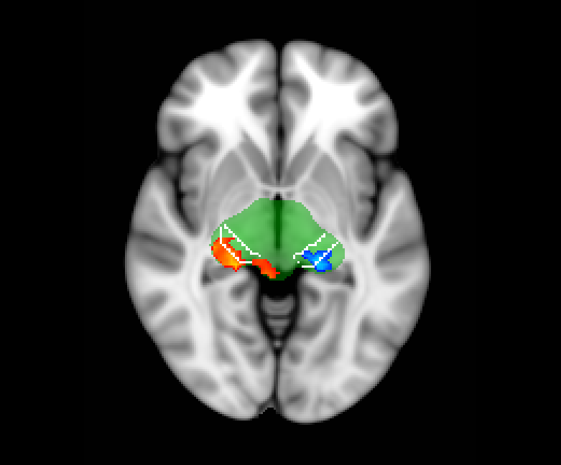

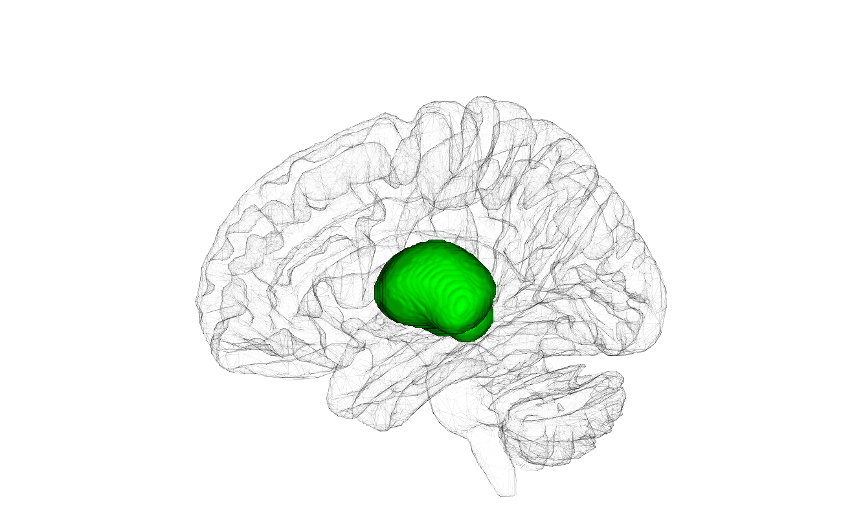
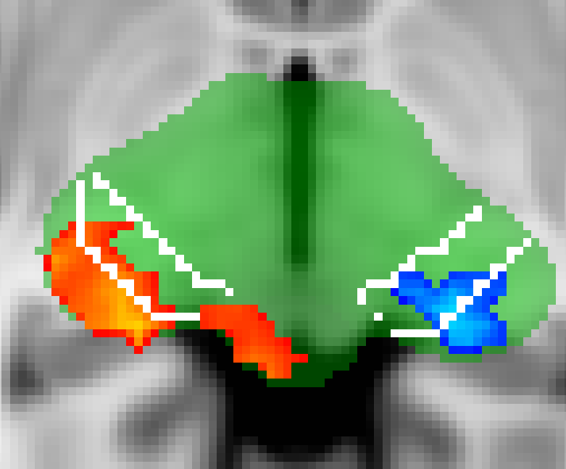
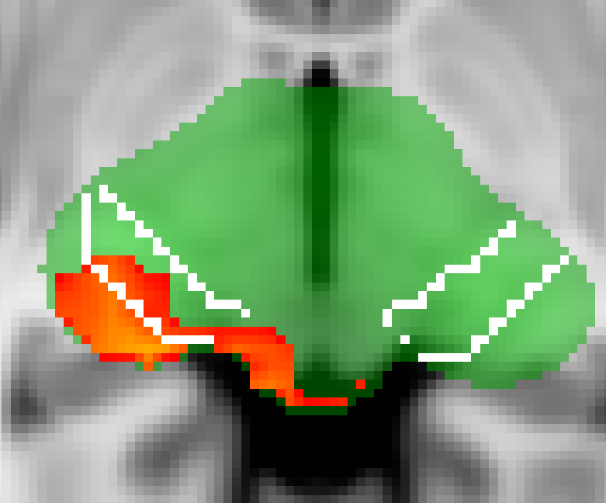
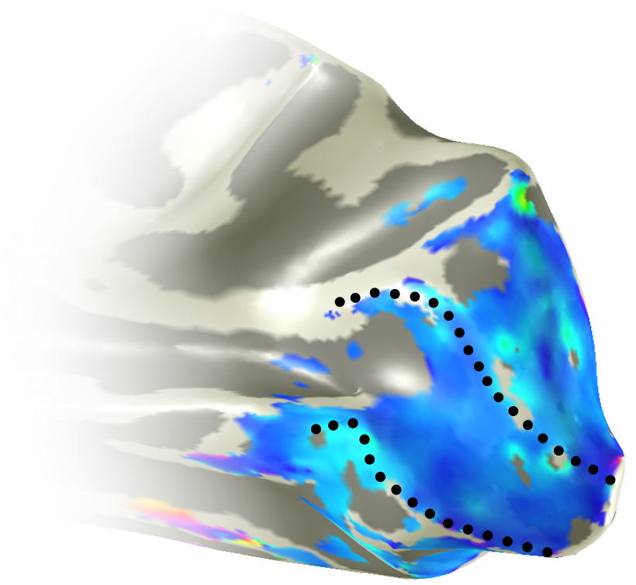
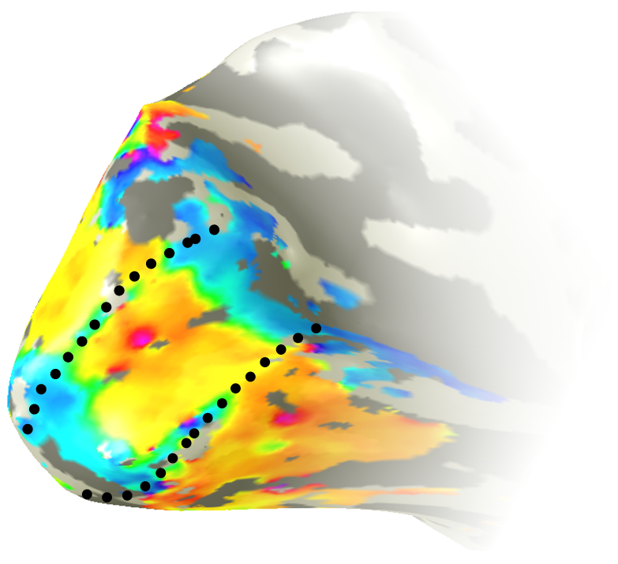
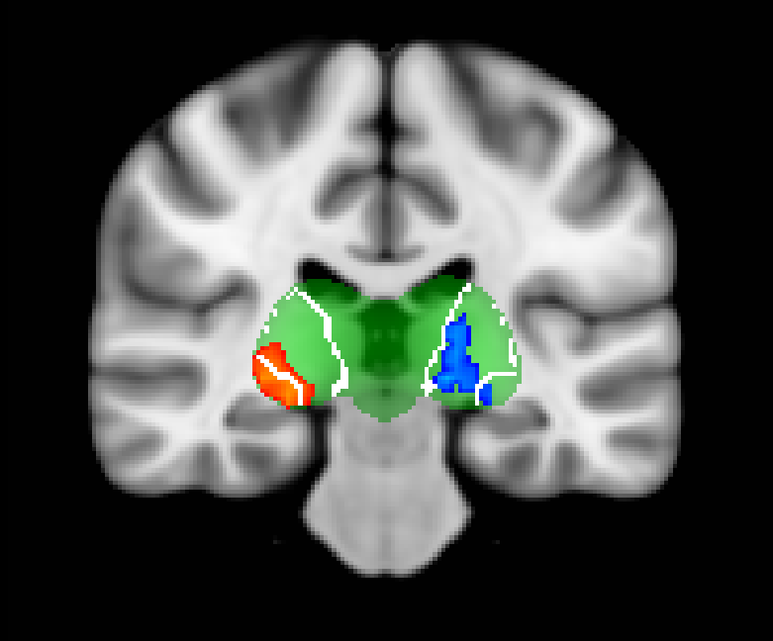
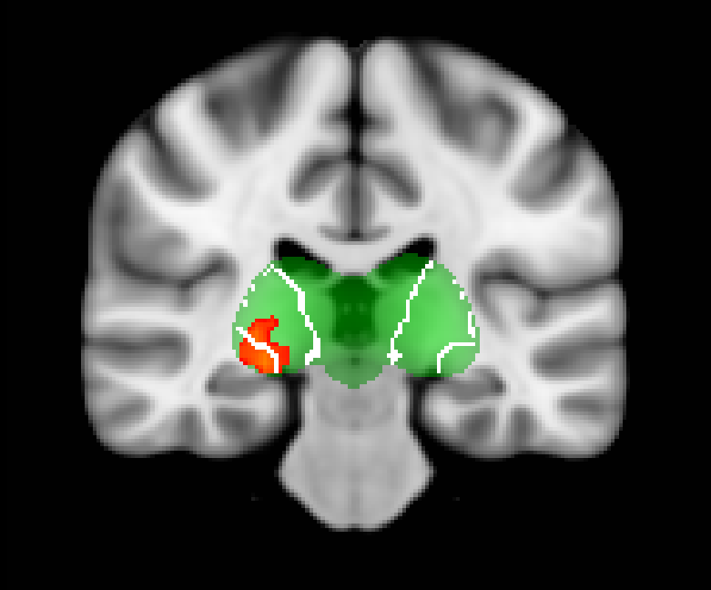
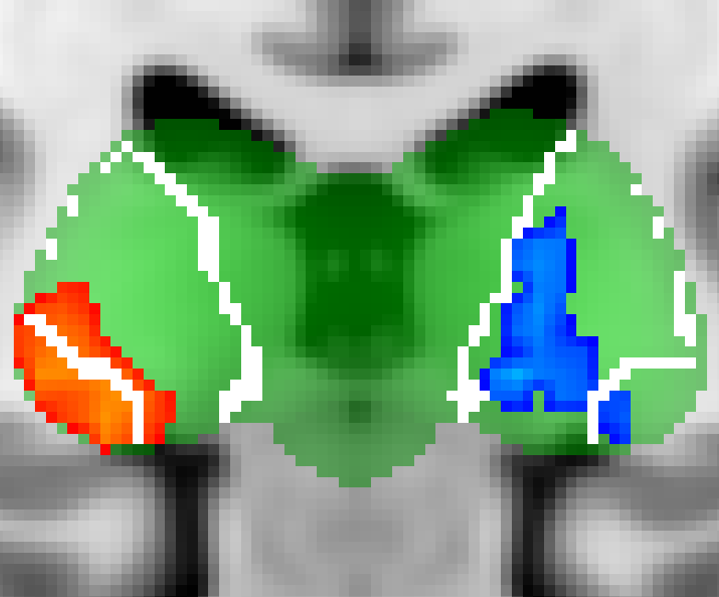
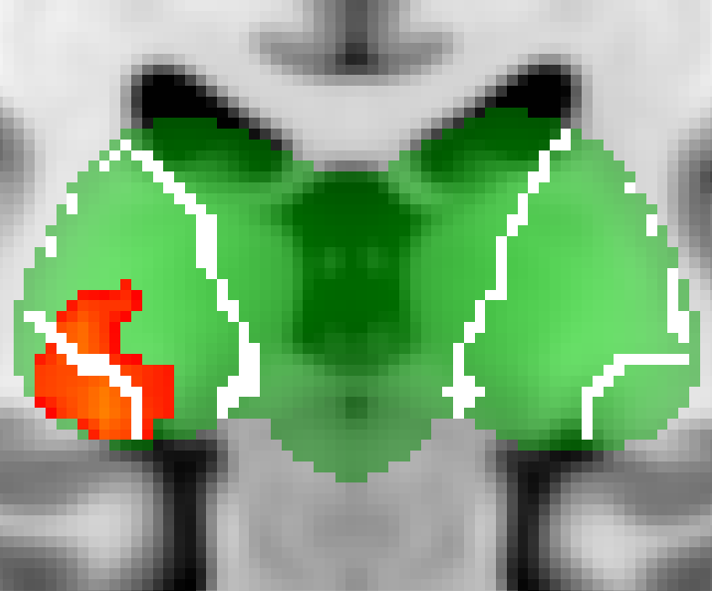
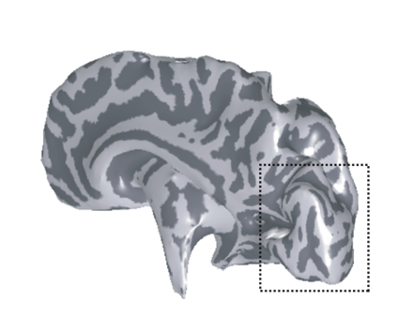
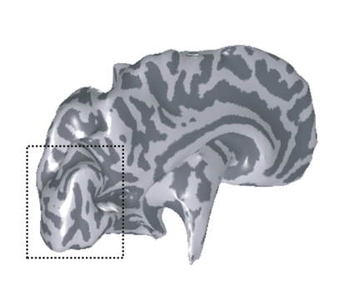
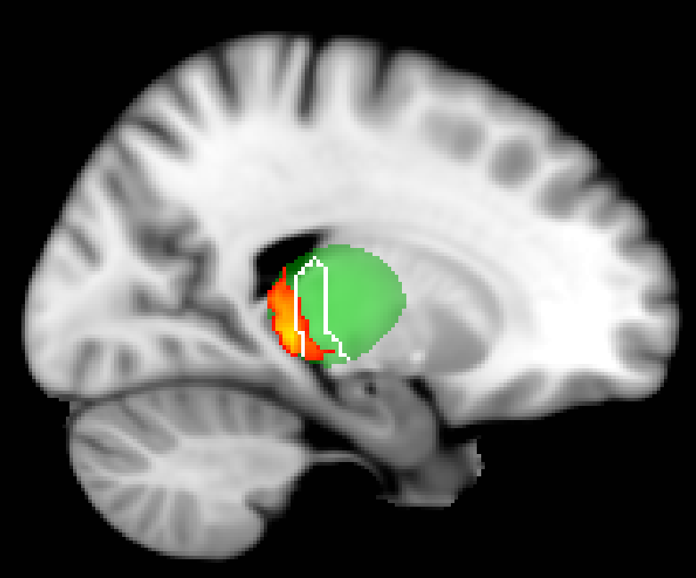

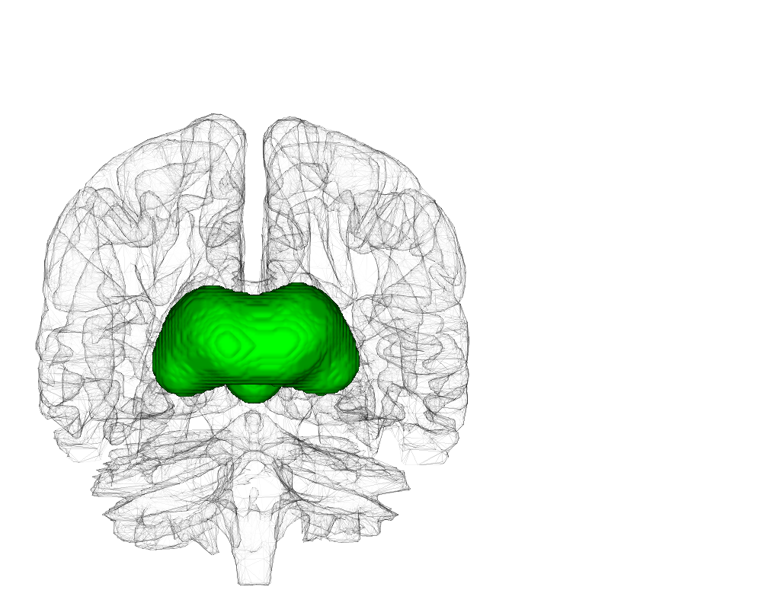
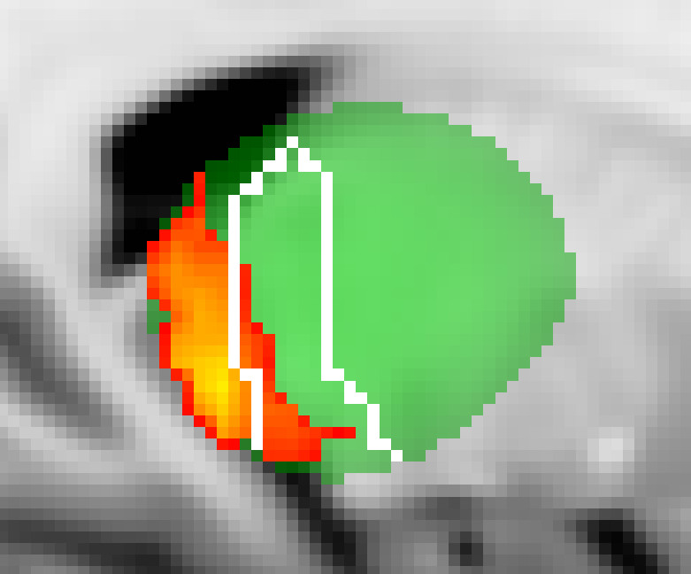
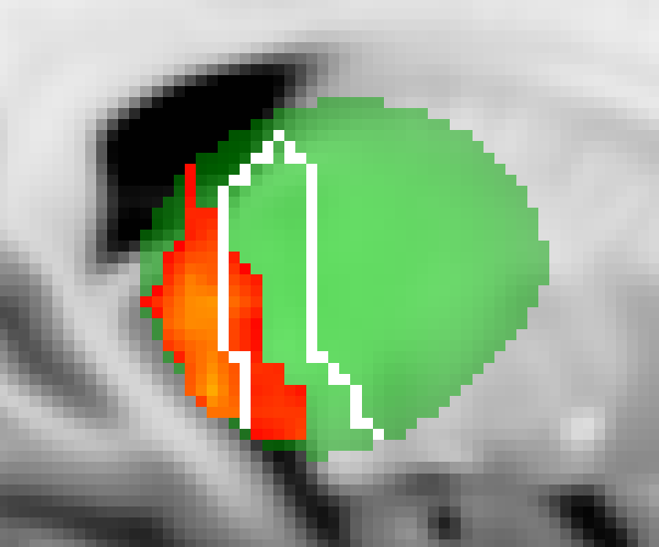
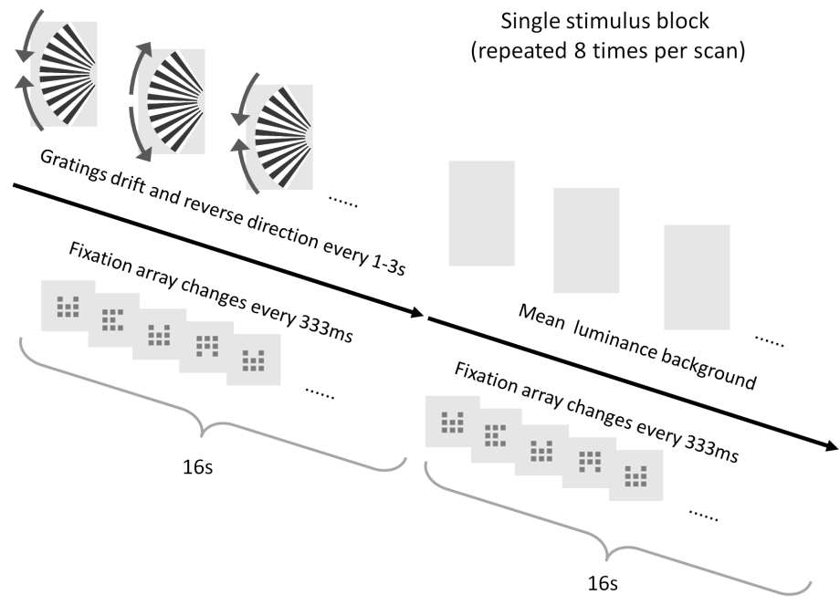
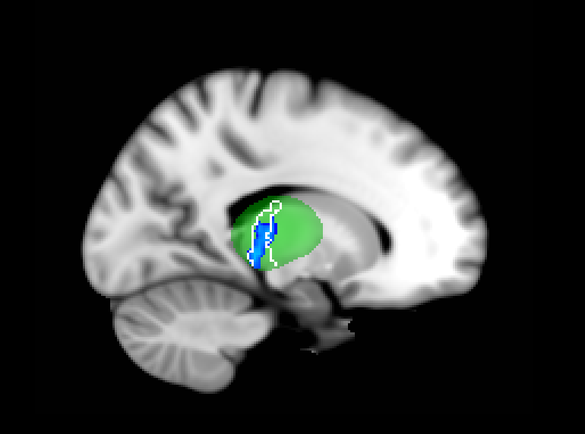
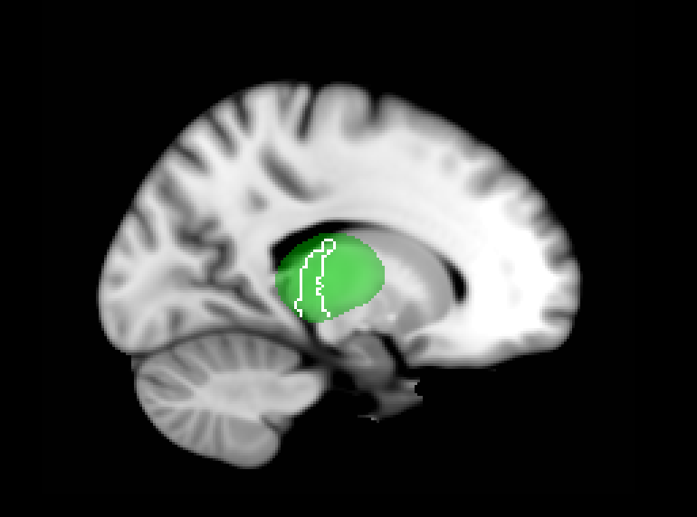
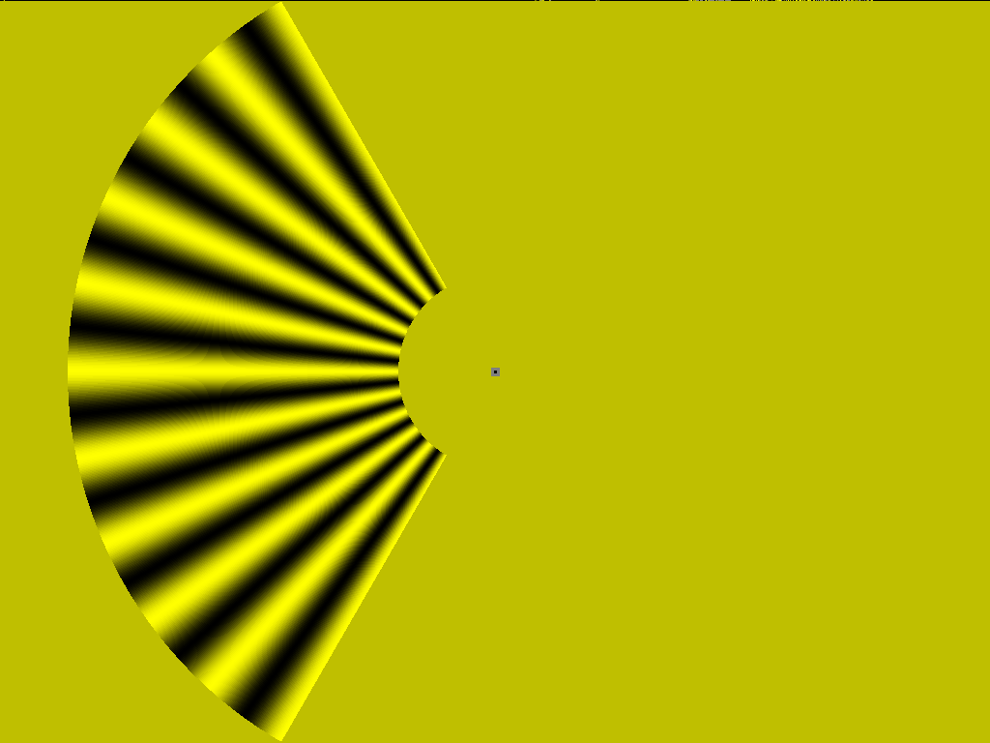
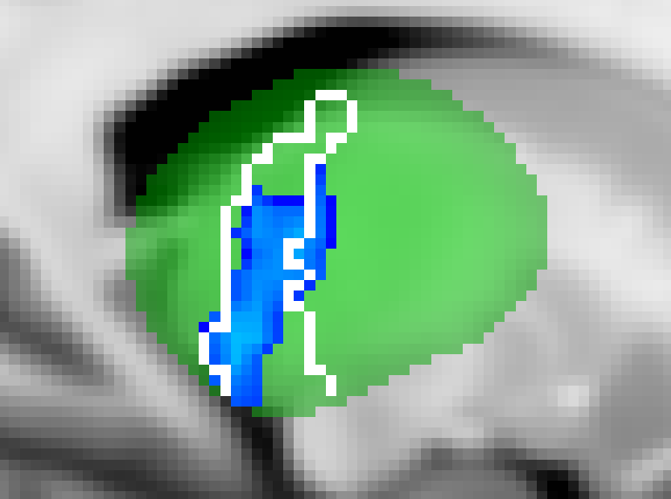
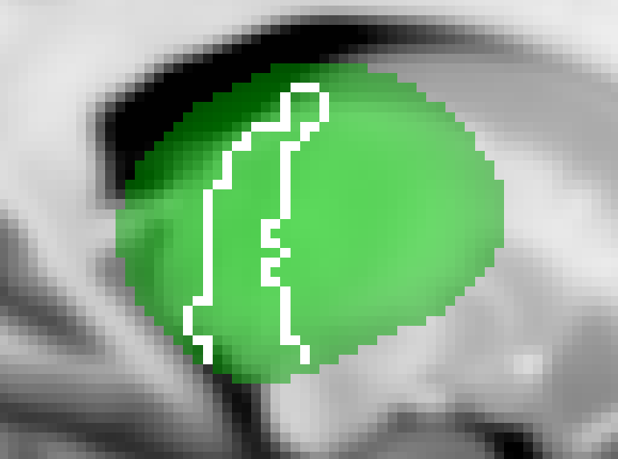
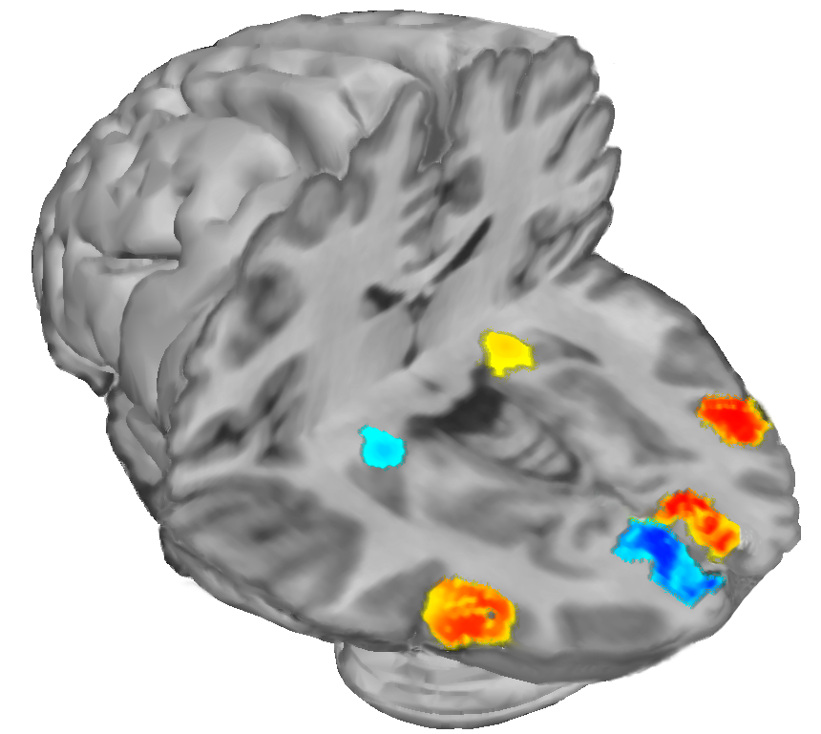
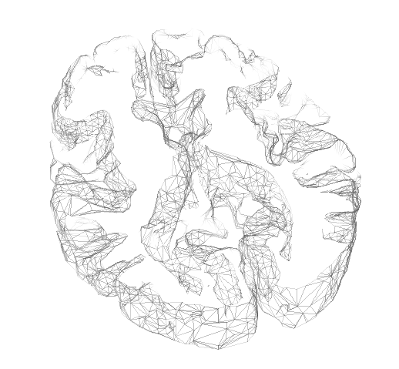
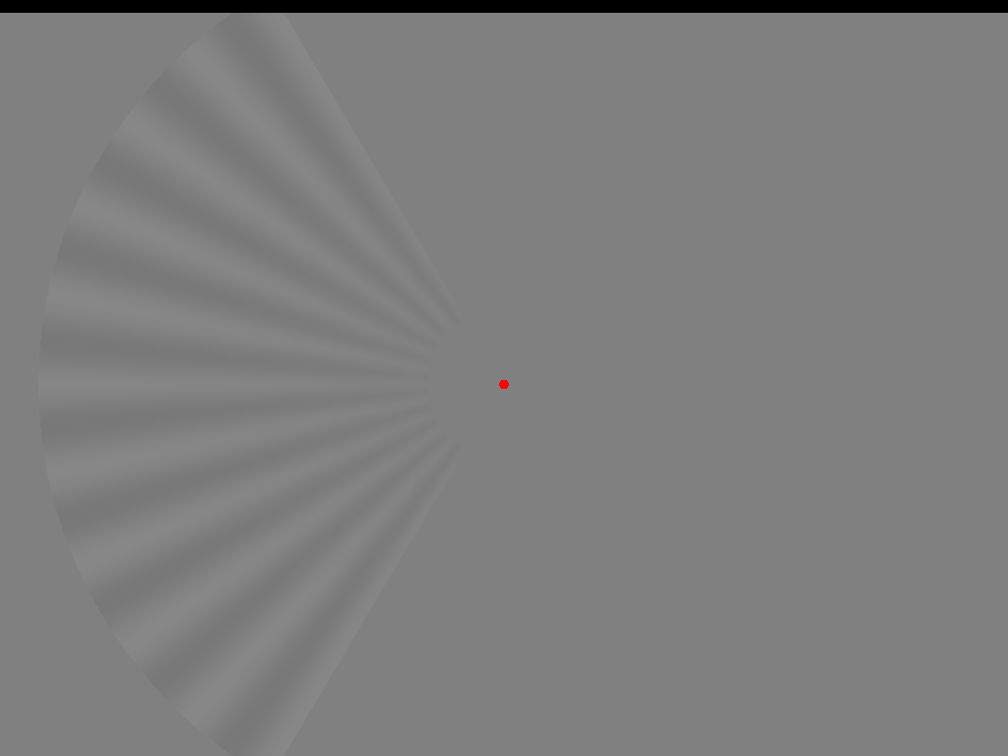
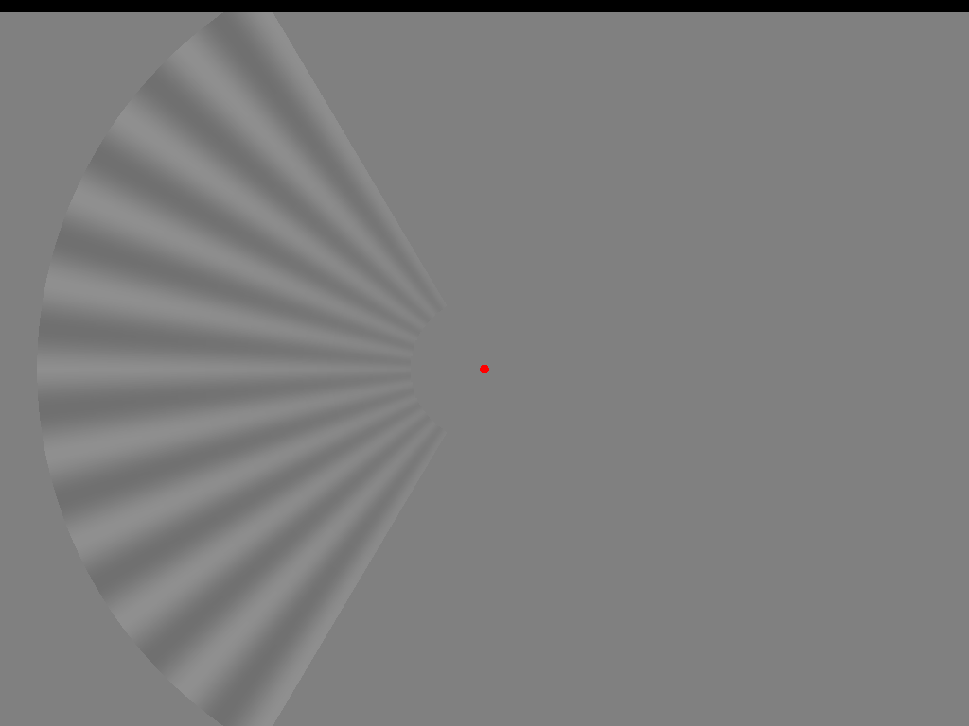
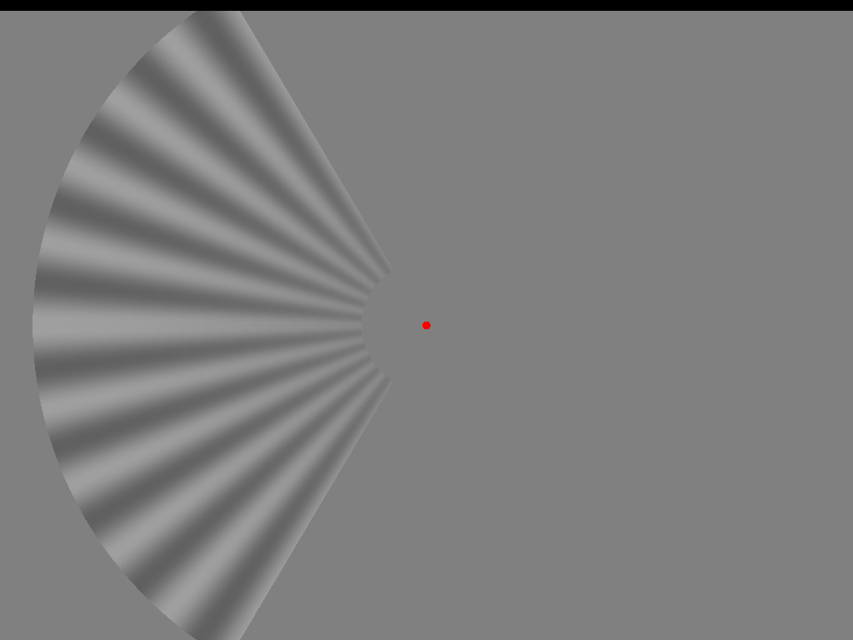
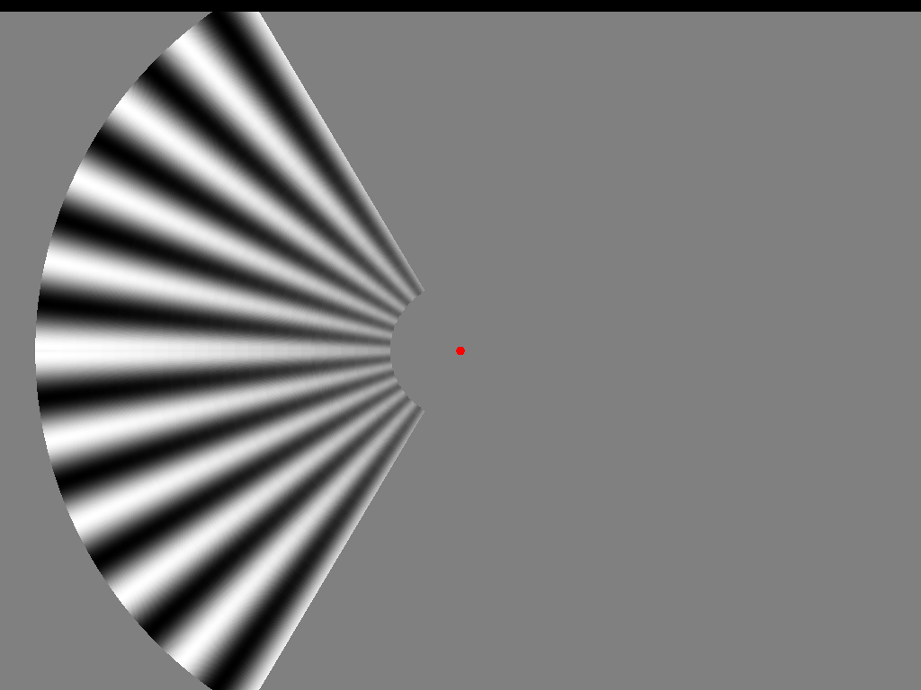
^{36.311} The role of cortical and subcortical suppression in spatial attention.
André D Gouws (andre@ynic.york.ac.uk), Ivan Alvarez, David Watson, Maiko Uesaki, Jess Rodgers, Antony B Morland
Background
The allocation of spatial attention results in enhanced perception at attended locations at the cost of perception at unattended locations. FMRI studies have shown that cortical representations of unattended visual locations can display negative BOLD responses, this ‘suppression’ remains poorly understood. We sought to characterise the suppression expressed in retinotopic representations of unattended locations asking the following questions. What is the task- and stimulus contrast- dependence of suppression? At what stages of the visual hierarchy is suppression expressed?
Results: Region of interest analyses
Group mean BOLD time series obtained from the LGN, V1 and V5 at different stimulus contrasts. Data are given for the LGN (A), V1 (B) and V5 (C). In each panel the data for the hemisphere contralateral and ipsilateral to the stimulus are given in the left and right plots, respectively. Data are plotted for four contrast levels, for stimulus-related task (top row) and stimulus-irrelevant task (bottom row). Error bars indicate standard errors across subjects.
Contrast responses for different visual structures obtained under stimulus-related (black squares, solid black lines) and central (gray circles, dashed gray lines) task conditions. Data are given for the LGN (A), V1 (B) and V5 (C) contralateral (top row) and ipsilateral (bottom row) to the stimulus. (D) Data for the region of V1 in the hemisphere contralateral to the stimulus that flanks the stimulus representation. The lines through the data were generated by fitting a power function to the data as described in the text. Error bars indicate standard errors of the mean across subjects.
Results: “whole brain” GLM of thalamus
Stimulus-related task
Central task
z = -4
Superior colliculus
LGN
Regions with increased BOLD signal while the stimulus is on
y = -27
+5.1
Regions showing decreased BOLD signal while the stimulus is on
+1.63
Left early visual cortex
Right early visual cortex
Typical distribution of positive (yellow-red) and negative (cyan-blue) BOLD in early visual cortex with left visual field stimulation when the left visual field is attended
-1.63
x = 22
Dorsolateral pulvinar
Methods
-3.71
x = -16
Mediodorsal pulvinar
Connects to parietal cortex
Stimulus-related task
Conclusions
Suppression is highly task-dependent and can be measured in early subcortical structures.
Anatomically distinct sub-regions of the pulvinar are differentially activated or suppressed according to the spatial extent of attention and task performed.
Parietal cortex is known to be extensively connected in a feedback loop with the pulvinar, it may influence signals in V1 and the LGN (directly or indirectly).
This network may underlie the ‘salience map’ predicted by Petersen & Shipp, or the “attention field” by Reynolds, Heeger, Boynton and others, although this field would appear to suppress unattended locations.
Central task
6%
We defined regions of interest for LGN, V1 and V5 using separate anatomical or functional scans
8 subjects performed a central of peripheral task while viewing stimulus at 6,12, 25 or 100% contrast
Subjects performed either the central or stimulus-related (peripheral) task for four scans of 8 cycles
4 x 2 repeated measures design (8 sessions)
12%
25%
100%

