Slide 1

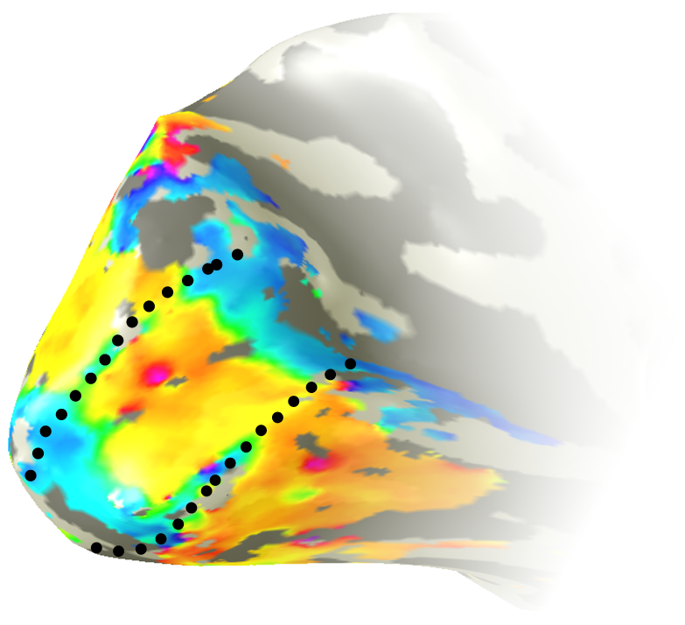
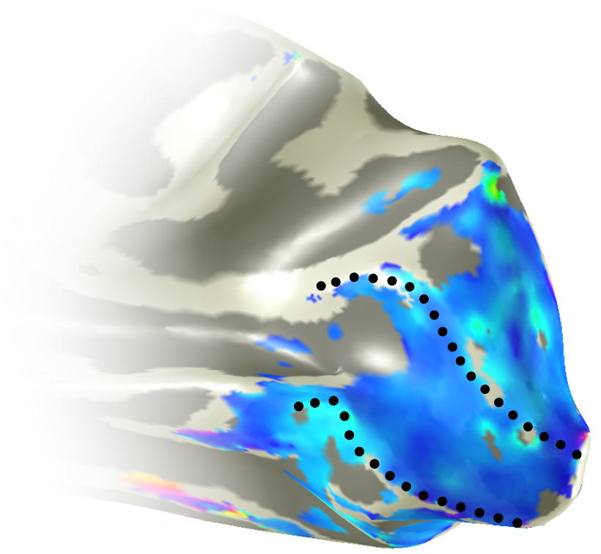
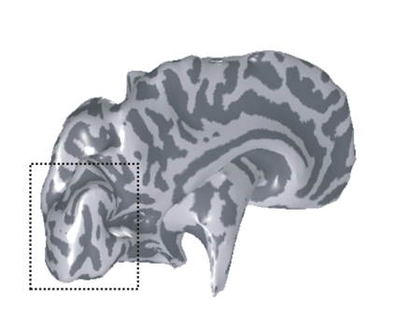
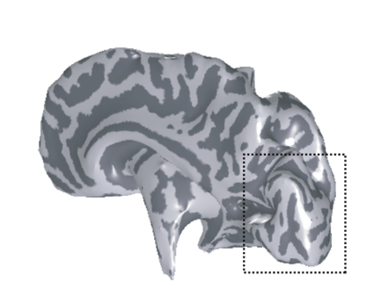
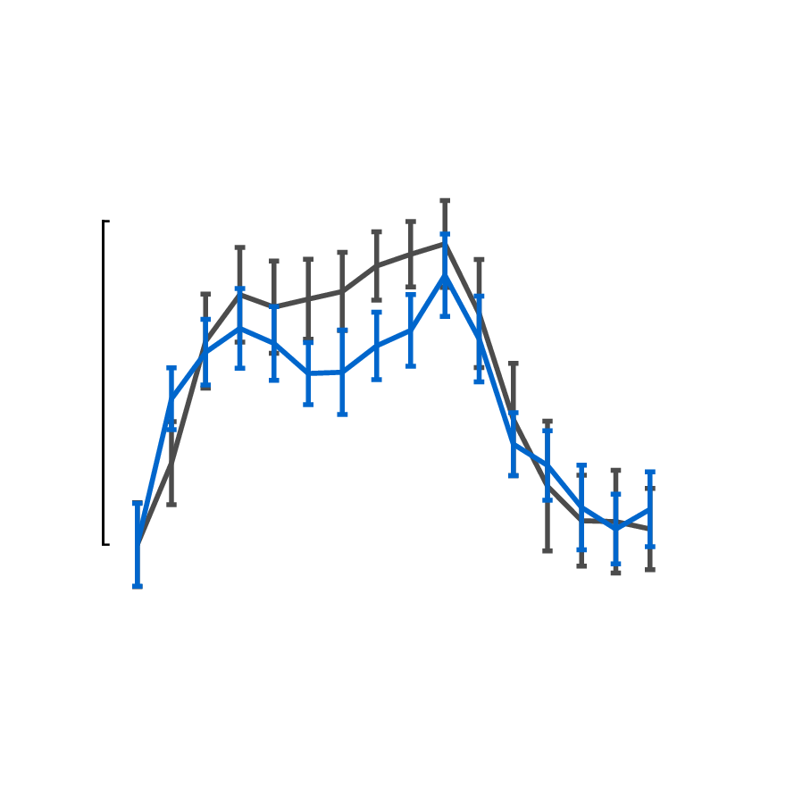
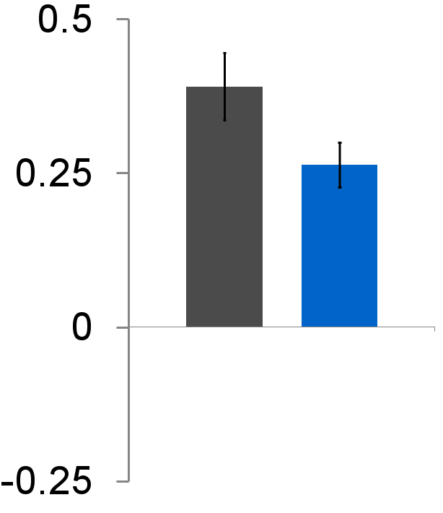
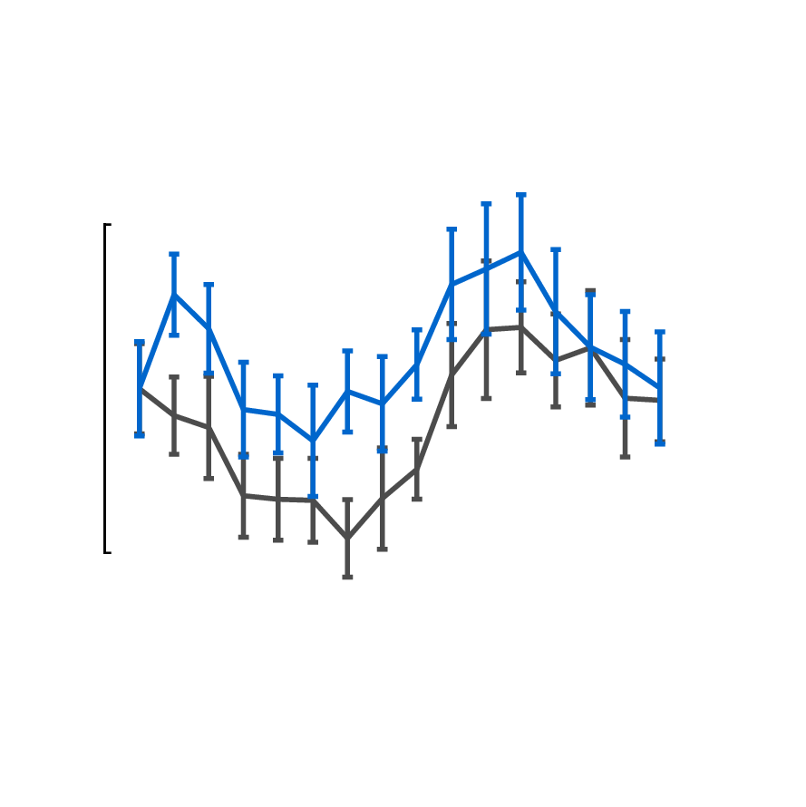
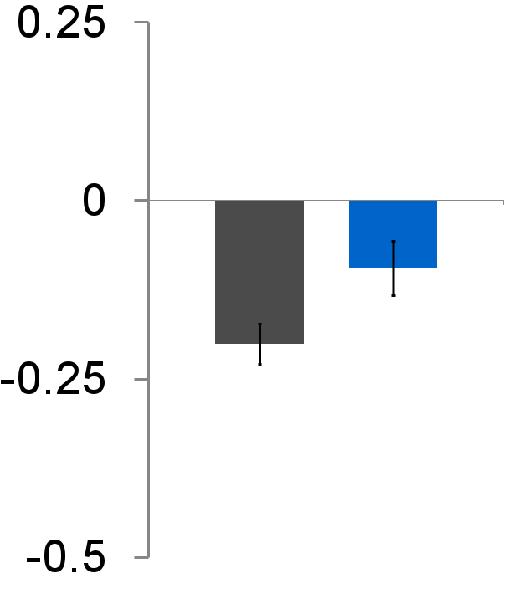
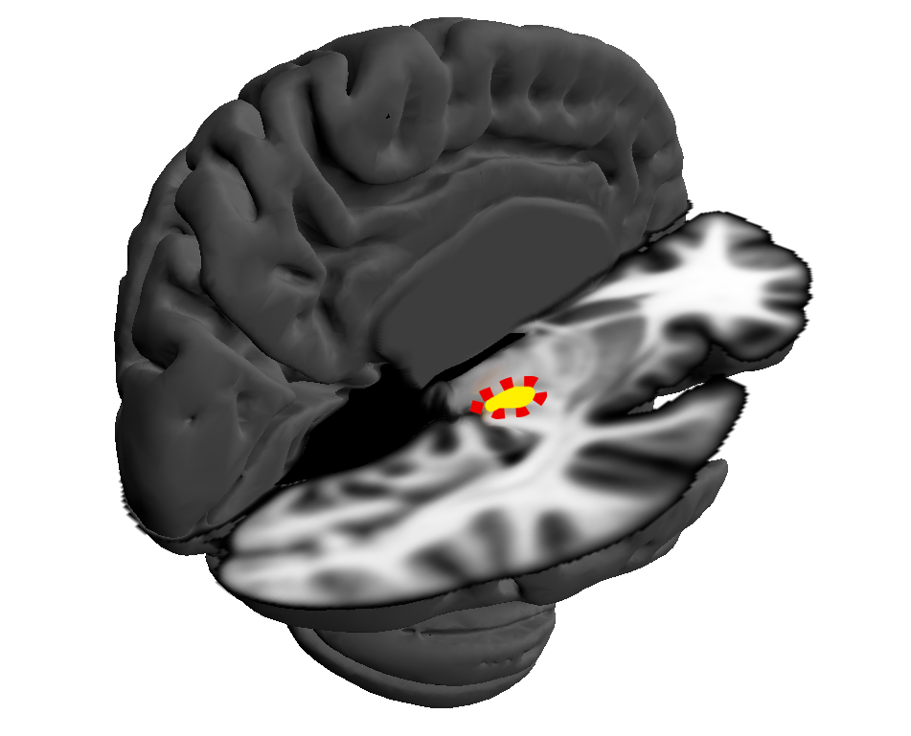
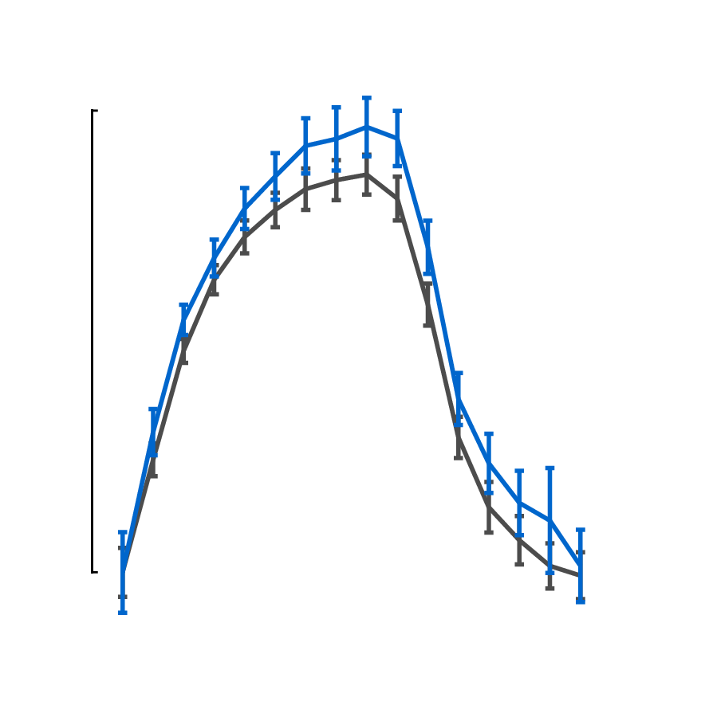
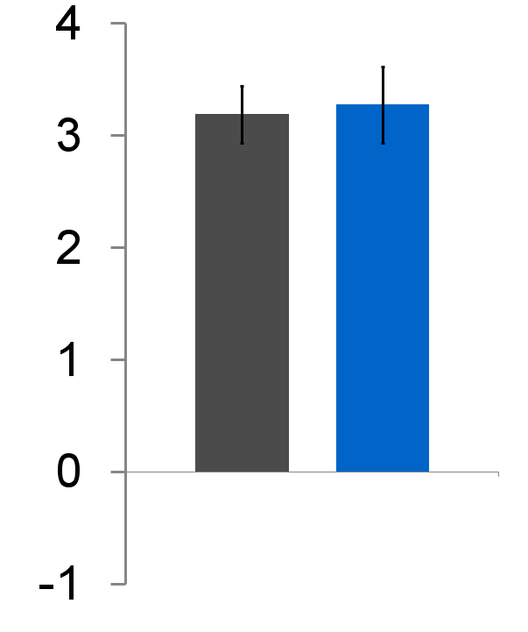
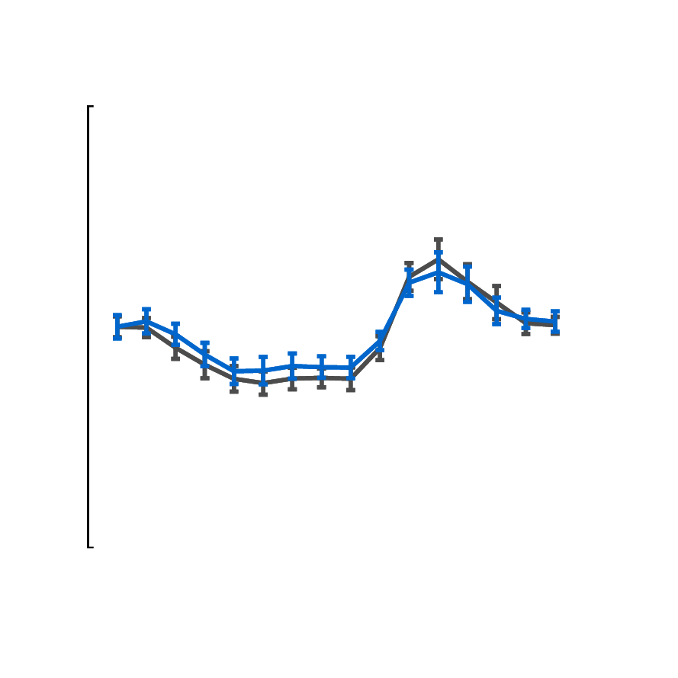
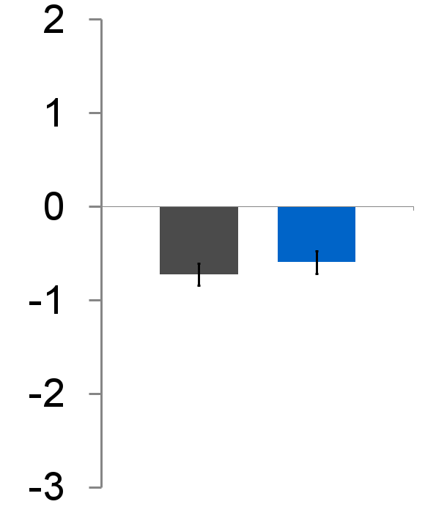
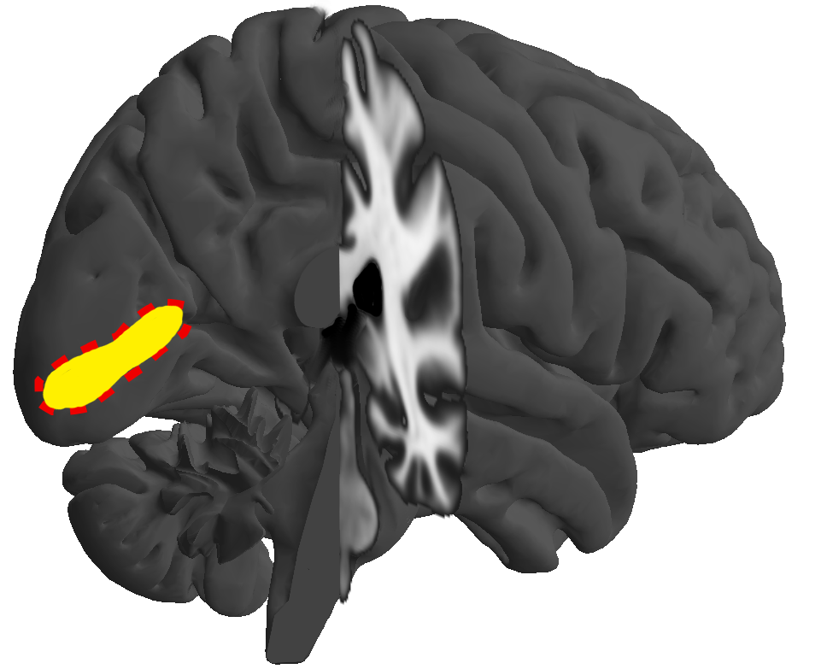
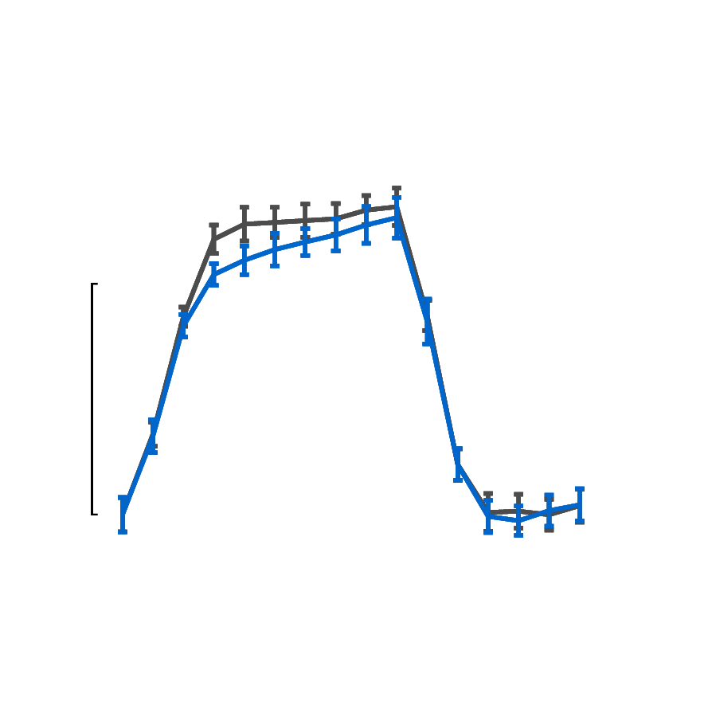
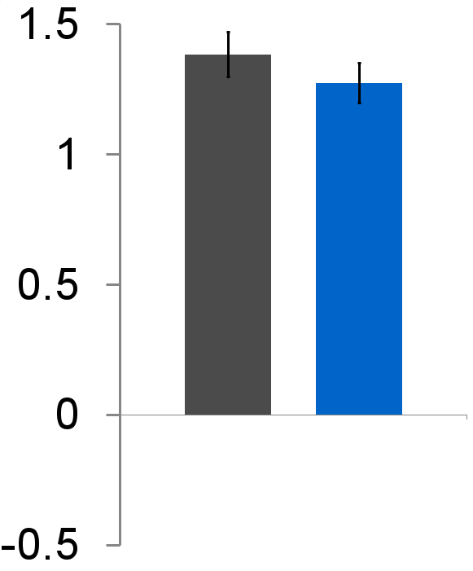
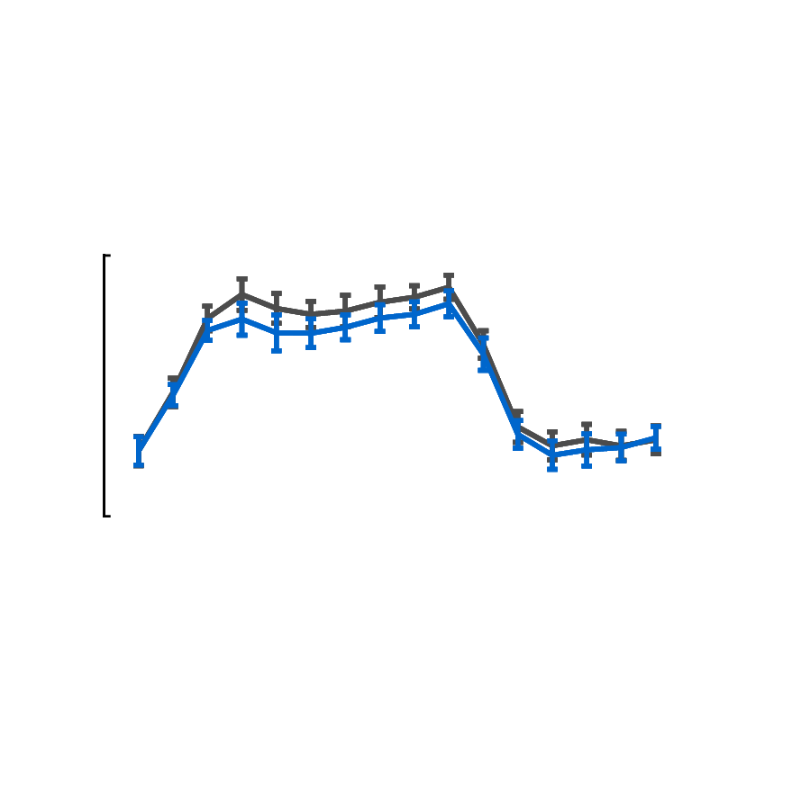
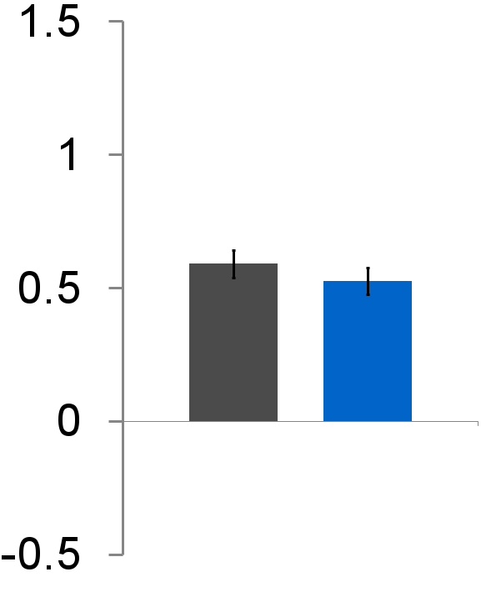
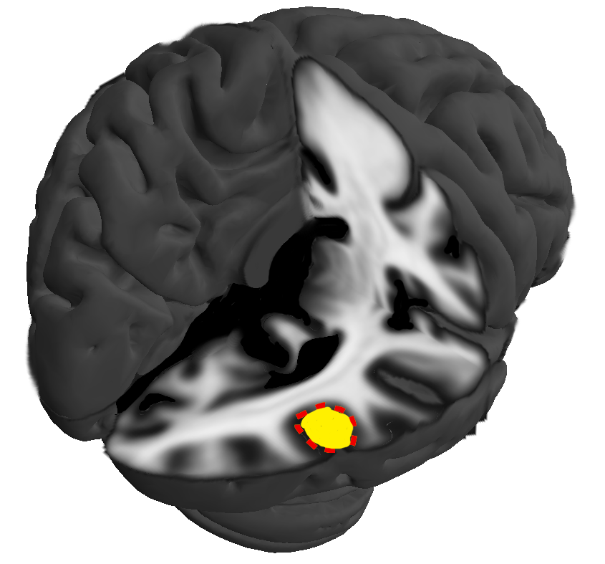


Negative BOLD responses to luminance contrast and chromatic contrast defined stimuli.
A. GOUWS, L. GLOVER, W. SCHALLER, W. STEVEN, M. YATES, I. ALVAREZ, D. WATSON, Y. YU, A. MORLAND;
800.20 / LL11
Background
Positive BOLD responses (PBRs) are often accompanied by both proximal and distal negative BOLD responses (NBRs). Recent work¹ suggests that proximal NBRs can be largely attributed to processing by magnocellular mechanisms. We previously observed distal NBRs in V1 and LGN ipsilateral to a lateralized visual stimulus. These distal NBRs showed task dependent modulation. We modified our paradigm to evaluate magnocellular specificity of distal (inter-hemispheric) NBRs, by presenting either luminance contrast or isoluminant, chromatic contrast gratings.
Data analysis and results
We computed a single time series for each ROI for each experimental run by averaging data across voxels. The time series’ for multiple runs for each condition were then averaged within participant to produce a mean time series for the two conditions for each participant. A general linear model was then applied to the resulting time series (one per condition for each participant). We used the stimulus blocks convolved with (1) a canonical HRF (SPM8⁶, default parameters) and (2) the first temporal derivative of that HRF, as two explanatory variables. The model fits generated parameter estimates for each participant x condition. Repeated measures t-tests were used to compare the parameter estimates across conditions. Time series data were also reduced to a representative response to a single stimulus block by averaging across all blocks and are presented alongside bar graphs showing the group mean and standard error of the parameter estimates. Significant positive BOLD responses were elicited in V1 and LGN contralateral to stimulation, as well as V5 bilaterally for both achromatic and chromatic conditions. Both conditions also produced significant negative BOLD responses in V1 and LGN ipsilateral to stimulation. The effect of condition showed a borderline significance in both LGN and V5 bilaterally, but not in V1.
Regions with increased BOLD signal while the stimulus is on
Regions showing decreased BOLD signal while the stimulus is on
Contralateral
Ipsilateral
Achromatic
Group mean single-cycle time series
GLM parameter estimates
Group mean single-cycle time series
GLM parameter
estimates
Chromatic
Left early visual cortex
Right early visual cortex
LGN
*
Previously reported distribution of positive (yellow-red) and negative (cyan-blue) BOLD in early visual cortex with right visual field stimulation during stimulus related task conditions in a representative participant
*
*
0.5%
0.5%
Methods
The stimulus, a 120° sector of an annulus (inner radius 4°, outer 18°), was equally divided by the horizontal meridian. Upper and lower halves of the stimulus were sinusoidal gratings (sf =.08 cycles/°polar angle, contrast = 100%, f = 6Hz), which always drifted in opposite directions and reversed unpredictably. The stimuli were either yellow-black or equiluminant red-green gratings. Equiluminance was established for the red-green grating for each participant using the minimum motion criterion. Each fMRI run comprised eight, 16s, grating blocks alternating with a uniform yellow field of mean luminance equal to that of the grating. Four runs were presented in each session; luminance and chromatic contrast conditions were tested in different sessions. Participants fixated a central dynamic target for the duration of each experimental run. We acquired fMRI data (128 EPI volumes, TR=2s, 8 cycles per scan, 4 scans per condition, n=10), while participants counted the number of motion reversals. We defined regions of interest with independent data. Retinotopic mapping techniques were used to identify V1^{2,3}; proton density weighted MRI scans⁴ were used to identify the LGN; anatomical landmark criteria⁵ were applied to high resolution T1 weighted images to define V5. Cortical ROIs were also restricted to gray matter following manual tissue segmentation.
% BOLD signal change
PE value of model fit
*
*
32 sec
*
V1
*
*
4%
4%
*
*
V5
*
*
*
*
1%
1%
*
*
* Group mean significantly different from zero (p<0.05, t-test , 2-tailed)
* Difference between group means is significant (p<0.05, t-test , 1-tailed)
Discussion
Negative BOLD responses can be detected distal to positive BOLD responses with both luminance contrast and isoluminant, chromatic contrast gratings. Although the negative BOLD responses in distal, ipsilateral regions appear to reduce with isoluminant chromatic stimuli (and thus as a function of decreased magnocellular input), this reduction mirrors the reduced positive BOLD responses regions contralateral to stimulation. Thus our results are inconsistent with the notion that distal negative BOLD responses are driven solely (or even largely) by magnocellular mechanisms. The data also suggest some level of coupling of the observed responses in the LGN and V5 that may be independent of V1.
References
Wade & Rolwand, 2010. J Neurosci 30:5008--5019.
Sereno et al., 1995. Science 26:889--893.
DeYou et al., 1996. PNAS 93:2382--2386.
Devlin et al, 2006. Neuroimage 30:1112--1120.
Dumoulin et al., 2000. Cereb Cortex 10:454--463.
Friston et al. 1994 Hum. Brain Mapp. 1:153--171.

Slide 2
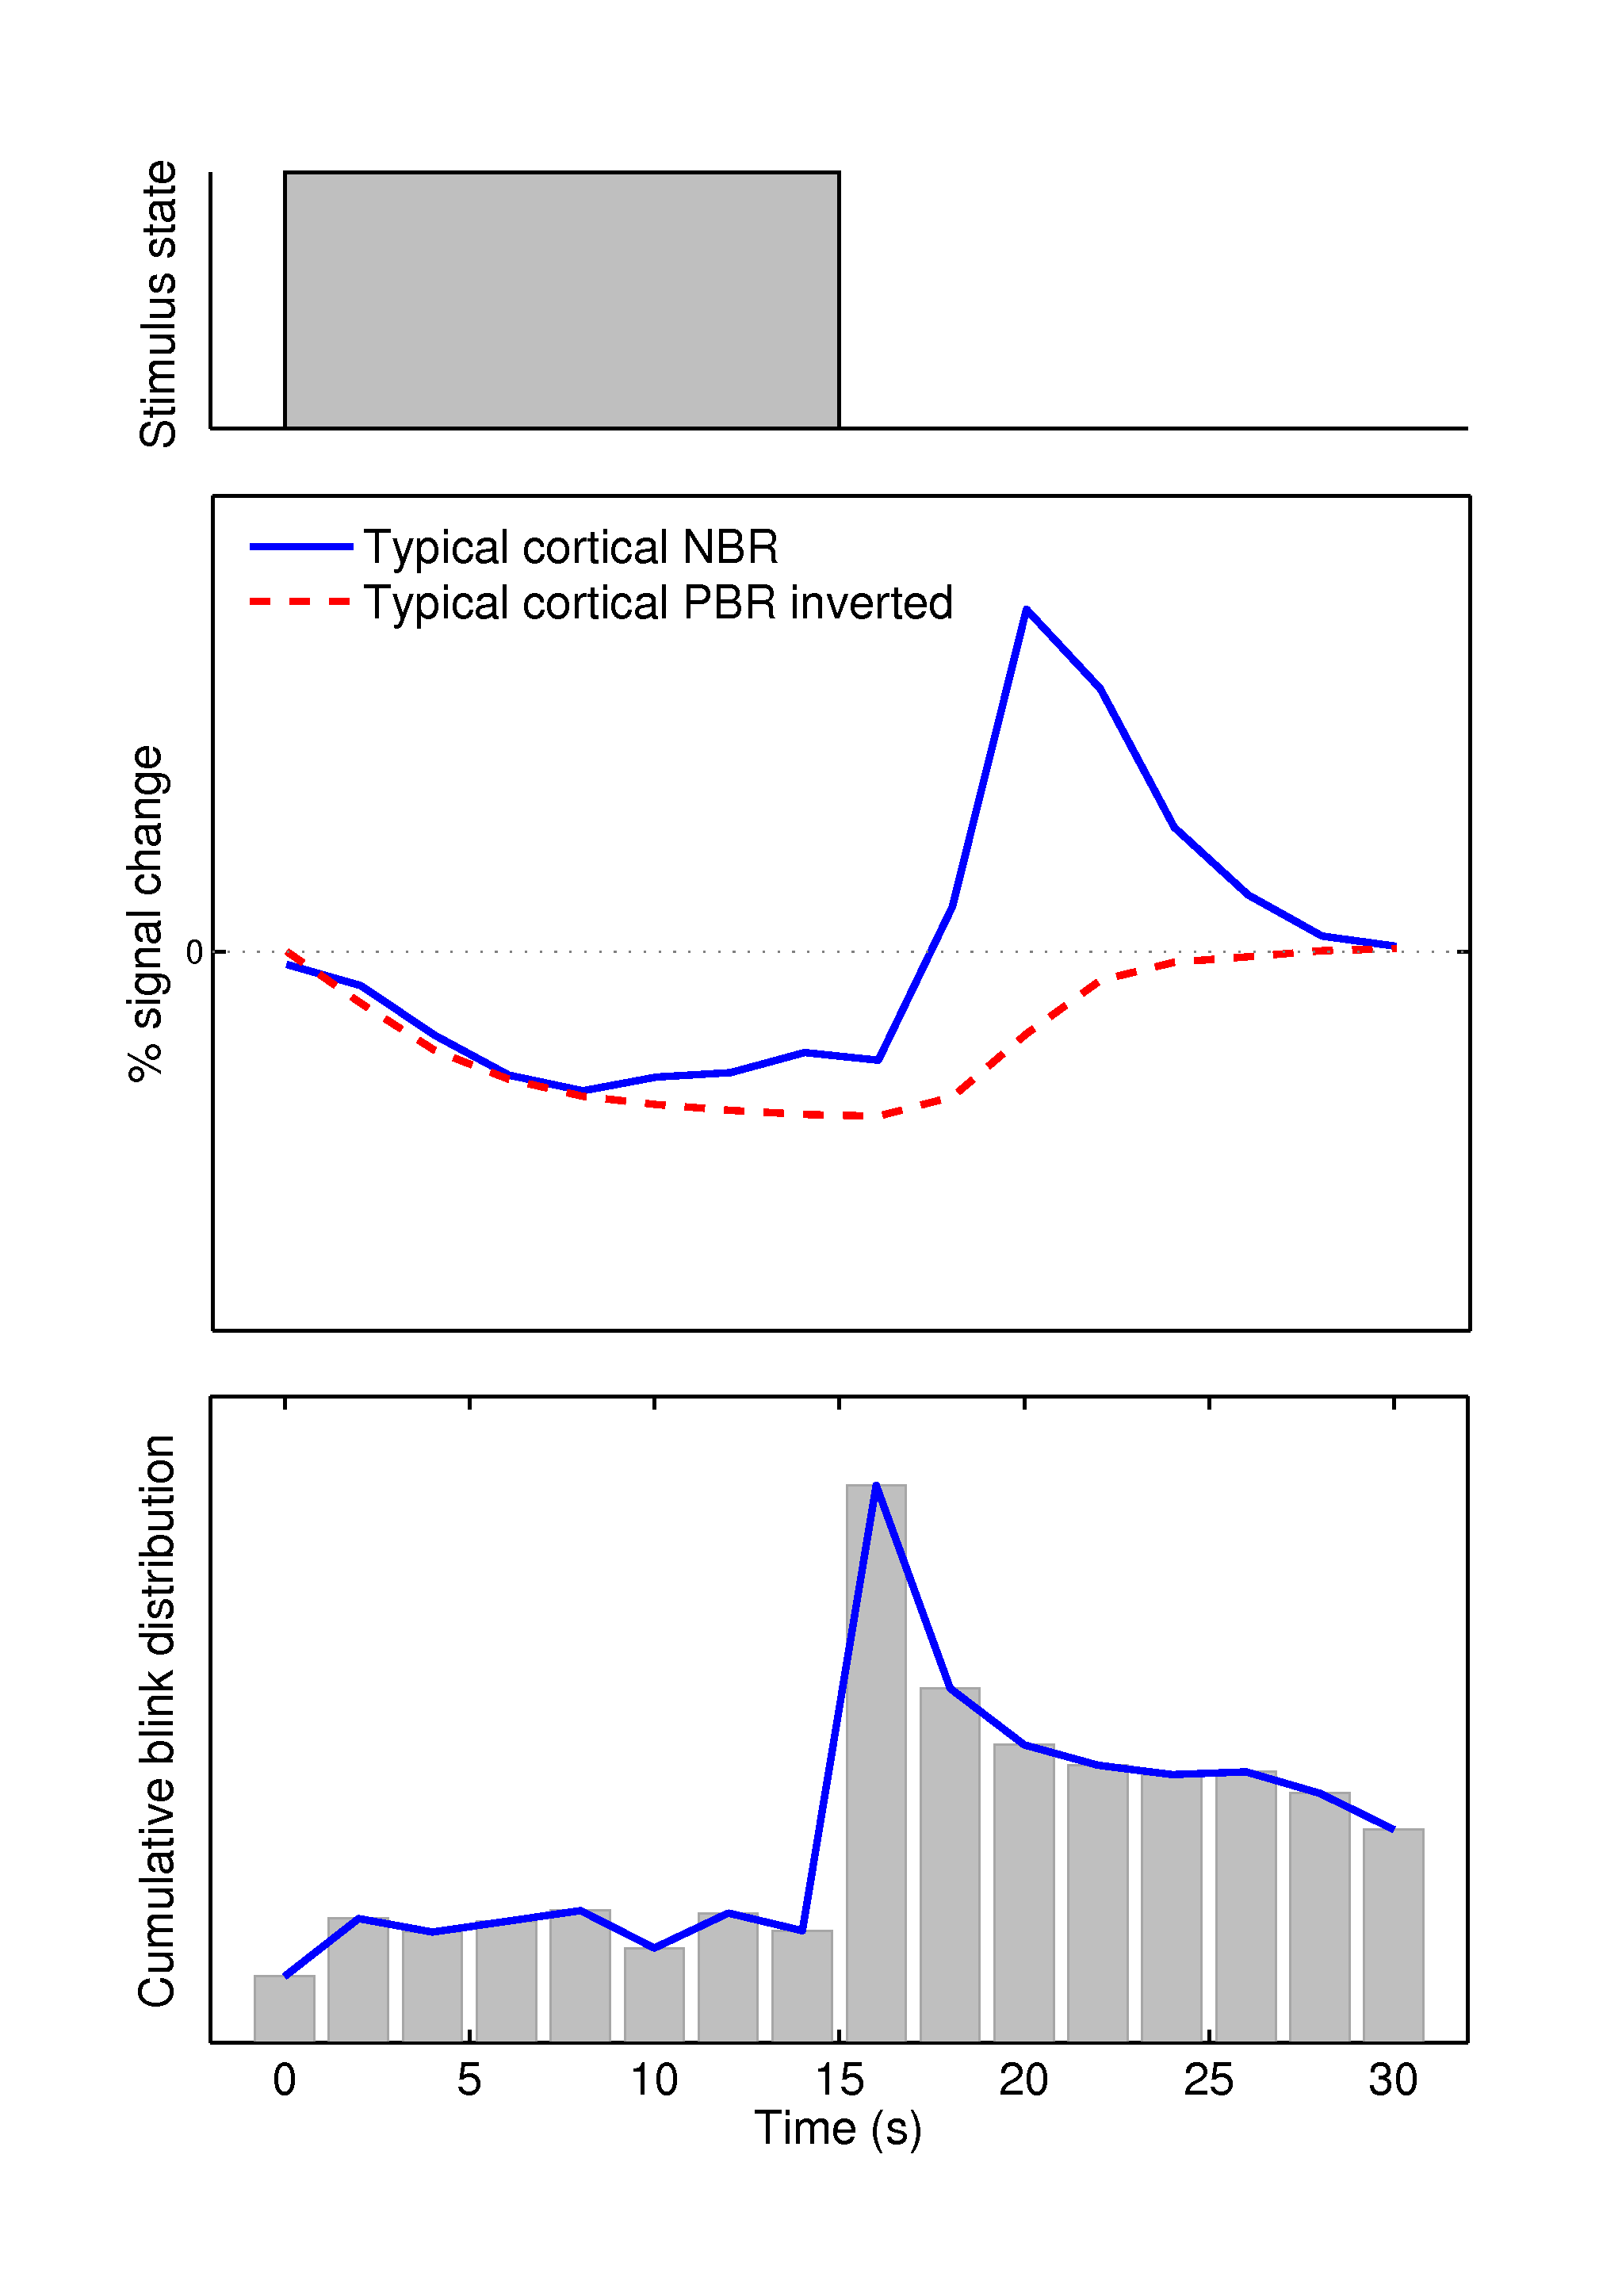
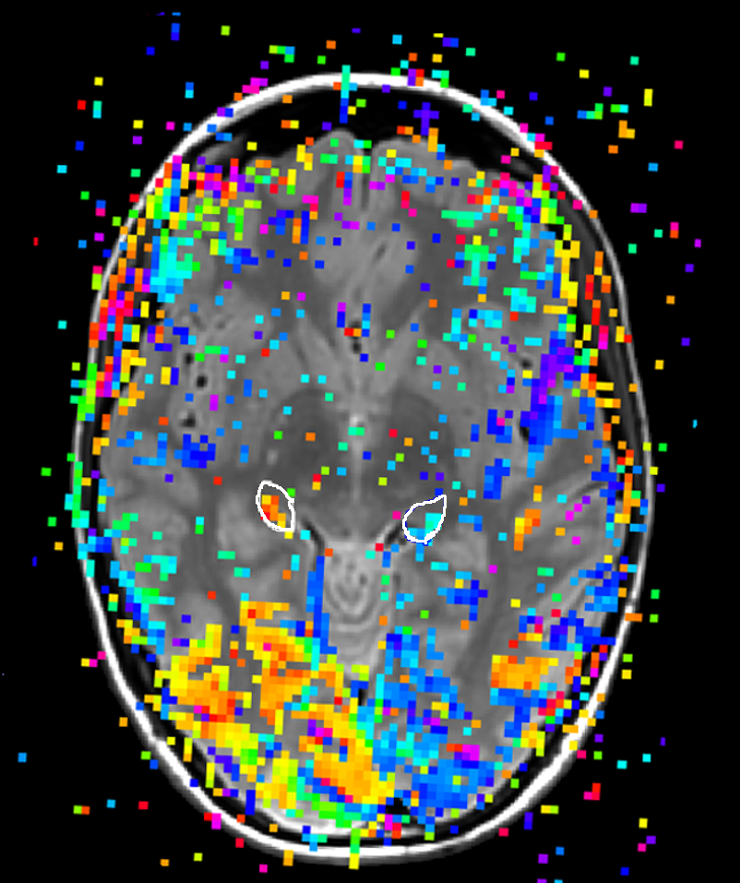
Contrast and task dependence of positive and negative BOLD responses in the human lateral geniculate nucleus and primary visual cortex.
A. D. GOUWS, J. RODGERS, M. HYMERS, A. B. MORLAND
571.30/FF1
Background
Positive BOLD responses (PBRs) are often accompanied by both proximal and distal negative BOLD responses (NBRs). Recent work¹ suggests that proximal NBRs can be largely attributed to processing by magnocellular mechanisms. We previously observed distal NBRs in V1 and LGN ipsilateral to a lateralized visual stimulus. These distal NBRs showed task dependent modulation. We modified our paradigm to evaluate magnocellular specificity of distal (inter-hemispheric) NBRs, by presenting either luminance contrast or isoluminant, chromatic contrast gratings.
Regions with increased BOLD signal while the stimulus is on
Regions showing decreased BOLD signal while the stimulus is on
Left early visual cortex
Right early visual cortex
Previously reported distribution of positive (yellow-red) and negative (cyan-blue) BOLD in early visual cortex with right visual field stimulation during stimulus related task conditions in a representative participant
Methods
The stimulus, a 120° sector of an annulus (inner radius 4°, outer 18°), was equally divided by the horizontal meridian. Upper and lower halves of the stimulus were sinusoidal gratings (sf =.08 cycles/°polar angle, contrast = 100%, f = 6Hz), which always drifted in opposite directions and reversed unpredictably. The stimuli were either yellow-black or equiluminant red-green gratings. Equiluminance was established for the red-green grating for each participant using the minimum motion criterion. Each fMRI run comprised eight, 16s, grating blocks alternating with a uniform yellow field of mean luminance equal to that of the grating. Four runs were presented in each session; luminance and chromatic contrast conditions were tested in different sessions. Participants fixated a central dynamic target for the duration of each experimental run. We acquired fMRI data (128 EPI volumes, TR=2s, 8 cycles per scan, 4 scans per condition, n=10), while participants counted the number of motion reversals. We defined regions of interest with independent data. Retinotopic mapping techniques were used to identify V1^{2,3}; proton density weighted MRI scans⁴ were used to identify the LGN; anatomical landmark criteria⁵ were applied to high resolution T1 weighted images to define V5. Cortical ROIs were also restricted to gray matter following manual tissue segmentation.

