Slide 1

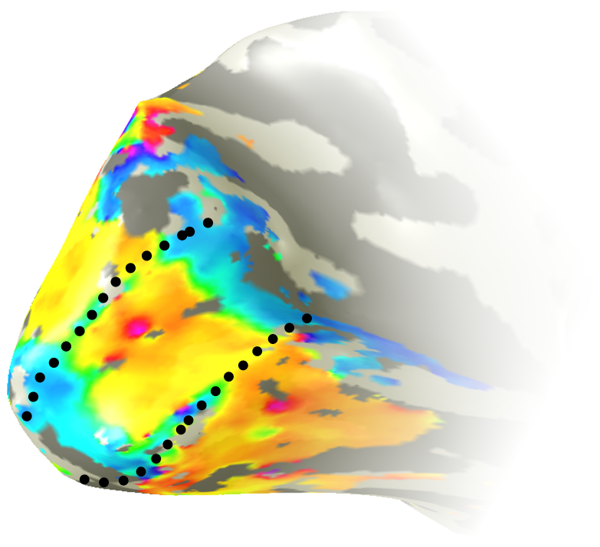
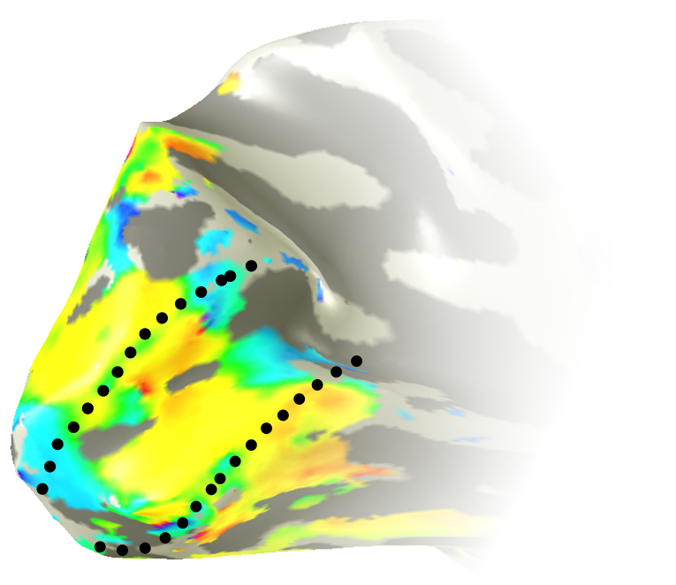
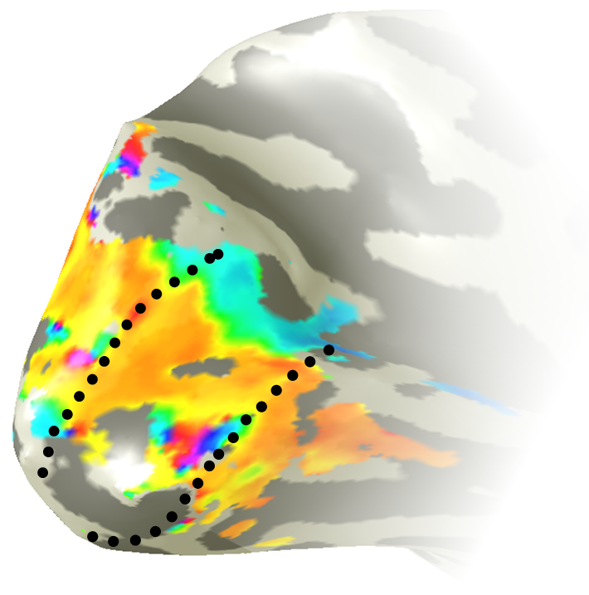
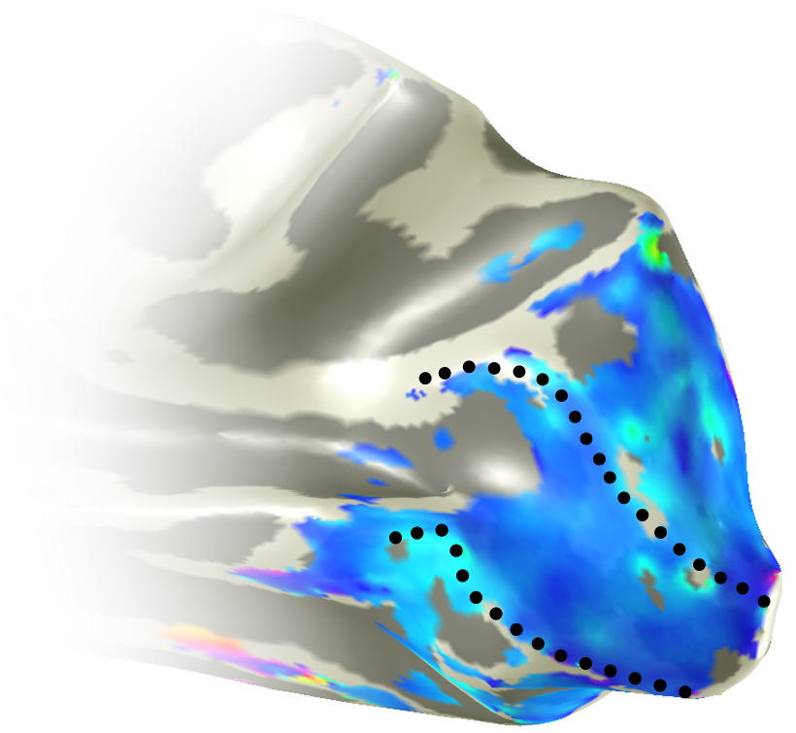
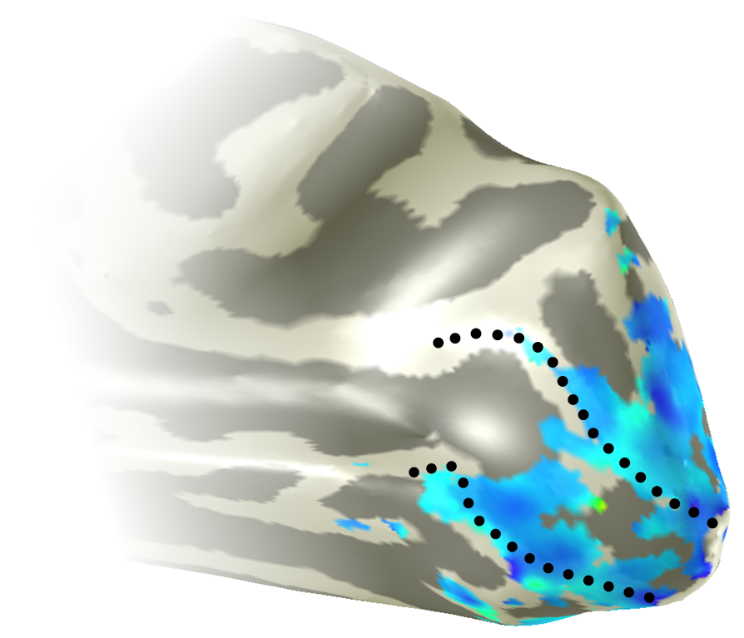
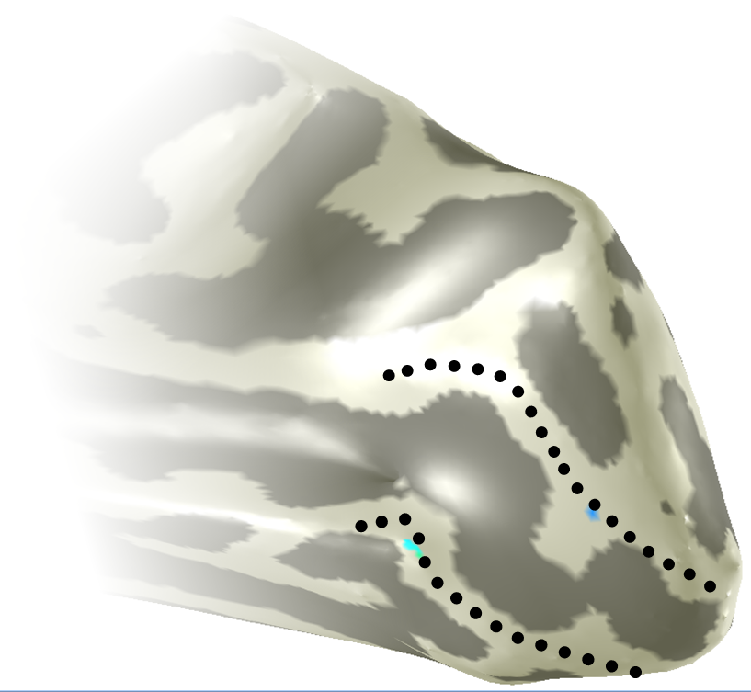
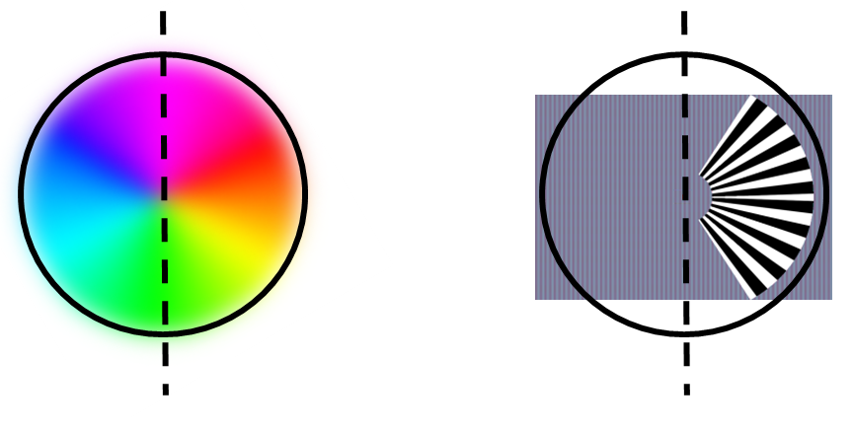
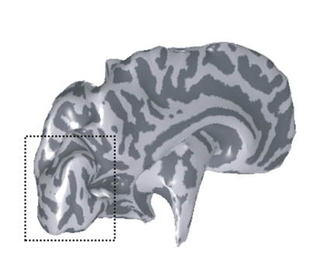
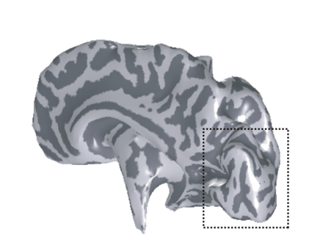
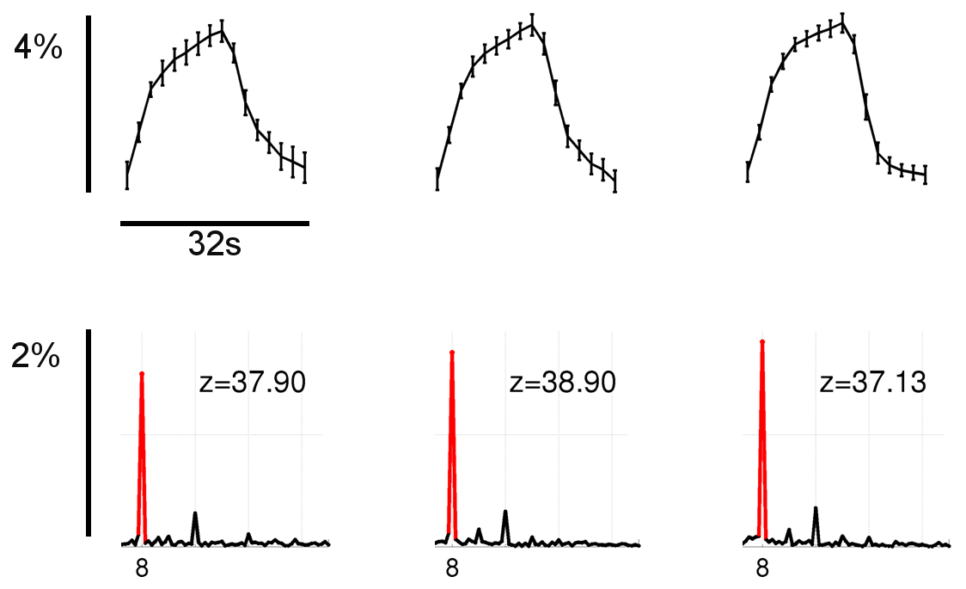
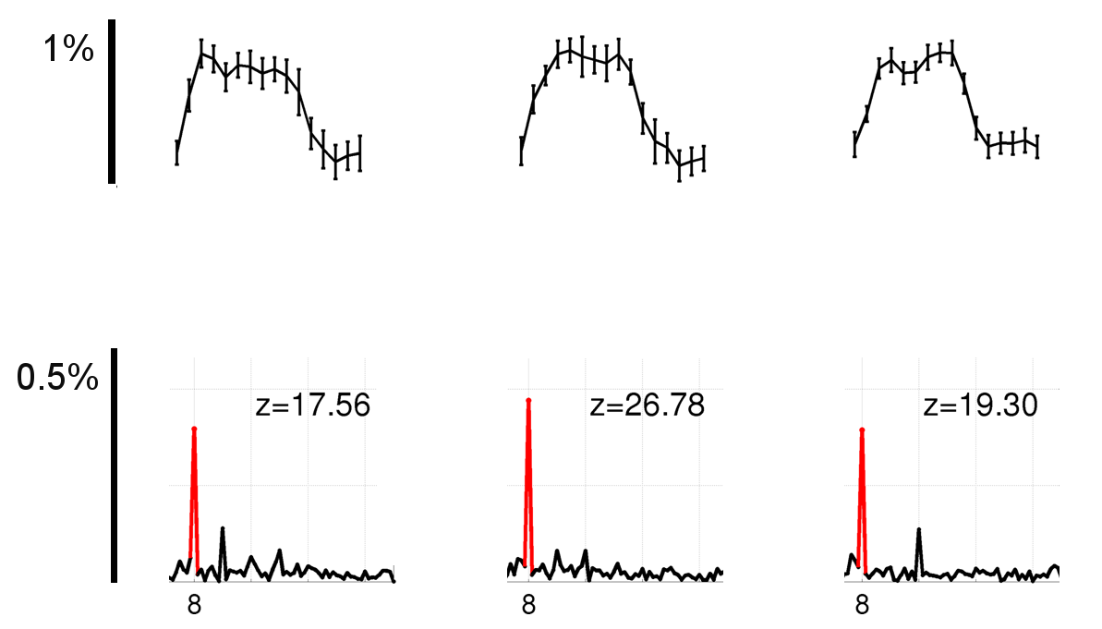
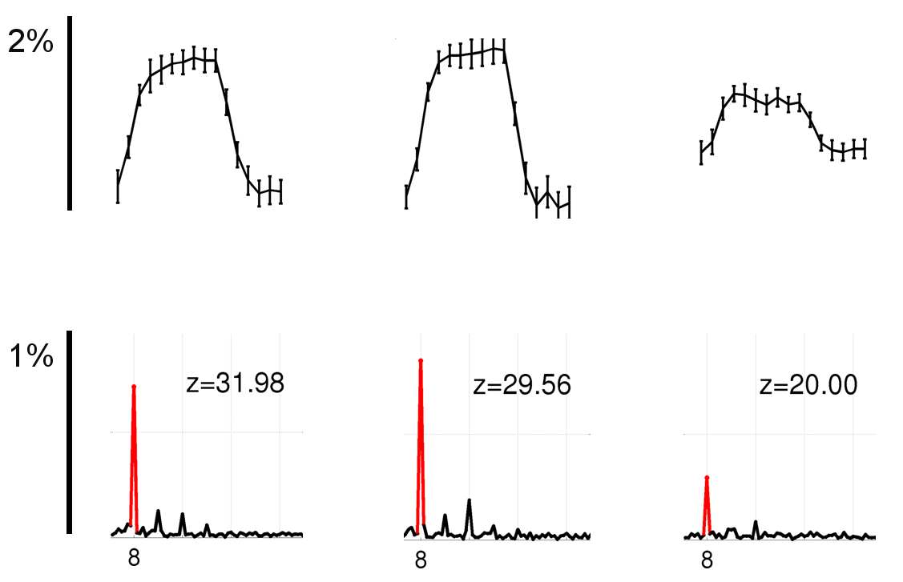
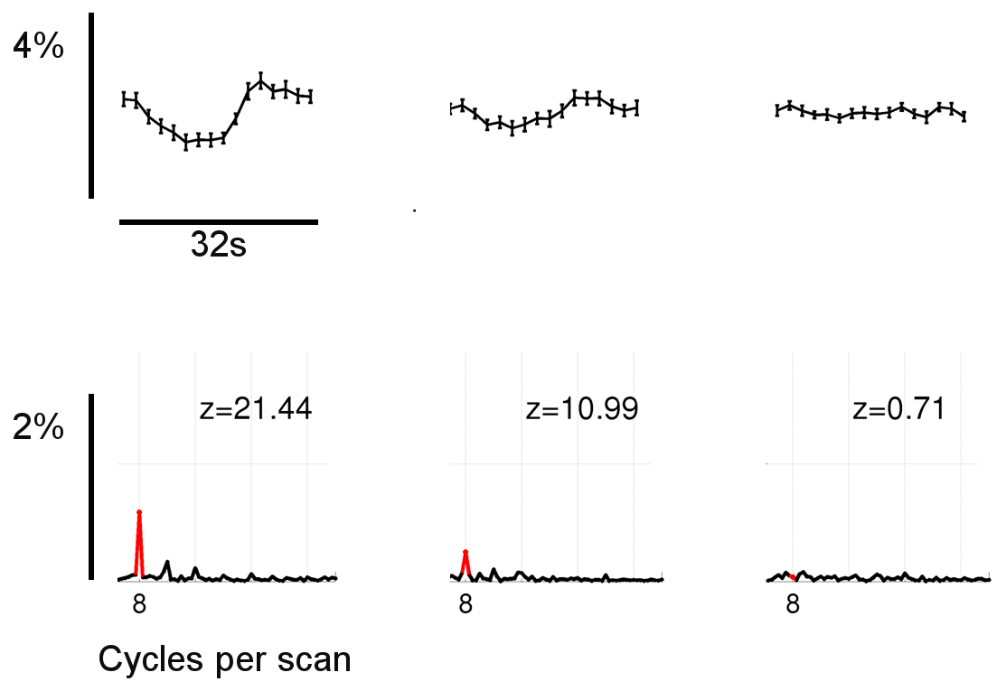
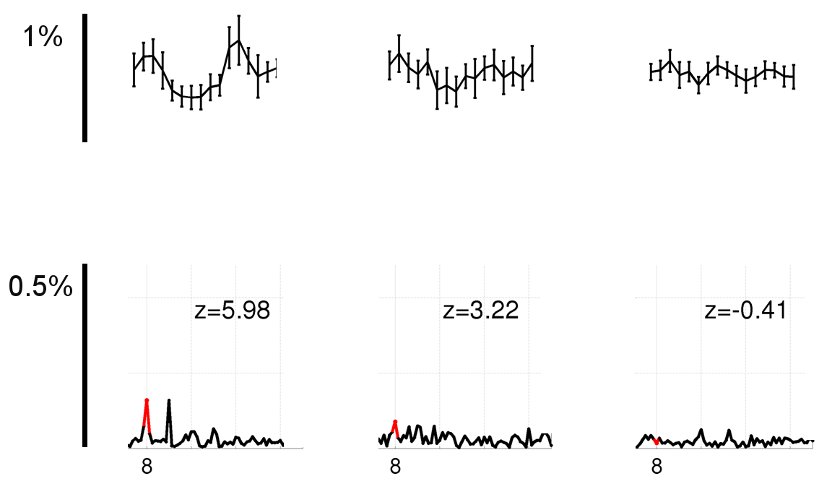
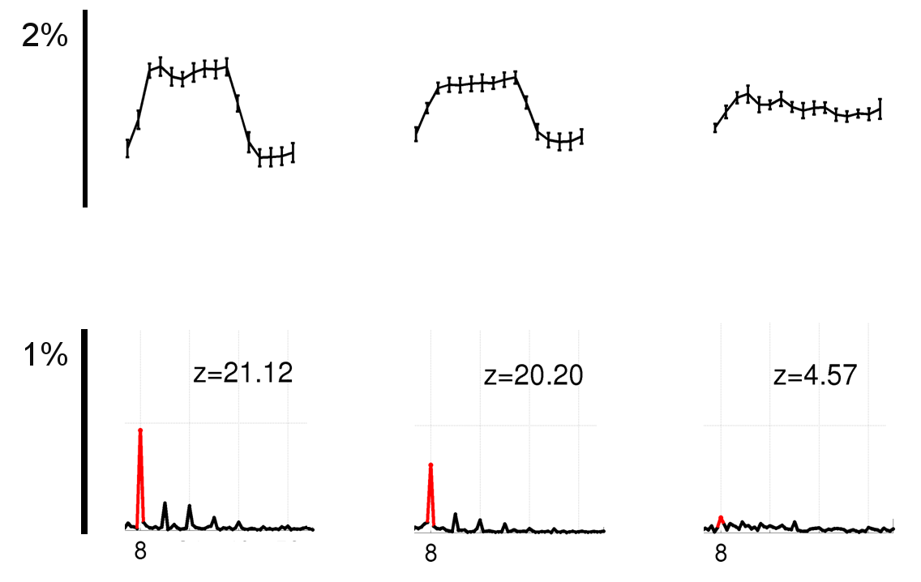
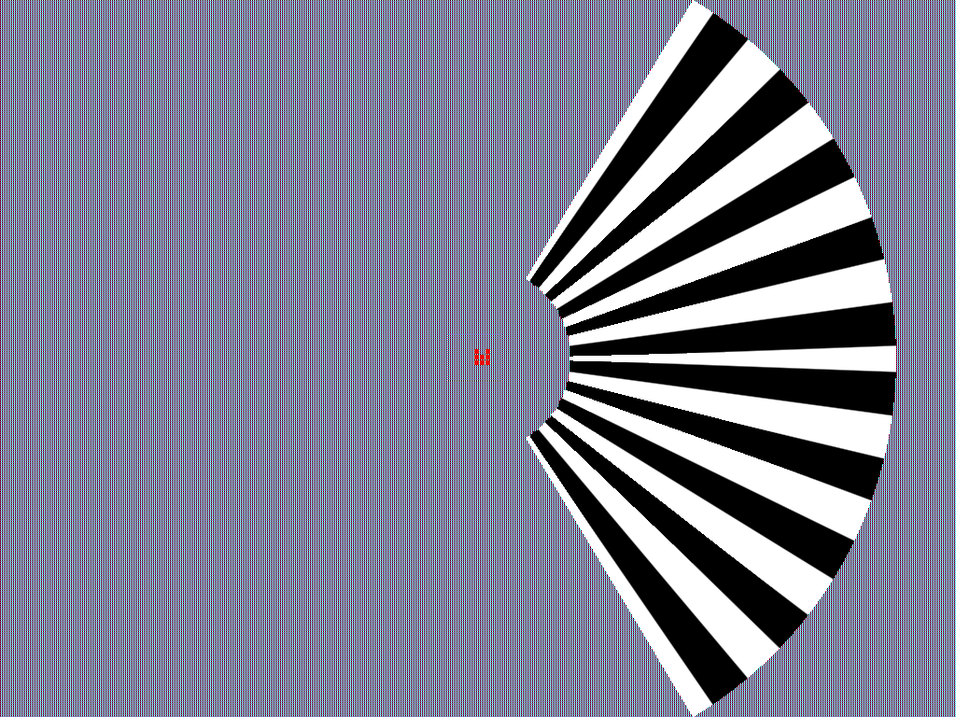

Negative BOLD in the lateral geniculate nucleus:
Evidence for cortico-thalamic feedback
André Gouws, M. Hymers, I. Alvarez, M. Aslet, J. Bird, R. Dearden, S. Maslanka, M. Uesaki & A. Morland
276.8/PP13
Background
Previous research has shown that the normal positive BOLD response (PBR) can be accompanied by a proximal and distal negative BOLD responses (NBR). The NBR nearby the PBR could be interpreted as ‘blood-stealing’, but NBR observed at locations more distant from PBR is unlikely to be explained by such a mechanism. Instead long-range neural mechanisms have been implicated. Many studies have evaluated the NBR at the level of the visual cortex. In contrast, we looked for evidence of NBR in the LGN to test whether or not neural feedback from the cortex to the LGN could drive thalamic NBR.
Results:
Distribution of activation in early visual cortex
Stimulus related task
Passive viewing
Foveal
task
Stimulus related task
Passive viewing
Foveal
task
Visual field
L
R
Response
phase
Stimulus
Contralateral V1
Ipsilateral V1
Results:
Signals in V1, LGN and V5
V1
LGN
V5
Methods
We acquired multiple time series comprising 128 EPI volumes (TR=2s) from 10 participants, while they were presented with visual stimuli. The stimulus was a 120° sector of an annulus (inner radius 4°, outer 18°). The stimulus was equally divided by the horizontal meridian. Upper and lower halves of the stimulus were filled with a drifting square-wave grating (sf = .08 cycles/°polar angle, contrast = 98%, f = 6 Hz) that always had opposite motion directions (clockwise or counter-clockwise) and reversed unpredictably in 16s blocks. The background was a spatially uniform grey with luminance equal to the mean luminance of the gratings (42 cdm⁻²). Participants viewed the stimulus while fixating a spot which was also visible during the control period (spatially uniform grey). In 3 different stimulus/task manipulations across 3 sessions, participants maintained central fixation while passively viewing, counting the number of rotation reversals (stimulus-related task) or counting the number of target changes presented at the fixation point (stimulus-irrelevant, ‘foveal’ task). We defined regions of interest with independent data and criteria: for V1 using retinotopic mapping; for the LGN using proton density scans; for V5 using the anatomical landmark criteria described by ¹Dumoulin et al.(2000).
Stimulus related task
Passive viewing
Foveal task
Stimulus related task
Passive viewing
Foveal task
Stimulus related task
Passive viewing
Foveal task
Time
series
Contralateral
FFT
.
Time
series
Ipsilateral
FFT
Discussion
NBR was detected in locations local to retinotopically stimulated cortex in a manner consistent with previous findings (²Wade & Rowland): the NBR is detected to all sides of the PBR when a stimulus related task is performed (central fixation, peripheral attention); the foveal NBR (at the occipital pole) is abolished when a central task is undertaken. NBR can also be detected in distant locations, in the hemisphere contralateral to the retinotopically stimulated cortex. We found that the NBR can be detected in the LGN contralateral to the stimulated cortex. Consistent with previous findings (³Smith et al.), our data offer further evidence suggesting that neurally suppressive mechanisms underlie the NBR rather than ‘blood stealing’. Responses detected in the hemisphere ipsilateral to the stimulated cortex all show amplitude modulation as a function of attention: the greater the attention paid to the stimulus, the greater the amplitude of the ipsilateral signal. This signal is negative in V1 and the LGN, and positive in V5. It is likely that the cortical modulations feed back to cause the NBR observed in the LGN. Attentional modulation of BOLD responses has been extensively investigated by paradigms that alternate attention between two stimulated locations (often hemifields). Conventionally, the attentional modulation of BOLD responses has been interpreted as an increase in signal to the attended stimulus (e.g. ⁴Martinez et al., ⁵Buracas & Boynton, ⁶O’Connor et al.) as found in neurophysiological studies (e.g. ⁷Desimone & Duncan, ⁸McAlonan et al.). Our stimulus manipulation, coupled with our findings suggest that decreases in baseline activity may underlie previously reported attentional modulation of BOLD responses.
References
Dumoulin et al., 2000. Cereb Cortex 10:454–463.
Wade & Rolwand, 2010. J Neurosci 30(14):5008-5019.
Smith et al, 2004. Hum Brain Mapp 21: 213–220.
Martinez et al, 1999. Nat Neurosci 2:364-369.
Buracas & Boynton, 2007. J Neurosci 27(1):93-97.
O‘Connor et al., 2002. Nat Neurosci 5:1203-1209.
Desimone & Duncan, 1995. Annu Rev Neurosci 18:193-222.
McAlonan et al., 2008. Nature 456:391-394.
Stimulus configuration
(Inset: layout of 9 squares altered for use as fixation point or central task)
Typical single run BOLD activation to motion reversal counting task

