Slide 1
Cogs
YNiC’s Cognitive Neuroscience Discussion Group

Slide 2
Welcome to Cogs
PhD Students
Academic Staff
MSci and MSc Students
Postdocs and Research Staff
YNiC Team
Anyone and everyone who wants to talk about cognitive neuroscience, defined broadly

Slide 3
Format
Not too polished
Doesn’t require too much preparation for session leaders
Questions and mysteries are good for starting conversations
“Don’t knows” are often where discoveries begin
Let’s recapture the wonder that made us want to become scientists in the first place
Let’s make everyone feel like they belong

Slide 4
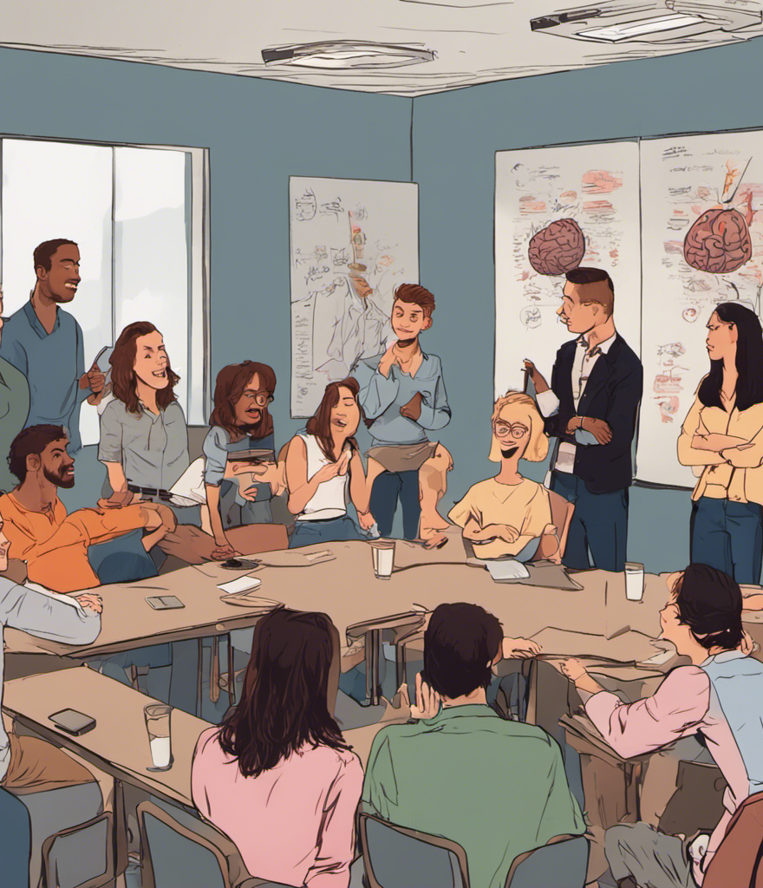
How should it work, then?

Slide 5
Online and asynchronous
Cogs should be something you can contribute to even if you can’t always make the meeting:
Mail the organizers: cogs@ynic.york.ac.uk
Visit the discussion board at: https://uniofyork.padlet.org/tomhartley/cogs
Post topics, papers and preprints that interest you.
Like and comment. ♥
At the moment it’s anonymous.

Slide 6
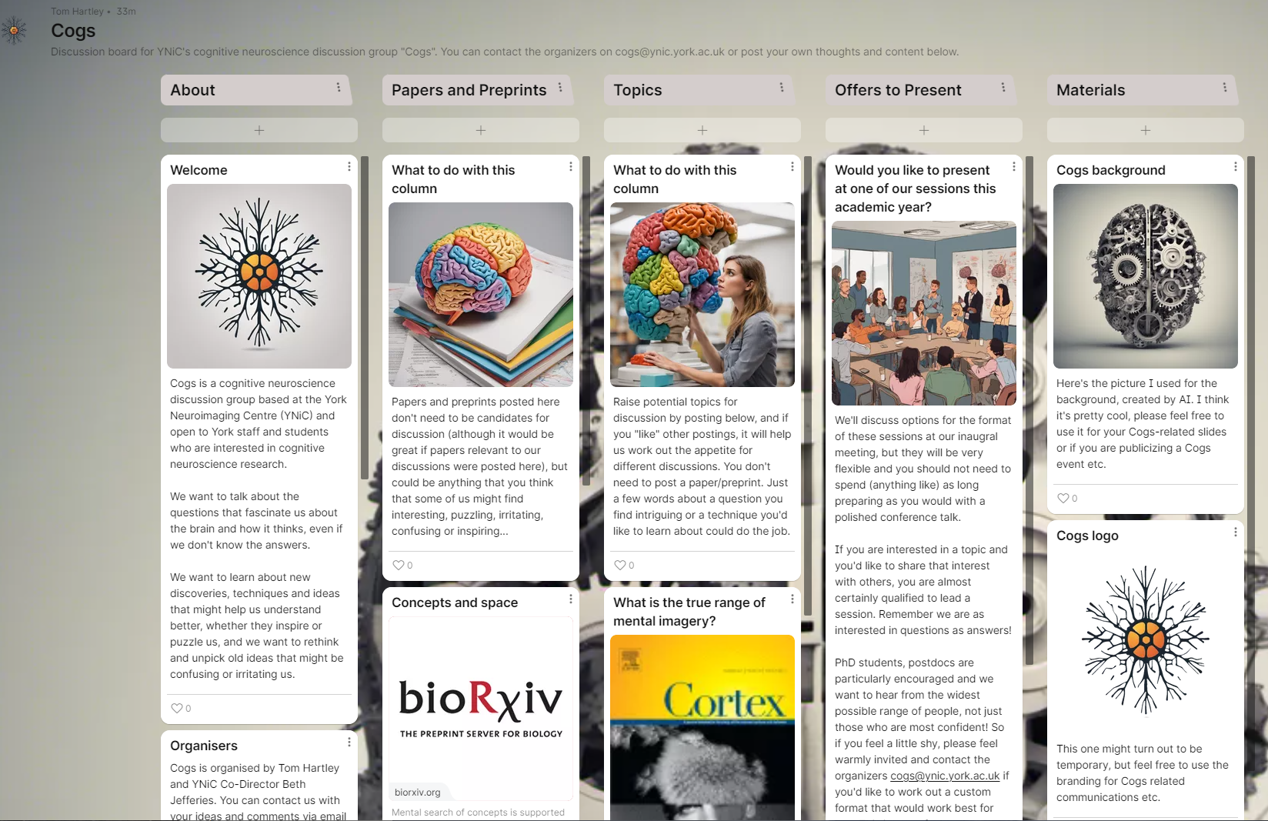

Slide 7
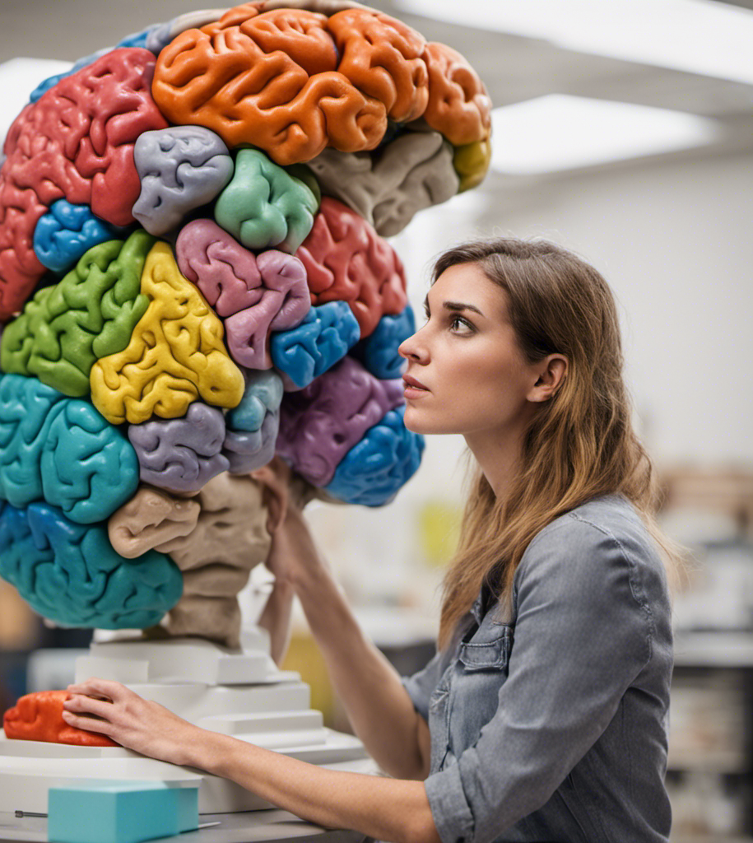
Let us know if you’d like to lead a session
Not just for the most confident
Organizers may be able to help think of a format that works for you and your topic:
more than one person
debate
invite an expert
any more ideas

Slide 8
Any ideas?
Topics
Preprints and papers
Including everyone
Formats
Other events, locations, online tools
Timetabling tips, tricks and pitfalls

